Slide 1
Visitor
Scott Kluttz

Slide 2
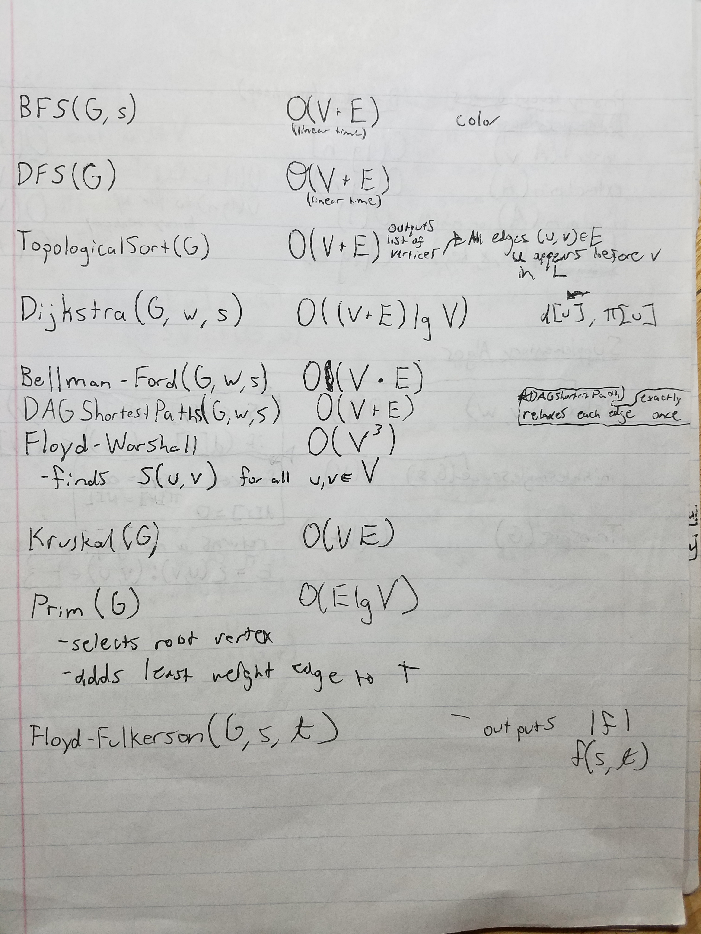

Slide 3
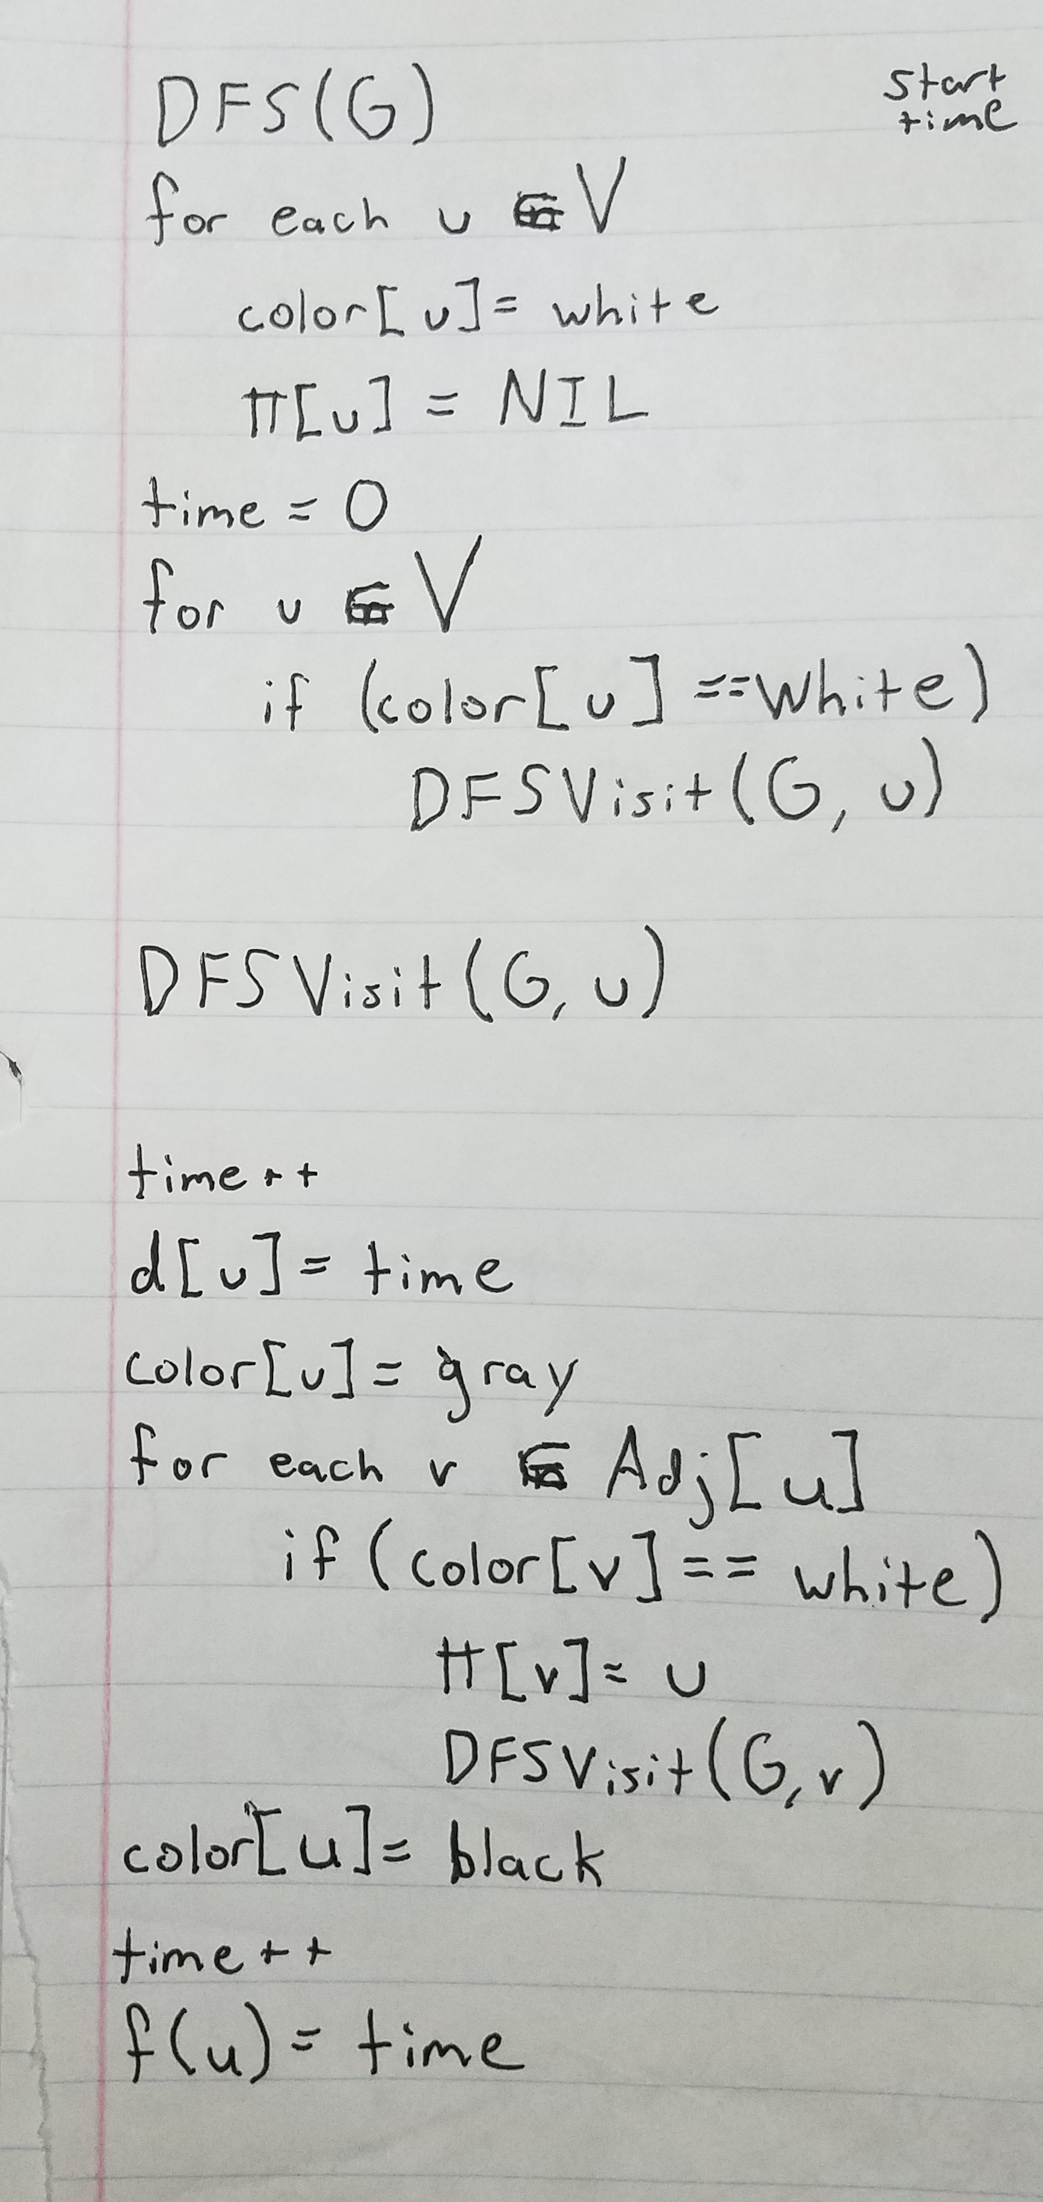

Slide 4
Design Problem:
Can we define new operations to some of our classes of an object structure without actually editing the classes? YES!

Slide 5
When is this useful?
Many unrelated operations on an object structure are required
Classes that make up object structure are subject to change
New operations need to be added frequently
An algorithm uses several classes of the object structure, but you’d like to manage it in one location

Slide 6
Real life
Ideal pattern to plug into public APIs, thus allowing clients to perform operations on a class using a “visiting” class without actually having to modify the source

Slide 7
Consequences
Visitor makes adding new operations easy!
A visitor gathers related operations and separates unrelated ones.
Adding new concrete element classes is complicated– You must make a new visitor class
Visiting access class hierarchies
Accumulating state
Breaking encapsulation

Slide 8
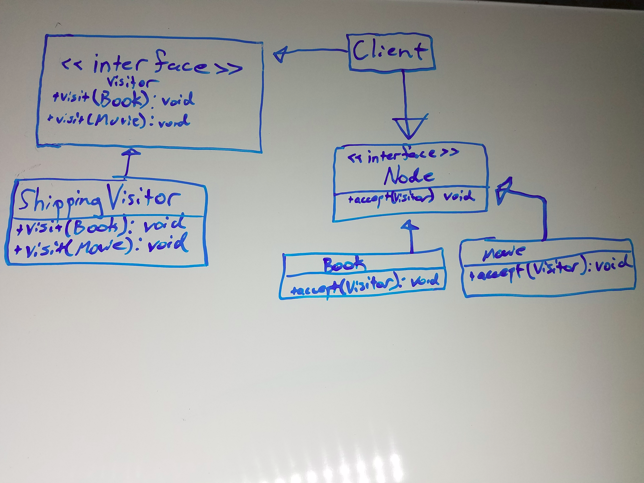
UML

Slide 9
Works Referenced
Design Patterns: Elements of Reusable Software by Gamma, Helm, Johnson, and Vlissides
visitor.cs classfile
https://dzone.com/articles/design-patterns-visitor
https://en.wikipedia.org/wiki/Visitor_pattern

