Slide 1
Synchronization with
Semaphores
Section 12
Instructor:
Haryadi Gunawi

Slide 2


3 concurrent threads
Lock(L)
Lock(L)
Lock(L)
Critical section
(must be atomic, no interleaving)
e.g., bookTicket(), modify shared var
unlock(L)
Only 1 thread in
critical section at a time

Slide 3
Semaphores
lock(L);
// critical section
unlock(L);
P(semaphore);
// critical section
V(semaphore);
(semaphore was the origin of lock)

Slide 4
Semaphores
sem_* are the real functions
P() and V() are wrappers
This
Lecture:
(simplified)
(same)
s = val;
P(s)
V(s)
Last
lecture:
lock *L;
init(L)
lock(L)
unlock(L)
Real
Usage in C:
sem_t *s = malloc(sem_t);
sem_init(s, 0, value);
sem_wait(s);
sem_post(s)

Slide 5
Semaphore
Semaphore: non-negative global integer synchronization variable
sem_t *s = malloc(sem_t);
int main() {
sem_init(s, 0, 1); // initialize s→val=1;
// create threads
}
void thread_functions() {
P(s);
// critical section (e.g., cnt++)
V(s);
}

Slide 6
Semaphore Operations
sem_t *s = malloc(sem_t);
sem_init(s, 0, 1); // initialize s→val=1;
// “1” means the lock is available
Semaphore: sem_t s;
  non-negative global integer synchronization variable
  (see man pages)
sem_init(s, pshared, value)
  Semaphore initially contains a non-negative integer value
  User cannot read or write value directly after initialization

Slide 7
Semaphore Operations
0 →
Lock is not available
sem_wait(s); // P(s)
// critical sec.
sem_post(s); // V(s)
  sem_wait(s) {
  while (s→val == 0)
  add thread to s->queue
  block thread; (sleep)
  s→val--;
  }
  P(s) { sem_wait(s); }
sem_wait(s) or P(s)
  P() for “test” in Dutch (proberen)
  Wait/block until value of sem is > 0, then decrement sem value
    Details: put current thread to s→waitqueue;
  (OS manage the wait and wake)

Slide 8
Semaphore Operations
0 → 1
Lock is available
sem_wait(s); // P(s)
// critical sec
sem_post(s); // V(s)
  sem_post(s) {
  s→val++;
  wake head(s->queue);
  }
  V(s) { sem_post(s); }
sem_post(s) or V(s)
  V() for “increment” in Dutch (verhogen)
  Increment value of semaphore
  Details:
    wake(s) checks if someone is waiting on the s→waitqueue

Slide 9
Semaphores
  ACQUIRE THE LOCK:
  sem_wait(s) {
  while (s→val == 0)
  block thread;
  s→val--;
  }
  P(s) { sem_wait(s); }
  RELEASE THE LOCK:
  sem_post(s) {
  s→val++;
  wake head(s->queue);
  }
  V(s) { sem_post(s); }
(The code above is just the high-level logic. The actual implementation is more complex)
OS kernel guarantees that operations inside P() and V() are executed atomically
  No data races inside P() and V()
  Only one P or V operation at a time can modify s
  How to implement P()/V()? Cs230 – require special HW instructions
Notes:
P = proberen (test/try)
V = verhogen (increase)

Slide 10
Simplified for subsequent slides
  P(s) {
  while (s→val == 0)
  block thread;
  s→val--;
  }
  V(s) {
  s→val++;
  wake waiting thread;
  }
  P(s) {
  while (s == 0)
  block(); // sleep
  s--;
  }
  V(s) {
  s++;
  }
Don’t worry about s→waitqueue and s->val and other details
Let’s just simplify semaphore S as non-negative integer

Slide 11
Example 1
  P(s) {
  while (s == 0)
  block();
  s--;
  }
  V(s) {
  s++;
  }
What happens if semaphore s is initialized to 2?
  Scenario: Three threads call P(s)
  …
  …
  3 threads: t1 / t2 / t3
  P(s);
  // critical sec
  V(s);
Notes:
…..
Two threads can proceed
One thread will be blocked (current S.value = -1)

Slide 12
Example 2: mutex with semaphores
Mutex with semaphore s:
P(s);
// critical sec.
V(s);
(Mutex: mutual exclusion)
  Only one thread in critical section
  We can achieve mutex with semaphores
To what value should S be initialized? …
What would happen if S is accidentally initialized to 0? …
Notes:
1 (one)
Whenever you initialize a semaphore value to 1, it will work like a lock (I.e. Init(S,1) → lock L)
What happens if S is initialized to 0?
No one will be able enter the C/S, the system is deadlock

Slide 13
Binary semaphores (FYI only)
Last example can be seen as binary semaphores
Binary semaphore is sufficient for mutual exclusion
  semaphore whose value is always 0 or 1
General semaphore is also called counting semaphore
Scheduling semaphores, S > 1
  E.g. ps -e | sort | grep something
  S initial value = size of buffer in pipe “|” implementation
  (FYI only)

Slide 14
Another way: pthread_mutex
Allocate and Initialize
  pthread_mutex_t mylock = PTHREAD_MUTEX_INITIALIZER;
  pthread_mutex_init(& mylock, NULL);
Acquire
  Acquire exclusion access to lock; Wait if lock is not available
  pthread_mutex_lock(&mylock); // just like P()
Release
  Release exclusive access to lock
  pthread_mutex_unlock(&mylock); // just like V()
Difference vs. Semaphore
  pthread mutex: no value in initialization

Slide 15
EXTRA: Thread Safety
Functions called from a thread must be thread-safe
Def: A function is thread-safe iff it will always produce correct results when called repeatedly from multiple concurrent threads
All functions in the Standard C Library are thread-safe
  Examples: malloc, free, printf, scanf,sem_wait/post
  No data races inside these functions
  (Not sure? Just check the manual or google it)
Notes:
K&R: Brian Kernighan and Dennis Ritchie

Slide 16
Deadlock

Slide 17
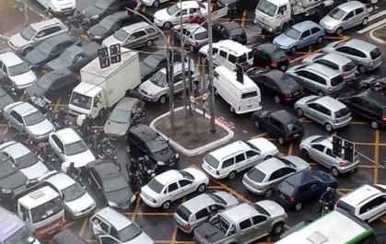
Deadlock: Why does it happen?
Every entity is waiting for resource held by another entity
None release until it gets what it is waiting for

Slide 18
Deadlock example
Two threads access two shared global variables, A and B
Variable A is protected by lock x, variable B by lock y
How to add lock and unlock statements?
Naively do:
  Before use A, lock X … and … after use A, release X
  Before use B, lock Y … and … after use B, release Y
Thread 1
A += 10;
B += 20;
A += B;
A += 30;
Thread 2
B += 10;
A += 20;
A += B;
B += 30;

Slide 19
Example (cont’d)
Thread 1
P(x);
A += 10;
P(y);
B += 20;
A += B;
V(y);
A += 30;
V(x);
Thread 2
P(y);
B += 10;
P(x);
A += 20;
A += B;
V(x);
B += 30;
V(y);
int A, B;
sem x, y;
// init to 1
Wait for y
wait for x
What can go wrong?
  T1 locks X and concurrently T2 locks Y
  Then, T1 wants y, T2 wants X

Slide 20

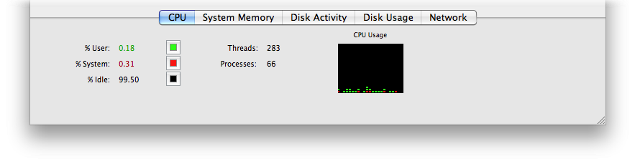
Feel it?
Spinning wheel
  Almost 0% CPU utilization
What is my computer doing?
  One reason: a deadlock
  Solution: Restart the app/OS
How about 100% CPU utilization? What’s wrong?

Slide 21
Detection Steps
List all pairs of locks that T1 and T2 can hold simultaneously
  locks = semaphores = mutexes (FYI)
Is there an overlap between the sets of pairs of locks?
  …
If yes, are the locks (within the pair) locked not in the same order?
  …
Is there a potential for deadlock?
  Yes, if locked not in the same order
Thread 1
P(x);
A += 10; ?
P(y);
B += 20; ?
A += B; ?
V(y);
A += 30; ?
V(x);
Thread 2
P(y);
B += 10; ?
P(x);
A += 20; ?
A += B; ?
V(x);
B += 30; ?
V(y);
Notes:
XY and YX
Yes, XY and YX are overlapping …. A pair of { X Y } locks
Yes, the pair { X Y } is not locked in the same order ….. XY order and YX ordering …
Yes, if there are at least two pairs of overlapping locks not locked in the same order → means deadlock

Slide 22


Deadlock prevention: Lock ordering
Thread 1
P(x);
A += 10;
P(y);
B += 20;
A += B;
V(y);
A += 30;
V(x);
Thread 2
P(y); ***
B += 10;
P(x); ***
A += 20;
A += B;
V(x);
B += 30;
V(y);
Thread 1
P(x);
A += 10;
P(y);
B += 20;
A += B;
V(y);
A += 30;
V(x);
Thread 2
P(x); ***
P(y); ***
B += 10;
A += 20;
A += B;
V(x);
B += 30;
V(y);
If multiple locks are used, threads should acquire them in the same order
Order in which locks released does not matter much
  (Threads are potentially blocked only when acquiring locks)

Slide 23
Recap

Slide 24


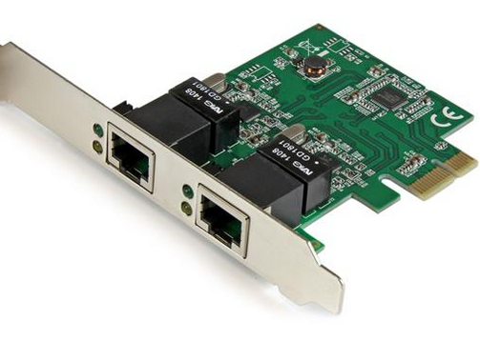


Concurrency vs. Parallelism (FYI only)
What’s the difference?
  (similar concept but slightly different application)
Another good answer:
https://www.quora.com/What-is-the-difference-between-concurrency-and-parallelism
while(tasks) {
doCompute();
doSomeIO();
}
// bad!
// sequential/serialized!!
T1: while(cpuTasks)
doCompute()
T2: while(ioTasks)
doSomeIO()
T1: while(dirty…)
doWash()
while(dirtyClothes)
doWash();
doDry();
// slow!
T2: while(wet…)
doDry()
time
Concurrent!

Slide 25
Concurrency vs. Parallelism (FYI only)
Parallelism
  (you have multiple resources of the same type)
  E.g. 3 washers, 3 dyrers
  Break big load/job to smaller tasks
At a single point in time:
  Can run parallel tasks of the same type
T1 / T2 / T3: while(dirty…)
doWash()
Parallel
within each job
T3 / T4 / T6: while(wet…)
doDry()

Slide 26
Summary
Users: faster, faster, faster!
Old days: single threaded program (slow)
Parallelism (multi-processors) and concurrency (overlapping I/Os)
Process is too heavyweight, threads was invented
Shared data + read/write conflicts → data races / race condition
Locks (atomicity, mutual exclusion, ..)
If get bad performance, must make independent “embarrassingly parallel” subtasks, don’t synchronize/lock too often
Wrong ordering of locks → deadlock
Use locks in order
Tough life!

Slide 27
Laundry List
Exam (check Piazza)
Office hours
  Check Piazza (and Google sheet) for office hours
  Come prepared w/ specific questions (Lec #X, Tag #Y, Slide #Z)
How to prepare?
  Do practice questions (TBA) → T/F questions to guide you to focus on the important materials
  Slides, slides, slides
  Do examples in slides
  Understanding != Correctness/Precision
    Students: “I thought I understand”
    E.g. order of concurrent printf()? content of file? → Need precision
  Draw, draw, draw
    Address space, file descriptors, time diagram (concurrent executions)

Slide 28
That’s it !!
Hope you enjoyed this class!

Slide 29
Extra

Slide 30
Summary
Programmers need a clear model of how variables are shared by threads
Variables shared by multiple threads must be protected to ensure mutually exclusive access
Semaphores are a fundamental mechanism for enforcing mutual exclusion

Slide 31
C semaphore operations
Pthreads functions:
#include <semaphore.h>
int sem_init(sem_t *s, 0, unsigned int val);} /* s = val */
int sem_wait(sem_t *s); /* P(s) */
int sem_post(sem_t *s); /* V(s) */
CS:APP wrapper functions:
#include "csapp.h”
void P(sem_t *s); /* Wrapper function for sem_wait */
void V(sem_t *s); /* Wrapper function for sem_post */

Slide 32
badcnt.c: Improper synchronization
int cnt = 0;
int main(int argc, char **argv)
{
int niters = atoi(argv[1]);
pthread_t tid1, tid2;
Pthread_create(&tid1, NULL,
thread, &niters);
Pthread_create(&tid2, NULL,
thread, &niters);
Pthread_join(tid1, NULL);
Pthread_join(tid2, NULL);
/* Check result */
if (cnt != (2 * niters))
printf("BOOM! cnt=%d\n”, cnt);
else
printf("OK cnt=%d\n", cnt);
exit(0);
}
void *thread(void *vargp)
{
int i, niters = *((int *)vargp);
for (i = 0; i < niters; i++)
cnt++;
return NULL;
}
How can we fix this using semaphores?
Notes:
Just find out where is the sharing.
Which data is shared … by multiple threads ?????

Slide 33
goodcnt.c: Proper synchronization
Define and initialize a mutex for the shared variable cnt:
int cnt = 0; /* Counter */
sem_t mutex; /* Semaphore that protects cnt */
sem_init(&mutex, 0, 1); /* mutex = 1 */
Surround critical section with P and V:
for (i = 0; i < niters; i++) {
P(&mutex);
cnt++;
V(&mutex);
}
linux> ./goodcnt 10000
OK cnt=20000
linux> ./goodcnt 10000
OK cnt=20000
linux>
Advantages? Safe and correct
Disadvantages? Remember try your best to create independent subtasks
Notes:
Warning: It’s much slower than badcnt.c.
Performance !!!!!!!

Slide 34
Why mutexes work
Thread 2
1
1
0
0
0
0
1
1
Provide mutually exclusive access to shared variable by surrounding critical section with P and V operations on semaphore s (initially set to 1)
Semaphore invariant
creates a forbidden region
that encloses unsafe region that cannot be entered by any trajectory.
T₂
1
1
0
0
0
0
1
1
V(s)
Forbidden region
0
0
0
0
S₂
-1
-1
-1
-1
0
0
-1
-1
-1
-1
0
0
U₂
Unsafe region
0
0
-1
-1
-1
-1
0
0
L₂
0
0
-1
-1
-1
-1
0
0
P(s)
1
1
0
0
0
0
1
1
H₂
1
1
0
0
0
0
1
1
Thread 1
H₁
P(s)
L₁
U₁
S₁
V(s)
T₁
Initially
s = 1

Slide 35
Recap
Basic idea:
  Associate a unique semaphore mutex, initially 1, with each shared variable (or related set of shared variables).
  Surround corresponding critical sections with P(mutex) and
  V(mutex) operations.
Terminology:
  Binary semaphore: semaphore whose value is always 0 or 1
  Mutex: binary semaphore used for mutual exclusion
    P operation: “locking” the mutex
    V operation: “unlocking” or “releasing” the mutex
    “Holding” a mutex: locked and not yet unlocked
  Counting semaphore: used as a counter for set of available resources

Slide 36
Representing deadlock
Vertices:
  Threads in system
  Resources (locks)
Edges:
  Indicate relationships
Resource-Allocation Graph
y
held by
wants
T1
T2
x
held by
wants

