Slide 1
OS3: Fork, execve, and signals
CMSC 15400: Introduction to Computer Systems
Chapter 8.4 – 8.5
Instructor:
Haryadi Gunawi
Notes:
Fork must finish in 30 minutes.
Signal takes 15-20 mins.
(way over 5 minutes in 2019, must cut some slides a bit)
In 2020, cut the slides I hide

Slide 2
fork() and execve()
How to write a program that creates a new process?
Relates to Project 4

Slide 3
fork() and execve() system calls
How do you start a program? How do you create a process?
  (a) Click the application button on desktop GUI
  (b) or run it from the shell: ./myprog
  Both of them call fork() and execve() system calls
See “man fork” and “man execve” for details
  int fork(void)
    creates a new process (child process) that is identical to the calling process (parent process)
  int execve(char *filename, char *argv[], char *envp[])
    Runs a new program (filename) in the current process
    Ex: execve(“somewhere/p0/hello”, …)

Slide 4
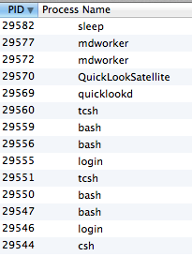
How to create a new process?
Basically all processes are rooted from a shell
  Desktop GUI is a “shell”
  A running shell is a process
    Many choices:
      E.g. /bin/sh, bash, csh, tcsh, …
      echo $SHELL (to know)
From a shell, you can start new processes (childrens)
  E.g. shell within a shell
  Childrens can create childrens
> echo $SHELL
/bin/csh
> bash
> tcsh
> hello & ;
P1 & ; p2 &
csh, 29544
bash, 29547
tcsh, 29551
hello
p1
p2

Slide 5
fork()
Fork()
  Creates a child
  Child inherits parent’s context
Last lecture: inherit CWD
  Shell’s CWD is “/data”
  Run myprog and CWD is passed from the shell process to myprog
CWD=/data
Shell:
% cd /data
% /code/myprog
…
CWD=/data
myprog:
main() {
fd = open(“file.txt”)
if (fd == -1) ERROR;
}

Slide 6
Example
OS
Example:
  Parent: the shell process
    % ./myprog
  “PCB”: process control block (i.e. proc states)
Flow of execution:
  fork() → create a child process
    copy process state (PC, SP, …)
  execve(myprog) →
    Take the program from disk (/code/myprog) and overwrite the child’s code segment
    Initialize the heap and stack for the new program, and jumps to main()
Shell PCB
Child PCB
MyProg PCB
Child’s stack
MyProg’s stack
execve(MyProg)
Child’s heap
MyProg’s heap
Child’s code
MyProg’s code
Shell’s stack
Shell’s heap
fork()
Shell’s code

Slide 7
fork() and execve()
OS provides fork() and execve()
Parent and child relationship
Child inherits the same process state of the parent

Slide 8


An illustration (memory view)
execve( )
Fork()

Slide 9



Another Illustration (control flow perspective)
(the road is the sequence of instructions)
execve(redcar)
ret == a positive value
(the parent)
ret == “0”
(the child)
ret = fork()
PID: silver

Slide 10
fork() and execve() in shell
OS
% myprog
SHELL CODE:
While (true) {
cmd = getNewCommand();
// execute the command
}
Pid 77’ stack
Pid 77’s heap
Pid 77’s code

Slide 11
fork() and execve() in shell
OS
% myprog
SHELL CODE:
While (true) {
printf(“My pid is” + getpid()); // pid???
cmd = getNewCommand();
// execute the command
}
Pid 77’ stack
Pid 77’s heap
Pid 77’s code

Slide 12
fork() and execve() in shell
OS
% myprog
SHELL CODE:
While (true) {
cmd = getNewCommand();
if (cmd is a program file) {// e.g. “/bin/ls”
ret = fork(); // (if “cmd” is a program)
...
}
}
PID 88’s stack
PID 88’s heap
PID 88’s code
Pid 77’ stack
Pid 77’s heap
Pid 77’s code
Notes:
“cmd” can be built-in commands such as “echo”, “cd”, “pwd”

Slide 13
fork() and execve() in shell
OS
% myprog
SHELL CODE:
While (true) {
cmd = getNewCommand();
if (cmd is a program) {
ret = fork(); // (if “cmd” is a program)
// both processes are now at this line
if (ret == 0) { // the child
}
else { // ret == 88 (child’s pid)
}
}
PID 88’s stack
ret=??
PID 88’s heap
PID 88’s code
Pid 77’ stack
ret=??
Pid 77’s heap
Pid 77’s code

Slide 14
fork() and execve() in shell
OS
% myprog
SHELL CODE:
While (true) {
cmd = getNewCommand();
if (cmd is a program) {
ret = fork(); // (if “cmd” is a program)
if (ret == 0) { // the child
}
else {// ret == 88 (child’s pid)
// I’m still the parent (the shell),
printf(“My pid is” + getpid()); // pid???
}
}
PID 88’s stack
ret=??
PID 88’s heap
PID 88’s code
Pid 77’ stack
ret=??
Pid 77’s heap
Pid 77’s code

Slide 15
fork() and execve() in shell
OS
% myprog
SHELL CODE:
While (true) {
cmd = getNewCommand();
if (cmd is a program) {
ret = fork(); // (if “cmd” is a program)
if (ret == 0) { // the child
printf(“My pid is” + getpid()); // pid???
...
}
else { // ret == 88 (child’s pid)
// I’m the parent (the shell),
}
}
PID 88’s stack
PID 88’s heap
PID 88’s code
Pid 77’ stack
Pid 77’s heap
Pid 77’s code

Slide 16
fork() and execve() in shell
OS
% myprog
SHELL CODE:
While (true) {
cmd = getNewCommand();
if (cmd is a program) {
ret = fork(); // (if “cmd” is a program)
if (ret == 0) { // the child
printf(“My pid is” + getpid()); // pid???
execve(cmd, …);
// OS will jump to the main()
// in the program in “cmd” string
}
else { // ret == 88 (child’s pid)
// I’m the parent (the shell),
}
}
PID 88’s stack
PID 88’s stack
PID 88’s heap
PID 88’s heap
PID 88’s code
PID 88’s code (cmd)
Pid 77’ stack
Pid 77’s heap
Pid 77’s code

Slide 17
Repeat …
(the road is the sequence of instructions)
execve(redcar)
ret == (positive value)
(ret = PID of child, 88)
ret == “0”
ret = fork()
PID: 77

Slide 18
Fork Example #2
Both parent and child can continue forking
void fork_ex2()
{
printf("L0");
fork();
printf("L1");
fork();
printf("Bye");
}
Bye
L1
Bye
Bye
L0
L1
Bye
Please read the textbooks “web aside” on process graphs:
http://csapp.cs.cmu.edu/
“Web Asides” →
http://csapp.cs.cmu.edu/public/waside.html
“Chapter 8: Exceptional Control Flow; ECF:GRAPHS — Process graphs” →
http://csapp.cs.cmu.edu/public/waside/waside-graphs.pdf
Provides useful further information about the topological sort of nodes in graph
Notes:
How many times will we print L0, L1, and Bye?

Slide 19
Fork Example #2 (with pid)
Both parent and child can continue forking
void fork2()
{
print("L0 ” + getpid());
fork();
print("L1 ” + getpid());
fork();
print("Bye “ + getpid());
}
Bye
L1
Bye
Bye
L0
L1
Bye
Notes:
How many times will we print L0, L1, and Bye?

Slide 20
Fork Example #3
Both parent and child can continue forking
void fork3()
{
printf("L0\n");
fork();
printf("L1\n");
fork();
printf("L2\n");
fork();
printf("Bye\n");
}
Bye
L2
Bye
Bye
L1
L2
Bye
Bye
L2
Bye
Bye
L0
L1
L2
Bye
http://csapp.cs.cmu.edu/public/waside/waside-graphs.pdf
Provides useful further information about the topological sort of nodes in graph

Slide 21
Fork Example #4
printf("L0");
rv = fork();
if (rv > 0) {
printf("L1");
rv = fork();
if (rv > 0) {
printf("L2");
fork();
}
}
printf("Bye");
3?
5?
7?
1?
2?
4?
6?
http://csapp.cs.cmu.edu/public/waside/waside-graphs.pdf
Provides useful further information about the topological sort of nodes in graph

Slide 22
Non-determinism / concurrency / race condition
void fork_ex9() {
int ret = fork();
if (ret == 0) {
printf(”Child");
}
else {
printf(”Parent");
}
exit();
}
Child
Parent
See “child” first, then “parent”
or vice versa
(Depends on OS
Scheduling)
Parent
Child
fork()
(a)
print
“parent”
(b)
print
“child”
and (b) are concurrent
Notes:
Note that order cannot be known for sure.
Adding print statements may change the order ☺

Slide 23
Wait
void fork_ex9() {
int status;
int ret = fork();
if (ret == 0) {
printf(”Child");
}
else {
wait(&status);
printf(”Parent");
}
exit();
}
Child
Parent
Impossible!!
parent waits for child before it prints parent
Parent
Child
fork()
“child”
exit()
wait(child)
(depends on
i.e., happens after)
Wait until my child exits
print(“parent”)
Print “child” and “parent” are NOT concurrent
Notes:
Note that order cannot be known for sure.
Adding print statements may change the order ☺

Slide 24
Are X and Y concurrent?
How to debug concurrency?
  Draw the lattice!
  X → Y, X must happen before Y
A and B concurrent ? …
B and D ? …
C and D ? …
If X and Y are concurrent, “XY” or “YX” possible
X must happen before Y, if there is X → ….. → Y
fork()
Print A
fork()
Print B
Print C
wait(child)
Print D
Notes:
-
Yes, no, yes

Slide 25
wait() and waitpid()
wait(..)
  Wait for one (any) of the childrens
Please see lec18-extra.pptx, slides #1-10 (A MUST!)
waitpid(pid, ..)
  Wait for specific child with pid

Slide 26
Why should you care?
Many software programs must create new processes
  Firefox program runs plugins as new processes
    If (a plugin) fork() … execve(adobeFlash)
  Chrome creates a tab as a new process
    If (newTab) fork()
Want more practice examples?
  Read the book (and “lec18-extra.pptx” slides)

Slide 27
Signals

Slide 28
A motivational example
Firefox
  Demo:
    Open .html file with a long paragraph
    Resize the window
  What is happening?
    As window size changes, text display is rearranged
    How come?
    Signals!
    Mouse → (I/O interrupt, steals CPU) → OS → Firefox process
Another example (read offline)
  Open a PDF files in two PDF readers (Acrobat reader and preview/skim/etc)
  Modify the file with “acrobat reader pro”
  “skim” will say “file has changed, do you want to refresh?”
  Acrobat→Save→sync()→OS→SignalToSkim→SkimReload

Slide 29
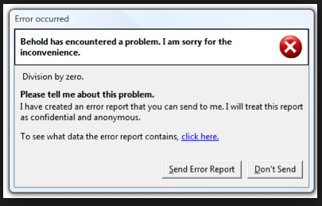
Another motivational example
Divide by zero, …
  Old days: process killed, no message
A nicer way: send the process an error signal (SIGFPE)
  OS: “Hey P, you make an FPE. You decide yourself what do do.”
  P: “Thank you for the signal, I will print out a specific message to my user”
    E.g. “Send diagnosis report to Firefox developer?”
How does this work?
  A program P provides a SIGFPE signal handler
    Note: Signal handler (in program) != exception handler (in OS)
  OS lets P have its own way to deal with the error

Slide 30
Signals
A signal is a small “message” that notifies a process that an event of some type has occurred in the system
  Signal type is identified by small integer IDs (1-30)
  Signals can come directly from the OS
  Signals can come from other processes (mediated by the OS)
Process
Process
(ex: shell)
SIGKILL
Process
(ex: firefox)
SIGFPE
OS
OS
Exception
(e.g. DivByZero)
CPU

Slide 31
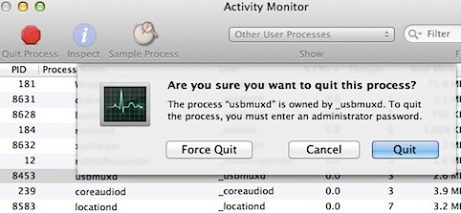

Slide 32
Signals
..
ID | Name | Default Action | Corresponding Event
2 | SIGINT | Terminate | Interrupt (e.g., ctl-c from keyboard)
9 | SIGKILL | Terminate | Kill program (cannot override or ignore)
11 | SIGSEGV | Terminate & Dump | Invalid memory reference (segmentation fault)
14 | SIGALRM | Terminate | Timer signal
17 | SIGCHLD | Ignore | Child stopped or terminated
28 | SIGWINCH | Ignore | Window size changed
Notes:
30 signals defined in POSIX standard

Slide 33
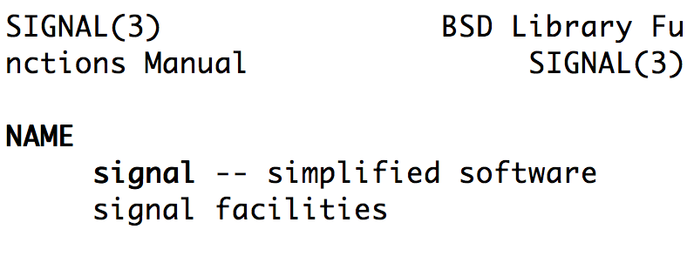
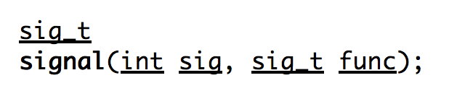
Writing+Registering Signal Handlers
// Examples of receiving signals
// in YOUR PROGRAM (not in OS)
Void my_fpe_handler(int sig) {
printf(”I received FPE signal %d\n", sig);
exit(0);
}
Void my_sigwinch_handler(int sig) {
// adjust my window size here
...
}
int main() {
// register the signal handlers (func addresses)
signal(SIGFPE, my_fpe_handler);
signal(SIGWINCH, my_winch_handler);
// do some work
x = y / 0; // → will call your my_fpe_handler()
}

Slide 34
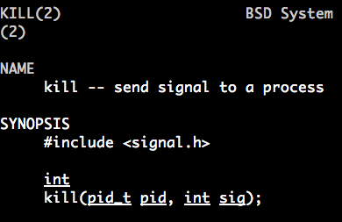
Sending signals – kill()
// A shell (an example of a SENDER), ex: kill -9 somePid
if (cmd == “kill -9”) { // -9 → SIGKILL
pid = getPidToKillFromArg(args);
kill(pid, SIGKILL); // → system call (more in “man 3 kill “)
}

Slide 35
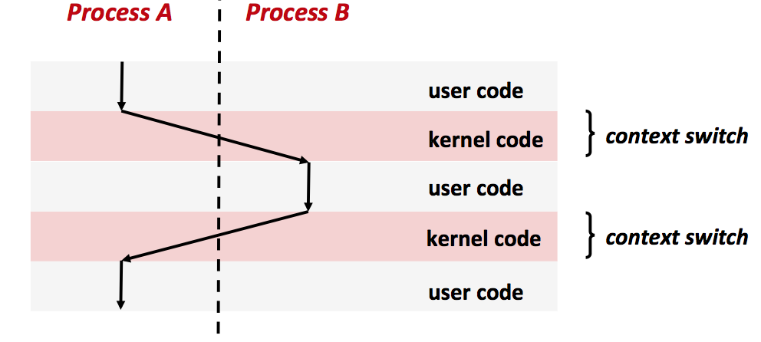
kill(B, S)
Jump to B’s
S_handler
()

Slide 36
Signal and concurrency (in Homework)
Process1:
  main()
  kill (2,sig)
  Print C
Process 2
  main() { print A }
  sig_handler() { print B }
Questions:
  Are A and B concurrent? …
    Why? S_handler is a new execution “thread” not in main()
    “thread” will be discussed in future lecture
  B and C? …
    Why? Print C only happens when kill() returns (that is after S_handler() finishes)
  A and C ? …
p1
p2
kill(2, sig)
(waiting to be called)
S_handler()
Print B
main()
Print A
Print C

Slide 37
Signal summary
Create signal handlers
  void some_function_name(int sig)
Register them -- signal()
  signal(SIG???, some_function_name);
Send signals -- kill ()
  Specify destination pid
  kill(pid, SIG???);
Your program may ignore signals (i.e. no handlers)

Slide 38
Extra

Slide 39
Why need fork() and execve()?
CWD=/data
Shell:
% cd /data
% /code/myprog
…
myprog:
main()
fd = open(“file.txt”)
if (fd == -1) ERROR;
Yes, ideally: fork() + execve(prog) → createNewProgram(prog)
  (wait for the next lecture to understand why)
  Short answer: sometimes we need to modify the child’s file descriptors after fork() and before calling execve()
fork → child inherits parent’s process state
  Simplicity of creating a new process address space (and inheriting parent’s process state)
  The two processes above, CWD = /data
What would happen if fork does not copy the process state?
  What is the CWD of myProg?
  What is one implication to the programmers?
    E.g.: open(“???”)
  Another example: the “make” program
    gcc file.c (not gcc /…/full/long/path/file.c)

Slide 40
Core dump
ID | Name | Default Action | Corresponding Event
11 | SIGSEGV | Terminate & Dump | Invalid memory reference (segmentation fault)
An example:
  run main() { int *p; *p = 17; }
  See “core” file
  Can debug using “gdb”; more: google “How to debug core file”
What’s happening?
  The hardware/MMU throws a segmentation fault exception (more in memory management) – handled by OS
  OS sends SIGSEGV to the process
  OS creates a core dump file
    Contains the current state of the processor and memory (i.e. the process state of faulting process)
http://en.wikipedia.org/wiki/File:Ferrite_core_memory.jpg
Notes:
Show an exampel

Slide 41
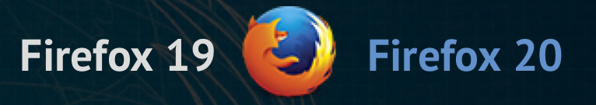
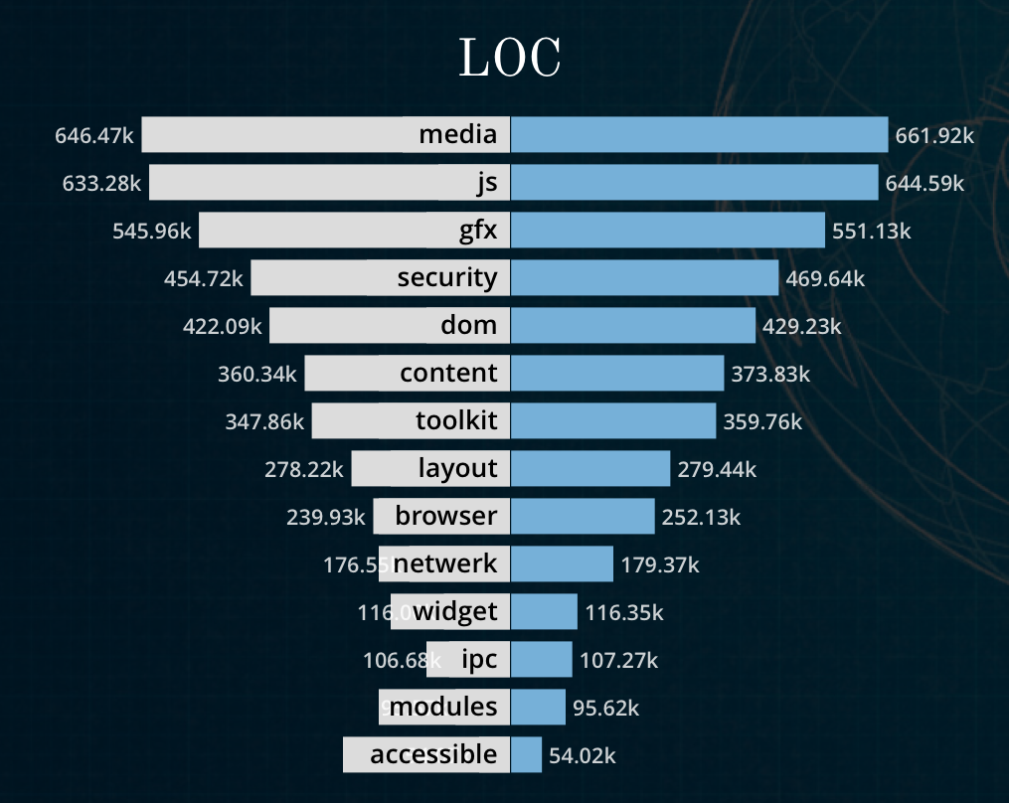
Just the beginning …
Google: evolution of firefox codebase
  http://almossawi.com/firefox
Software systems are complex
  Bugs exist!

Slide 42
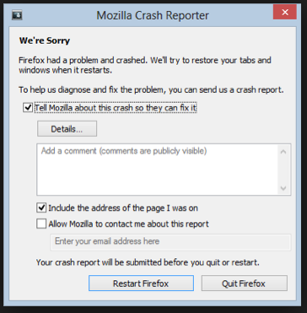
Just the beginning …
Among many purposes of signal, it is a mechanism/interface to generate error messages and core dumps

Slide 43
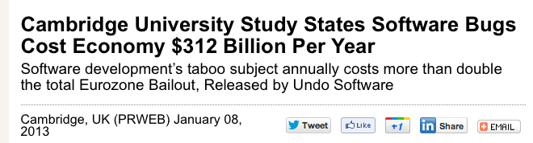
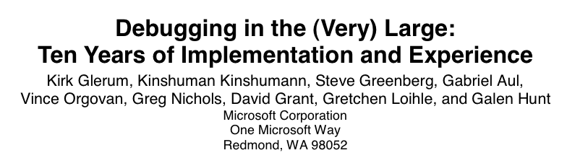
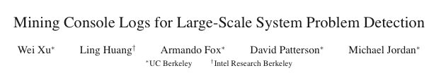

Just the beginning …
What comes after error reporting? Error/log Analysis!

Slide 44
Sending a Signal
Kernel sends (delivers) a signal to a destination process by updating some state in the context of the destination process
Kernel sends a signal for one of the following reasons:
  Kernel has detected a system event such as divide-by-zero (SIGFPE) or the termination of a child process (SIGCHLD)
  Another process has invoked the kill system call to explicitly request the kernel to send a signal to the destination process
Process
Receiving
OS
Sending

Slide 45
Receiving a Signal
A destination process receives a signal when it is forced by the kernel to react in some way to the delivery of the signal
Three possible ways to react:
  Ignore the signal (do nothing)
  Terminate the process (with optional core dump)
  Catch the signal by executing a user-level function called signal handler
    Akin to a hardware exception handler being called in response to an asynchronous interrupt
ID | Name | Default Action | Corresponding Event
9 | SIGKILL | Terminate | Kill program (cannot override or ignore)
11 | SIGSEGV | Terminate & Dump | Invalid memory reference (segmentation fault)
19 | SIGTSTP | Stop until next SIGCONT | Stop signal from terminal
28 | SIGWINCH | Ignore/catch | Window size changed

Slide 46
Pending and Blocked Signals
A signal is pending if sent but not yet received
  There can be at most one pending signal of any particular type
  Important: Signals are not queued
    If a process has a pending signal of type k, then subsequent signals of type k that are sent to that process are discarded
A process can block the receipt of certain signals
  Blocked signals can be delivered, but will not be received until the signal is unblocked
A pending signal is received at most once

Slide 47
Signal Concepts
Kernel maintains pending and blocked bit vectors in the context of each process
pending: represents the set of pending signals
  Kernel sets bit k in pending when a signal of type k is delivered
  Kernel clears bit k in pending when a signal of type k is received
blocked: represents the set of blocked signals
  Can be set and cleared by using the sigprocmask function

Slide 48
Another View of Signal Handlers as Concurrent Flows
Process A
Process B
user code
Signal delivered
I_{curr}
Process
context switch
(A to B)
kernel code
Signal received
user code (handler)
kernel code
context switch
(B to A)
user code
I_{next}

