Slide 1
OS2: System Calls and Processes Chapter 8.2-8.3 [Show Slide 24 – before class starts]
Instructors:
Haryadi Gunawi
Notes:
IF NO TIME, CAN SPILL TO NEXT LECTURE

Slide 2
System Calls

Slide 3
System Calls
Top-down description (wikipedia.org)
In computing, a system call is how a program requests a service from an operating system's kernel.
This may include hardware-related services (for example, accessing a hard disk drive), creation and execution of new processes, and communication with integral kernel services such as process scheduling.
System calls provide an essential interface between a process and the operating system.
My simple version:
A program cannot do everything by itself
Need OS to help (e.g. read/write to disk, or gettimeofday(), or receive data from the network card)

Slide 4



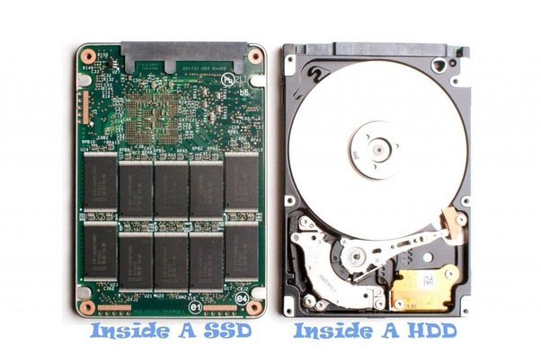
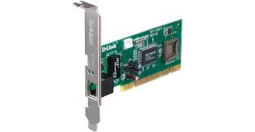
Opening and writing files
Fd = open(/tmp/newfile.txt)
write(fd, buffer, len);
Fd = open(…/Dropbox/newfile.txt)
write(fd, buffer, len)
Applications / Programs / Processes
sys_open
sys_write
…
System calls in
OS Kernel
Cloud
Notes:
http://lxr.linux.no/#linux+v3.6/include/linux/syscalls.h#L567

Slide 5
System calls vs. library calls
write(stdout, buf, len)
write(stdout, “a”, 100)
Bug??
write(stdout, “44.44”, 5)
Print up to two decimal places
Easy to setup?
printf(manyFormats)
printf(“a”)
Length is implicit
printf(“%5.2f”, float)
Nice formatting supports
Other examples:
Java OutputStream
Libraries→user friendly
Eventually will make system calls! (for hardware access)

Slide 6
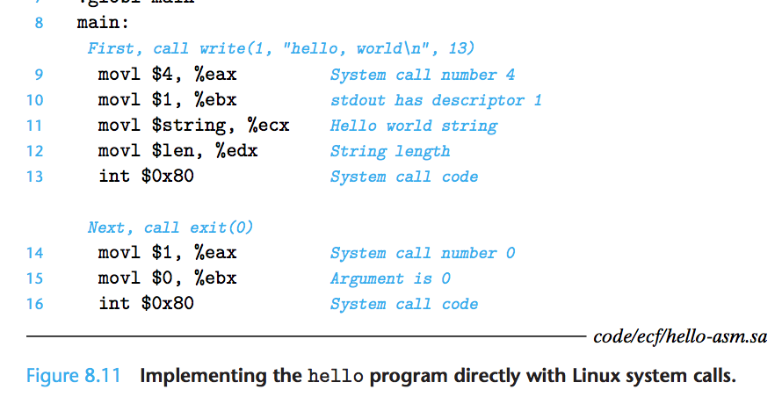
Passing arguments from program to OS
Why not use stack? Why put args in registers?
What are these ebx, ecx, edx, doing?
Notes:
Will be described later in detail in slide 10.

Slide 7
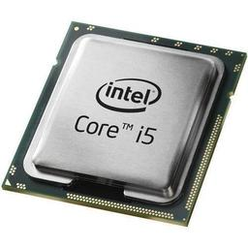
Library call vs. Systems call
Just put arguments in the stack (in x86_32 bit arch)
Must pass arguments through CPU registers
Your main() calls:
lib_write(1, “hello”, 5);
You call:
write(1, “hello”, 5);
Vmlinux
sys_write() { }
5
“hello”
1
Stack
len
buf
%ebx = 1
%ecx = “hello”
%edx = 5
Memory
fd
mylib.o:
int lib_write(
int fd,
char buf[],
int len) {
…}
in OS/vmlinux space:
int sys_write(
int fd,
char buf[],
int len) {
…}
Your program:
main():
lib_write();

Slide 8
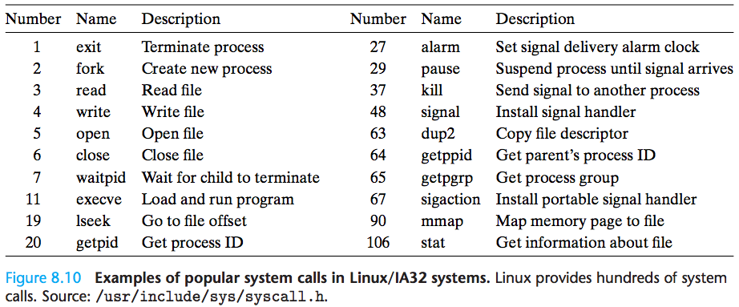
System calls
What are these eax and
int x80 doing?
What are these eax and
int x80 doing?
Well, how many system calls?
Google “Linux system call table”
1st hit: https://filippo.io/linux-syscall-table/
Or, objdump –t vmlinux | grep sys_
300+ system calls (and you can add your own system calls)
Notes:
Discuss each system call in the table briefly.
Lseek = skip minutes in video file

Slide 9
The problem!
Last lecture:
Jumping from user program to
OS/kernel functions
can ONLY be done via interrupts
An interrupt # → A kernel function
Interrupt #0 → DivideByZero function
300+ system call functions!!
Interrupt# | Interrupt handler functions
0 | 0xC0003000 (divByZero)
… | …
128 | 0xC0001000 (syscall)
… | …
200 | 0xC0002000 (timer intr)
…
255 | …..
But interrupt table is limited!
Exception/interrupt table in HW (e.g., 256 entries, many for other purposes such as network, disk, timer interrupts)
How to call them from user program?
2-level indirection
Notes:
Discuss each system call in the table briefly.
Lseek = skip minutes in video file

Slide 10
System Calls
x86_32:
https://en.wikibooks.org/wiki/X86_Assembly/Interfacing_with_Linux
(We use %eax, %ebx, %ecx)
In x86_64:
syscall = int 0x80
Bottom-Up Description
3 arguments
But, why 4 registers?
Notes:
Will be described later in detail in slide 10.

Slide 11

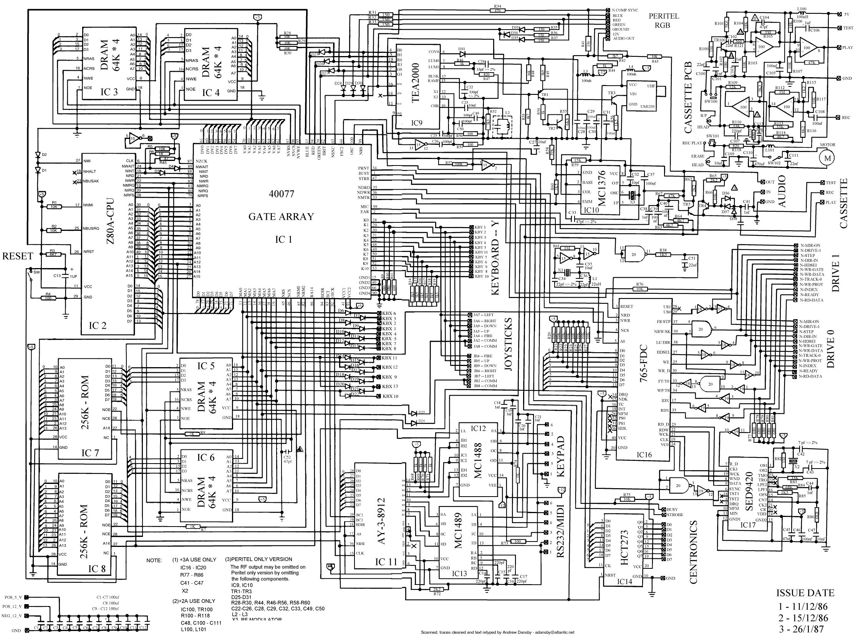
Two-level indirection
In OS kernel:
syscall_handler (int arg) {
…
}
1st level:
Use only 1 syscall handler
int 0x80
Trap to interrupt[128]
Calls syscall_handler() in OS
Vmlinux
Syscall_handler(){}
Memory
0xC0001000
Int# | Addresses
… | …
128 (0x80) | 0xC0001000
… | …

Slide 12
Two-level indirection
With only 1 handler, how to route many system calls?
e.g. open, read, write, exit, …
2nd level: Use syscall number and syscall arguments
Additional notes:
Different OSes (Linux, Mac, etc.) will have a different syscall table and syscall arguments (the compilers will take care of this)
x86-64 also has a different syscall table
In OS kernel:
syscall_handler(num, args) {
if(num==1) sys_exit(args);
…
if(num==4) sys_write(args);
…
}

Slide 13
Making write system call
How does a program make a system call?
Step 1: Set the arguments in registers (e.g. eax, ebx, ..)
eax: the system call number (4 → write)
The rest (ebx, ecx, edx): used by the specific system calls
write() accepts 3 arguments
Step 2: Make the interrupt 0x80
(The OS automatically copy eax-edx to “num” and “args”)
// Inside Linux OS:
syscall_handler(num, args) {
if(num==1) sys_exit(args);
…
if(num==4) sys_write(args);
…
}

Slide 14
Systems calls
Must pass arguments through CPU registers
You call:
write(1, “hello”, 5);
Vmlinux
syscall_handler() {}
%eax = 4 (write)
%ebx = 1 (stdout)
%ecx = “hello”
%edx = 5 (strlen)
int 0x80
Memory
in OS/vmlinux space:
int syscall_handler(num, args) {
// auto set up:
// num = %eax
// args = %ebx, %ecx …
if (num == 4)
sys_write(..)
}
Your program

Slide 15
Making exit() system call
Explicit (call exit yourself) or implicit (end of main() function)
The OS will clean up your process’ memory
Step 1:
eax: the system call number (1 → exit)
The rest (ebx): used by the specific system calls
exit() accepts only 1 argument (the exit code: 0, -1, etc.)
Step 2: Make the interrupt 0x80
x86_32:
exit = syscall #1
In x86_64:
exit = syscall #60
1
syscall_handler(num, args) {
if(num==1) sys_exit(args);
…
if(num==4) sys_write(args);
…
}

Slide 16
User and Kernel Mode

Slide 17
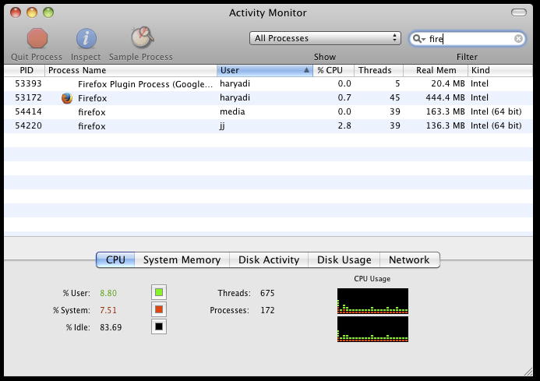
User vs. System/Kernel Mode
System calls
CPU runs user code → User mode
CPU runs OS kernel code → Kernel/system mode
Examples:
Watch youtube → green or red?? Why??
Infinite loop of i++ → green or red?? Why??

Slide 18
User vs. Kernel Mode
Vmlinux
sys_handler ()
sys_write ()
timeofday()
Simplified Example:
CPU in green or red mode?
2^{n}-1
0xC000 5000
0x 8000 1100
0x 8000 1200
0x 8000 1300
0x 8000 1400
0x 8000 1500
F()
i++;
write(1, i, ..);
j++;
gettimeofday();
k++;
0xC000 6000
0xC000 7000
Memory
0
i++
time
CPU, 0x 8000 1100
(prepare eax…edx
and make int 0x80)
CPU, 0x 8000 1200
CPU, 0x C000 5000
sys_handler()
sys_write()
Program
calling
syscalls
CPU, 0x C000 6000
CPU, 0x 8000 1300
j++
0x80001100
CPU, 0x 8000 1400
int 0x80
CPU, 0x C000 5000
sys_handler()
CPU, 0x C000 7000
timeofday()

Slide 19
User and kernel mode
How does the CPU know whether it’s in user or kernel mode?
Whenever HW interrupt happens, user→kernel
When returning to user, change CPU to user mode
Kernel mode (important!)
“King/God mode” → can access anything!!! All hardware, disk content, all process’ memory, etc.!!
Hacker’s destination
CPU, 0x80001100
CPU, 0x80001200
CPU, 0xC0005000
time
CPU, 0xC0005...
CPU, 0x80001300
CPU, 0x80001400
CPU, 0xC0007000

Slide 20
Why should you care about sys/libcalls?
Suppose you want to print something to the screen ..
Which one is faster? Why? Which program has more red/green?
for (i=1…10000)
write(stdout, i, ..);
char bigstr[1000000];
for(i=1…10000)
offset=…(quite complex here);
strcpy(bigstr[offset],itoa(i));
// bigstr=“1 2 3 4 5 6 7 … 10000”
write(stdout, bigstr, …);
for (i=1…10000)
printf(“%d ”, i);

Slide 21
Why should you care?
Ideally reduce unnecessary user/kernel crossings
User/kernel crossing is expensive
Long jump, saving registers, saving return address, setup arguments via registers, etc. etc.
Hence, the many C libraries are provided today!

Slide 22
System call vs. library call
Library call does not involve user/kernel crossing
Library (e.g. libc.so) is loaded into the user’s code segment
So a call to the library will only make a local jump
(eventually make a syscall if needed)
Is a function “f” a syscall or library?
Run “man 3 f” and see the description
(or just google it)
(Some libraries e.g. fwrite will eventually make system calls e.g. write)
Vmlinux
sys_write()
Memory
Memory
Call
strcpy()
/lib/libc.so
strcpy()
Call
write()

Slide 23
Processes

Slide 24
Program vs. Process
We use this code a lot in this lecture.
So please digest them while we wait for the class to start.
My files:
/code/myprog
/data/file.txt
Motivational example
“myprog” opens file.txt
Two shells run the programs but in different directories
Which one works?
Shell 1 or shell 2?
Why?
Yes, but specifically why?
What is inside “sys_open()” that returns the error?
Program becomes process(es)
Each process has its own process state
myprog:
main() {
fd = open(“file.txt”)
if (fd == -1) ERROR;
}
Shell 1:
% cd /code
% ./myprog
…
Success/Fail?
Shell 2:
% cd /data
% /code/myprog
…
Success/Fail?

Slide 25
Program vs. Process
Shell 1:
% cd /code ← CWD
% ./myprog
Program:
A collection of static code and static data
E.g. /code/myprog, /bin/ls
Process
Instance of a computer program that is being executed
Has its own context
Context: its code and data stored in memory (stack, registers, program counter, heap, etc.)
Has private virtual address space (more later in VM)
Process != program
In previous example: the two processes of the same program have different current working directories (CWD)
CWD is inherited from the parent process (i.e. the shell in this example) – more when we discuss fork()
Shell 2:
% cd /data ← CWD
% /code/myprog

Slide 26
1 firefox program, 3 processes
Why does OS separate processes for different users?
Why Mac OS doesn’t create multiple firefox processes for ‘haryadi’?
Why is firefox plugin process created as a separate process?

Slide 27
Process State (PID, PC, …)
“increment” program:
int i,j,k,..;
main() {
i++;
j++;
k++;
…
}
Process ID
Run “top” or “ps –e”
Firefox PIDs in previous slide
Program counter (PC / %eip)
Run 2 “increment” processes
P56 might already reach k++
P76 might only at i++
OS
“increment”
Pid 56
i++;
j++;
k++;
…
“increment”
Pid 76
i++;
j++;
k++;
…
Process 56
PC
PC
Process 76
Memory

Slide 28
Ex Process State: Stack and Heap
Heap / stack
Each process has its own stack
“i++” in two processes modify different memory locations of “i”
Will you see same “i” values?
OS creates a Process Control Block (PCB) per process
Keeps track the process state of a process
(More in future lectures)
“printRand”
i=rand();
print(i); …
“printRand”
i=rand();
print(i); …
Stack of 44
Code of 44
Stack of 55
Code of 55

Slide 29
Extra

Slide 30
Another view: Process as an abstraction
In the book: Process is “one of the most profound and successful ideas in computer science” – Profound, why?
Process abstracts processor
Do you deal with the processors/CPUs directly?
Do you worry about how many processors/cores are there?
100 processes on a quad-core (where to run?)
Stack/heap (local vs. global variables) abstracts …?
Do you deal with memory directly?
What are the locations of your variables in memory?
(In general, when systems get complex, you provide abstraction to simplify complexities and make your users happy/productive)

Slide 31
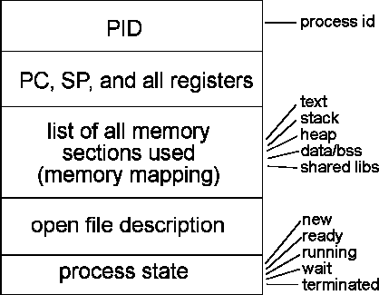
Processes (Summary)
Definition: A process is an instance of a running program.
One of the most profound ideas in computer science
Not the same as “program” or “processor”
Process provides each program with two key abstractions:
Logical control flow
Each program seems to have exclusive use of the CPU
Private virtual address space
Each program seems to have exclusive use of main memory
How are these Illusions maintained?
Process executions interleaved (multitasking) or run on separate cores
Address spaces managed by virtual memory system (next chapter)
At left: example of process table entry maintained by OS
http://www.cs.purdue.edu/homes/grr/cs354/LectureNotes/Spring2002/week5-1/

Slide 32
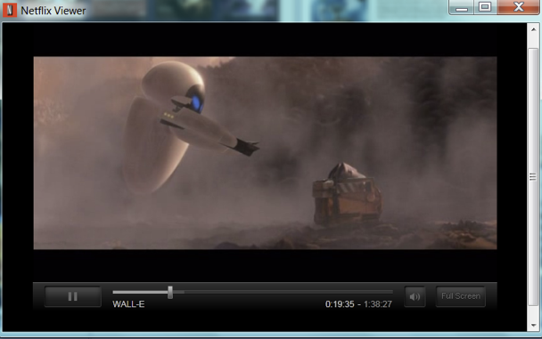
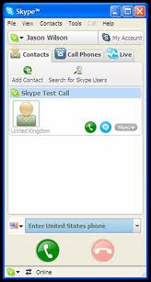
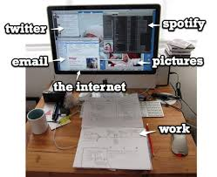
Multi-tasking/multi-programming
Multiple processes resident at a time
Creates an illusion that concurrent processes can run at the same time even if there is only one CPU

Slide 33
Context Switching
Control flow passes from one process to another via a context switch
Ex: CPU context switches from Process A to Process B
But what triggers context switch?
i.e. how can the OS “steal” the CPU from running the program?
(hint: From last lecture)
Process A
Process B
user code
kernel code
context switch
Time
user code
kernel code
context switch
user code
Notes:
Timer interrupt …

Slide 34
Concurrent Processes
Two processes run concurrently (are concurrent) if their flows overlap in time
Otherwise, they are sequential
Examples (running on single core):
Concurrent: A & B, A & C
Sequential: B & C
Process A
Process B
Process C
Time
Notes:
Note that this is an ambiguous definition.
Maybe should write COULD overlap in time.

Slide 35
User View of Concurrent Processes
Control flows for concurrent processes are physically disjoint in time
However, we can think of concurrent processes are running in parallel with each other
Process A
Process B
Process C
Time

