Slide 1
os1: OS and Exceptions
Chapter 8.1
(note: ex1 grades/viewing)
Instructor:
Haryadi Gunawi
Notes:
50+

Slide 2
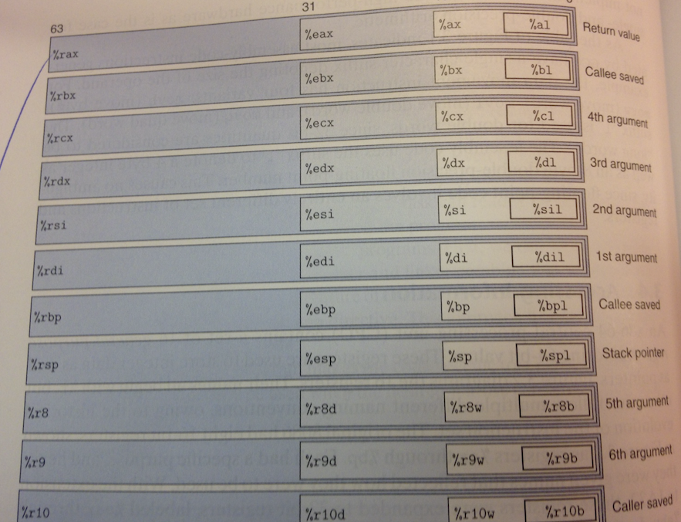
I hate 64 bits
OS lectures, I’ll use 32-bit registers: “r” → “e”
  %eip = program counter (%rip in x64)
  We’ll just four registers mainly %eax, %ebx, %ecx, %edx
    (not rax, rbx, etc.)
  mov %eax mem[addr]
  Understanding the concept is more important
Figure 3.2
(page 80 in
CSAPP book
ver3)

Slide 3
Control Flow
A processor does only “one thing”:
  From startup to shutdown …
    Reads an instruction from memory, then …
      Executes the instruction
This sequence is the CPU’s control flow
<startup>
inst₁
inst₂
inst₃
…
inst_{n}
<shutdown>
Time

Slide 4
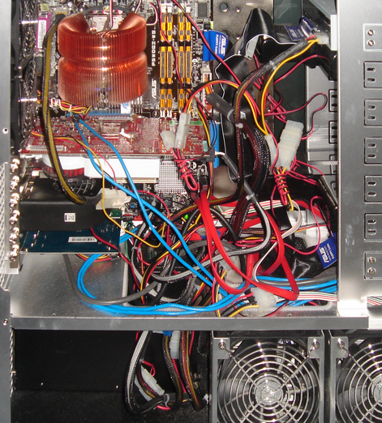
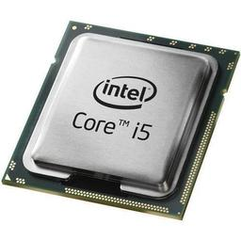
Processor != Computer
Network
Power
Memory (DRAM)
Disk/SSD
Different?
Cooling

Slide 5
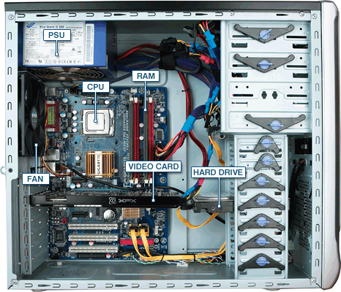
Processor != Computer
A processor is a “passive” component
  (A simple perspective; but also complex in reality)
A computer does much more
  Run many programs
  Deal with errors
  Receive network packets (e.g. Skype messages)
  Read/write data to disk/SSD
  Input/output: keyboard, mouse, screen
  But, who manages all of these?
The answer: the operating system
  Lots of mechanisms and policies
  We’ll begin with exception

Slide 6
What is an OS?
A top-down description
  Wiki:
    An operating system (OS) is software that manages computer hardware and software resources and provides common services for computer programs. The operating system is an essential component of the system software in a computer system. Application programs usually require an operating system to function.
  Book: …
This lecture: A bottom-up description
  See it! Feel it! Love it!
  (don’t forget to read the book … need both)

Slide 7

WHAT is an OS?
OS manages program executions
  Hundreds of programs are running on your laptop!
  (Including the execution of itself)
OS itself is a program
What does a program look like?
  Hello.c → hello (a binary file)
What does an OS program look like?
  Whole tree:
    https://elixir.bootlin.com/linux/latest/source
    CPU mgmt: https://elixir.bootlin.com/linux/latest/source/kernel/cpu.c
    Bluetooth: https://elixir.bootlin.com/linux/latest/source/net/bluetooth
  A bunch of C files! (just like hello.c)
  Compiled into /boot/vmlinux… (> 200 MB binary file)

Slide 8
Objdump
Objdump:
  objdump –t <binary> → functions
  objdump –D <binary> → all instructions
Program (binary) files
  objdump –t hello | grep -w F | wc –l
    12 functions, 8.2 KB
  objdump -t /boot/vmlinux | grep -w F | wc –l
    (or jut see /boot/System.map file)
    Linux: 30,000+ functions, 146MB (excluding loadable drivers)
    “vmlinuz” → compressed version of vmlinux
Where does a program live?
  In disk, and loaded to memory

Slide 9
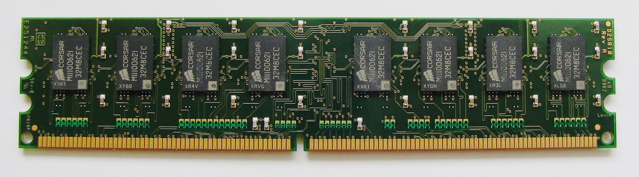
Memory (DRAM) and Addresses
Largest address --
Addressable high-speed volatile storage
  int i = 7;
  mov 7 Mem[Addr]
Address range
  8 bytes of memory
    [0x 0 – 0x 8)
  16 bytes of memory
    [0x 0 – 0x 10)
  32 bytes of memory
    [0x 0 -- ??
  2 GB
    [0x 0 – 0x 8000 0000)
  4 GB
    [0x 0 -- ??
  Mem[Addr]
i
0x 0

Slide 10
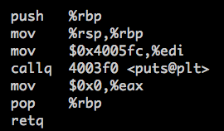
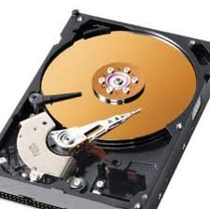
Programs and OS
2^{n}-1
OS
(vmlinux)
2^{n}-1
Where are they?
  So far abstract view. Real view:
  On the disk:
    (yourPath) /p1/hello
    /boot/vmlinux-3.2.0
  Gets loaded to memory
    Who loads hello?
    Who loads vmlinux?
0xC0004080
Memory
0
0x0800C040
main()
hello:
Main()
CPU
(need instructions)
0
OS registers the next
instruction address (%eip register)
e.g. 0x0800C040
/boot/vmlinux
…/p1/hello
Notes:
OS, bootloader

Slide 11
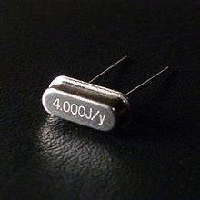
But … an infinite program?
2^{n}-1
Ex:
  While(true) { i++ };
    0x800C040: mov Mem[i] %eax
    0x800C050: inc %eax
    0x800C060: mov %eax Mem[i]
    0x800C070: jmp 0x800C040
A new program also runs
  Will you see print “A”? No/Yes?
  But how come?
    (CPU is just a passive component)
    …
Memory
0x0800C040
Infinite Program
New prog:
Print “A”
CPU
(running infinite Prog )
0
Notes:
…
Timer interrupt, every 10 ms .. OS code takes control over the CPU

Slide 12
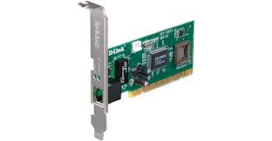

Or, a network “interrupt”
2^{n}-1
A long program is using the CPU
But then …
  An “important” tweet
  From where? NIC card
When to process the message?
  (Process message needs CPU)
  After the long program ends?
Memory
0
Long program
Twitter
CPU
(running long prog )
“Bieber has a
new tattoo”

Slide 13
Or, a buggy program
2^{n}-1
Vmlinux
divByZero
Handler();
Ex: divide by zero
  x = y / z; (say z is 0)
  0x800C040: idivl %ecx (%ecx is 0)
  0x800C050: mov (the result) mem[x]
What will happen?
  Execute the next instruction?
  What will happen to the buggy program?
  But how? What’s the next instruction to execute by the CPU?
    Exception flow to the OS code!
0xC0004080
Memory
0
0x0800C040
Buggy
program
CPU
idivl %ecx
0

Slide 14
Or, make a system call
2^{n}-1
Vmlinux
DiskRW()
{…}
2^{n}-1
Ex: write()
  X = write(fileDesc, buf, …)
  Where are the actual functions that perform reading/writing bytes from/to the disk?
0xC0005010
Memory
0
Programwith
I/Os
CPU
0

Slide 15
RECAP: The problem statement
inst₁
inst₂
inst₃
…<break>
inst_{n}
Computer is complex
  System calls, network interrupts, error handling, time sharing, ..
  But processor is “passive”
We need a mechanism to deal with these scenarios
  That is, we need to break the control flow of a running program
Solution: OS Exceptions
  In the book: “exceptional control flow”
  Alter the flow of a program
  (NOT the same as Java/C# exceptions)
The mechanisms:
  Exception handlers (written by OS Developers)
  Exception table (provided in the HW)
  HW and SW (i.e. OS) developers work together to solve the problem

Slide 16
Exceptions
Exception handlers and Exception table

Slide 17

OS contains exception handlers
TimerInterrupt() { // every 10 ms
SchedulePrograms();
Ex: P1 just ran, so now P2’s turn;
}
DivideByZeroError() {
// e.g. currentP just did x/0
kill(currentProcess);
popUpWindow(“hey something wrong”);
scheduleProcesses();
}
Syscall_handler (int arg) {
if (arg==READ) sys_read(…);
…
}
networkInterrupt() {
// read data from network card
}

Slide 18
Exception handlers
vmlinux/OS
divByZero(){}
timerInt(){}
sysHandler() {}
0xC0003000
0xC0002000
Memory
Compiled and get loaded to the memory
  They have “home” (physical) addresses
  (during boot time by the boot loader)
  Examples:
    divideByZero() is stored in address 0xC0003000
    timerInterrupt, 0xC0002000
    syscall_handler, 0xC0001000
    (Addresses are not static, known at boot time)
  These functions are waiting to be called (by who?)
0xC0001000

Slide 19
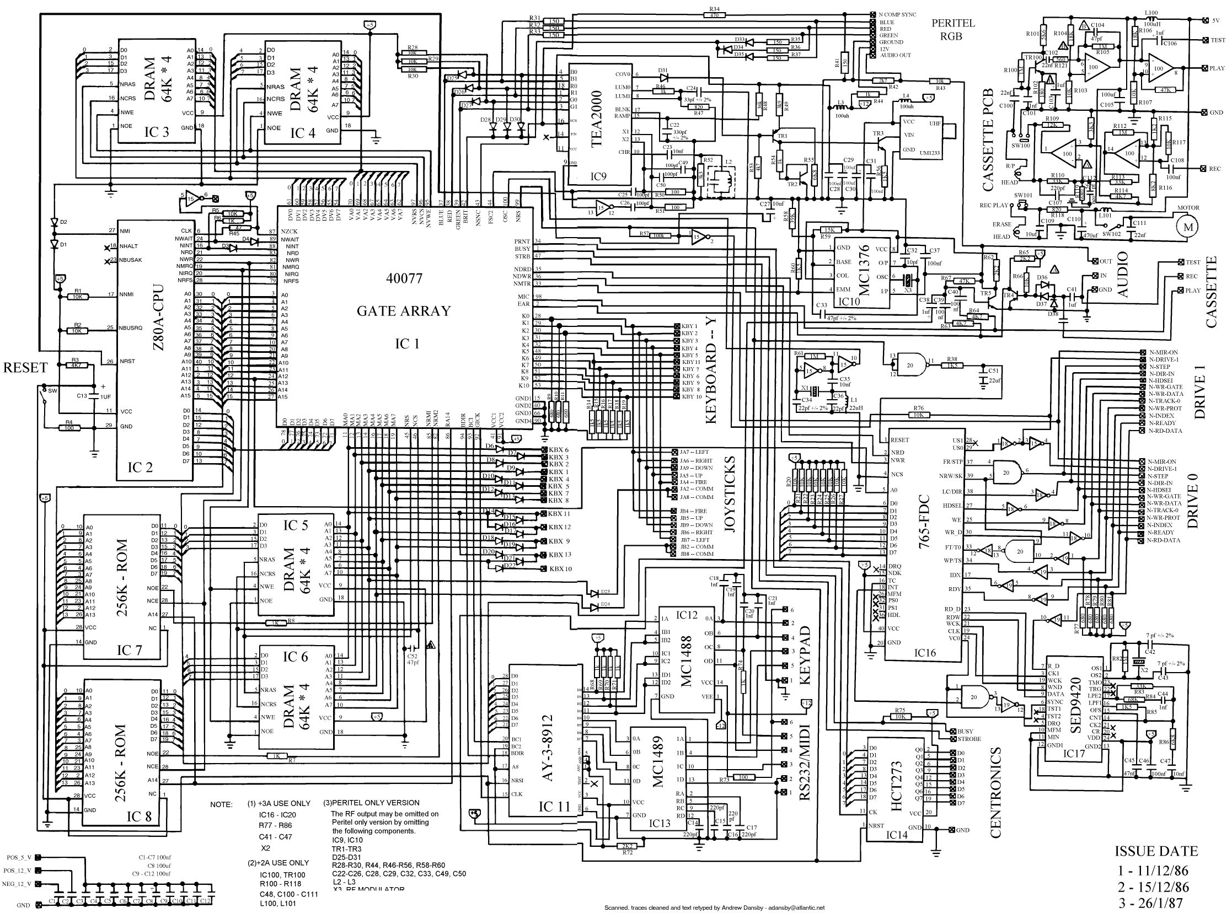
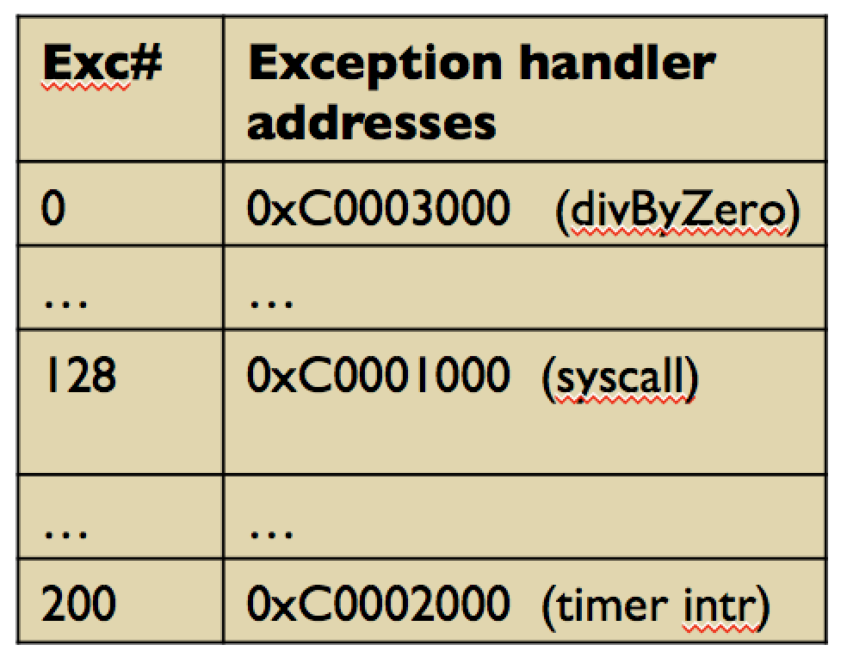
Exception/Interrupt Table
Exc# | Exception handler addresses
0 | 0xC0003000 (divByZero)
… | …
128 | 0xC0001000 (syscall)
… | …
200 | 0xC0002000 (timer intr)
Built inside the CPU
  256 entries
Initialization
  The boot loader boots the OS
  OS initialization code install addresses of exception handlers to exception table
Excep-tion # | Description | Actual Functions
0 | Divide Error | DivideByZeroError()
128 | Syscall | SyscallHandler()
200 | Timer interrupt | TimerInterrupt()
(See Fig. 8.9 in CSAPP book)

Slide 20
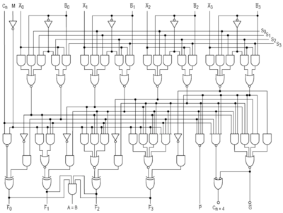
Example …
Vmlinux
DivByZero() { }
(handler)
0x0800C040
CPU
idivl Z
0xC0003000
In CPU, ALU circuit:
if (“Z == 0”)
(all bit lines are 0)
fetch exc[0]
Memory
0
0x0800C040
Buggy
program
 | Exception Table
0 | 0xC0003000
CPU
(Exec DivByZero())
set %eip =
0xC0003000
0

Slide 21
Example …
Vmlinux
timerIntr() { }
0x0800C040
CPU
(Long program)
0xC0001000
In CPU circuit:
(every 10ms)
fetch exc[200] → timer interrupt
Memory
0
 | Exception Table
200 | 0xC0001000
0x0800C040
Long
program
CPU
(Exec timerIntr())
%eip =
0xC0001000
0x08001010
Another
program
%eip =
0x08001010
CPU
(another program)
0

Slide 22
Context Switching
Control flow passes from one process to another via a context switch
  Ex: CPU context switches from Process A to Process B
But what triggers context switch?
  Timer interrupt (the most common trigger)
Process A
Process B
user code
kernel code
context switch
Time
user code
kernel code
context switch
user code
Notes:
Timer interrupt …

Slide 23
Summary
Computer is complex
  Need exceptional control flow
  Exceptional control flow (ECF) is important because its how we implement: Input/output, processes (and user-level control of process creation), virtual memory, interactions with OS, software exceptions
Exception handlers – in SW
  Basically OS functions, compiled, then get loaded to certain memory addresses
Exception table (or interrupt descriptor table) – in HW
  Built-in the CPU, initialized by the OS, contains addresses
  http://en.wikipedia.org/wiki/Interrupt_descriptor_table
HW and SW developers work together
  HW provides the interrupt table
  SW (OS) decides how to handle each exception/interrupt

Slide 24
Exceptional Control Flow (Cont’d)
(From the book)

Slide 25
Exceptions
An exception is a transfer of control to the OS in response to some event (i.e., change in processor state)
Examples:
page fault, I/O request completes, Ctrl-C, divide by 0 …
User Process
OS
event
I_current
exception
I_next
exception processing
by exception handler
return to I_current
return to I_next
abort

Slide 26
Asynchronous Exceptions (Interrupts)
Caused by events external to the processor
  Indicated by setting the processor’s interrupt pin
  Handler returns to “next” instruction
Examples:
  I/O interrupts
    hitting Ctrl-C at the keyboard
    arrival of a packet from a network
    arrival of data from a disk
  Timer interrupt
  Hard reset interrupt
    hitting the reset button
  Soft reset interrupt
    hitting Ctrl-Alt-Delete on a PC
Notes:
Exception handler called AFTER current instruction completes

Slide 27
Synchronous Exceptions
Caused by events that occur as a result of executing an instruction:
  Traps (example in next slide)
    Intentional, returns control to “next” instruction
    Examples: system calls, breakpoint traps, special instructions
  Faults
    Unintentional but possibly recoverable
    Examples: page faults (recoverable), protection faults (unrecoverable), floating point exceptions
      Page faults: (Imagine a 100 MB microsoft excel program, not all of them are loaded to memory; if next instruction (PC++) is not in memory, go to OS and fetch next code page from disk)
    Either re-executes faulting (“current”) instruction or aborts
  Aborts
    unintentional and unrecoverable
    Examples: parity error, machine check
    Aborts current program

Slide 28
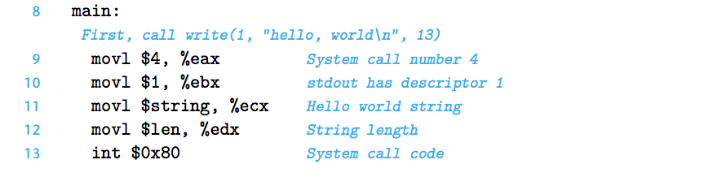
x86_32:
https://en.wikibooks.org/wiki/X86_Assembly/Interfacing_with_Linux
In x86_64 (book):
int 0x80 → syscall
printf(“hello world”)
In CPU circuit:
fetch code address at exc[128] 0x80==128
(the syscall_handler() in OS code, which will put the string to the monitor screen)

Slide 29
Summary
Exceptions
  Events that require nonstandard control flow
    “JUMPING” from user program to the OS code
  Generated externally/asynchronous (interrupts) or internally/synchronous (traps and faults)

Slide 30
EXTRA
(Quick recap)

Slide 31
Trap Example: Opening File
User calls: open(filename, options)
Function open executes trap instruction int (with syscall code x80=128)
OS must find or create file, get it ready for reading or writing
Returns integer file descriptor
0804d070 <__libc_open>:
. . .
804d082: cd 80 int $0x80
804d084: 5b pop %ebx
. . .
User Process
OS
int
exception
pop
open file
returns
Notes:
SYSTEM CALL – like a regular procedure call, but privileged, etc.

Slide 32
Fault Example: Page Fault
(You can ignore for now, until we learn about VM)
User writes to memory location
That portion (page) of user’s memory
is currently on disk
Page handler must load page into physical memory
Returns to faulting instruction
Successful on second try
int a[1000];
main ()
{
a[500] = 13;
}
80483b7: c7 05 10 9d 04 08 0d movl $0xd,0x8049d10
User Process
OS
exception: page fault
movl
Create page and
load into memory
returns

Slide 33
Fault Example: Invalid Memory Reference
int a[1000];
main ()
{
a[5000] = 13;
}
80483b7: c7 05 60 e3 04 08 0d movl $0xd,0x804e360
User Process
OS
exception: page fault
movl
detect invalid address
signal process
Page handler detects invalid address
Sends SIGSEGV signal to user process
User process exits with “segmentation fault”
Notes:
NESTED exceptions

Slide 34
Interrupt Vectors
Exception
numbers
code for
exception handler 0
Each type of event has a
unique exception number k
k = index into exception table
(a.k.a. interrupt vector)
Handler k is called each time
exception k occurs
Exception
Table
code for
exception handler 1
0
1
code for
exception handler 2
2
...
n-1
...
code for
exception handler n-1
Notes:
Set up when OS boots

Slide 35
Exception Table IA32 (Excerpt)
Exception Number | Description | Exception Class
0 | Divide error | Fault
13 | General protection fault | Fault
14 | Page fault | Fault
18 | Machine check | Abort
32-127 | OS-defined | Interrupt or trap
128 (0x80) | System call | Trap
129-255 | OS-defined | Interrupt or trap
0-31 are
Intel-
defined
32-255 are
OS-defined
Check Table 6-1:
http://download.intel.com/design/processor/manuals/253665.pdf
Notes:
0: divide by zero OR result too big for destination
13: “Segmentation fault” on Linux

Slide 36
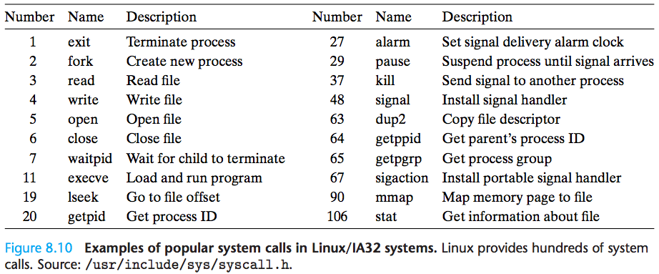
Linux/IA32 system call codes

