Slide 1
Machine Learning Impact on Datatypes and Instruction Set Architecture
CS 154: Intro to Computer Systems
Prof Chien
Lecture 15

Slide 2
Machine Learning / AI is Important
March 27, 2019 Turing Award Winners (Nobel Prize of Computer Science)
DNN => Deep Neural Networks => Deep Learning

Slide 3

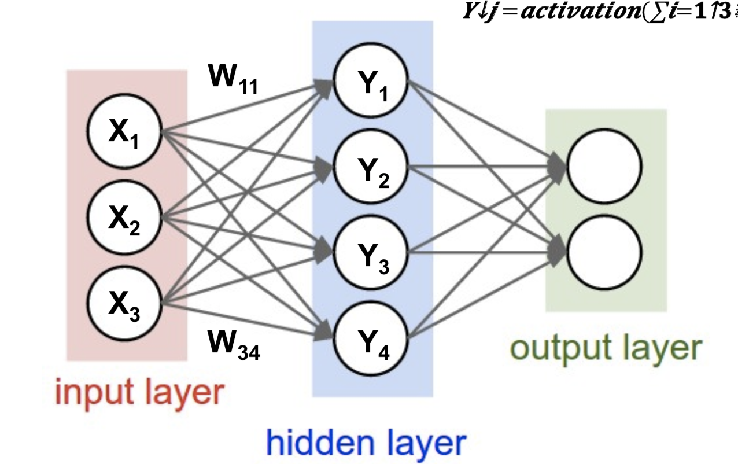

What is Deep Learning?
Design
Code
Learned
Outputs
Inputs
Outputs
Corrections
(Learning)
Improve
Test
Learning computational function from data
  Requires huge amounts of computation for learning, and perhaps inference (use)
Traditional: human expresses computational function

Slide 4
Deep Neural Network
Each Synapse has a weight for neuron activation (function)

Slide 5
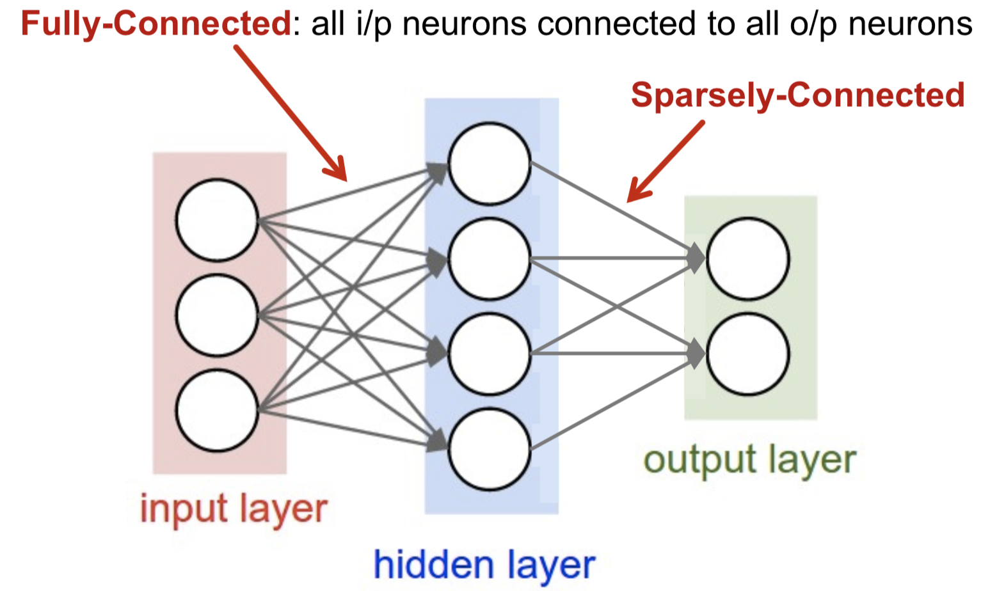
Fully Connected and Sparse
Connections define the computational structure
Sparsity can reduce computation by 10-100x or more for a layer
  And affect computational structure dramatically as well

Slide 6
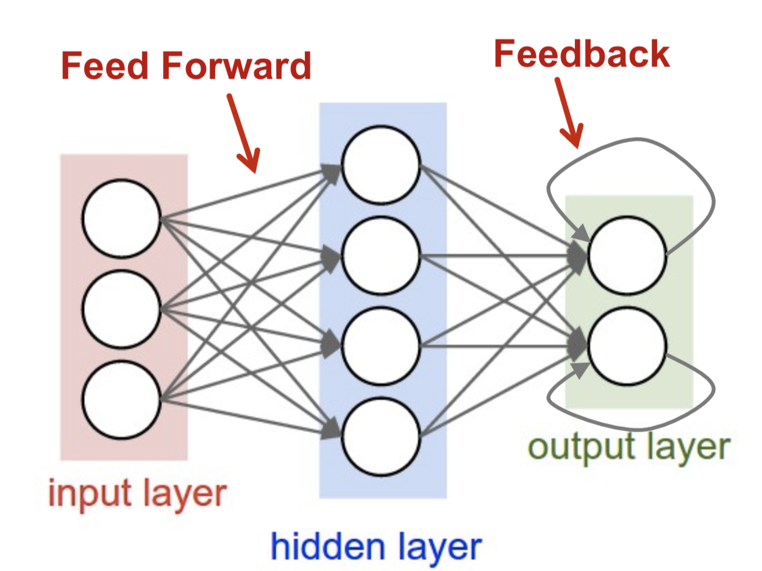
Feedforward and Recurrent
All of these ANN’s have massive parallelism. Feedforward is simple, with dependences.
Recurrrent/Feedback implies an iterative use of state.

Slide 7
Applications using Deep Learning have different requirements
Lots and lots of computational operations
Control flow? (not so much… but perhaps in implementation)
Procedures and modularity? (don’t know how to construct yet)
And interestingly… because the computations are ”statistical” and in some cases highly redundant, you can compute many wrong answers “slightly wrong”, “very wrong” and still get the correct result….
Hmmm…. Opportunity?

Slide 8
Traditional Values
William Kahan, 1989 Turing Award Winner: FP Standardized (once and for all!)
DNN’s want small values (cheaper operations, less space)
  What range and accuracy do they need?

Slide 9
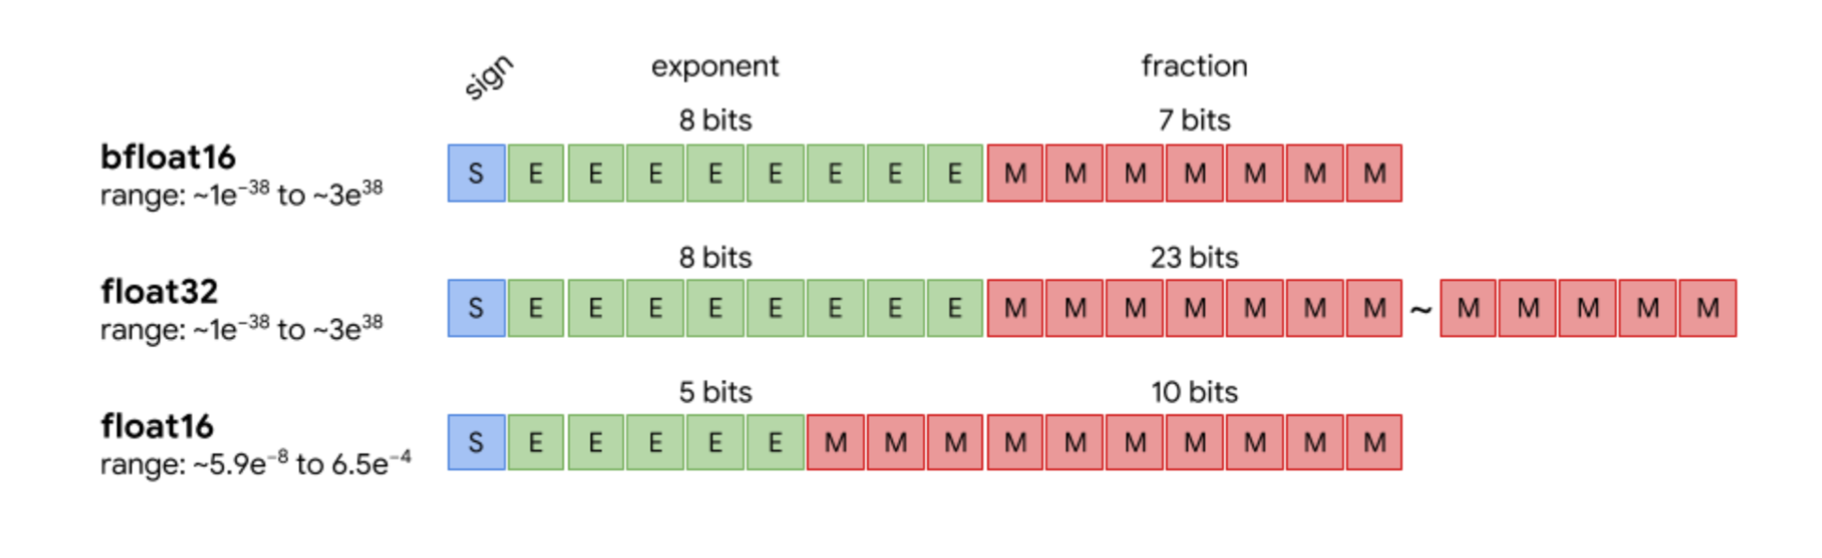
Google’s “Brain” Float (Bfloat16)
Idea: For lots of DNN training (Stochastic Gradient descent)
  FP32 works well… but can we use something even smaller?
    FP16… doesn’t work as well, why? [dynamic range, numbers exceed dynamic range]
  Bfloat16: similar dynamic range to FP32, but lower accuracy (fraction bits)
    Don’t care about accuracy! Much. Massive statistical training, many labelled inputs…
How much should Bfloat16 help vs. FP32?
  2x smaller data to move/store, 2x(?) lower cost per operation? – small fraction

Slide 10
Values, Energy and Area Operation Cost
Energy = Power cost (at constant operation rate)
FP32->I32, 0.2x, 10x => 30% savings/MAC
FP32->F16, 2x,3.5x => 3x savings/MAC
FP32->I16, => 4.3x savings/MAC
… but the REAL cost is memory access (we’ll come back to this….
Courtesy Dally and Han

Slide 11
How well does it work?
Cost: Power and Size [Compare Bfloat16 to FP32 (float)]
  2-4x benefit per operation in power and size (think about the work required to do a multiply)
  … requires NEW hardware…..
Convergence for training [Compare to FP16]
  How much faster are we converging…

Slide 12
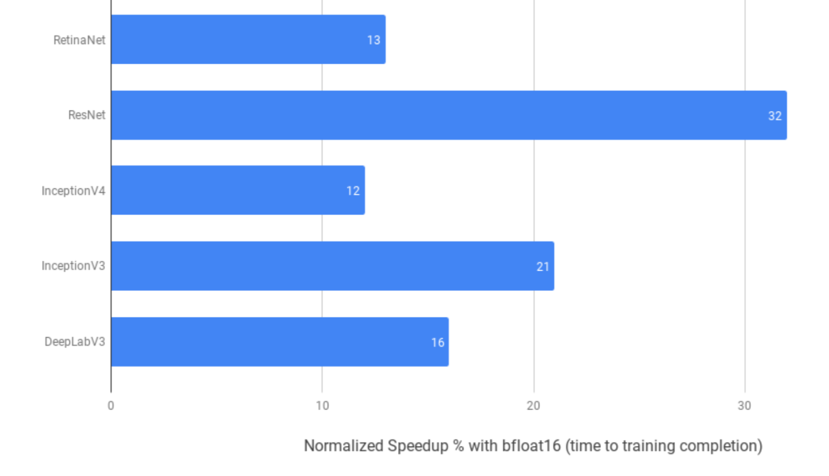
How much faster convergence? Bfloat16 vs. FP16
Percentage improvement!
(all less than 1.45x.)
Try training your models using Bfloat16 (if you’re running on Cloud TPU, which supports it)
  Because data is smaller, step times will typically be faster
  … and if your hardware supports it, significantly cheaper!... (Cloud TPU)
  For more information https://cloud.google.com/tpu/docs/bfloat16

Slide 13
Architecture support for Bfloat
Started with Google tensorflow (software), Nov 2015
1st Hardware Support was Google Tensorflow Processing Unit (TPU), only available in google cloud, 2016
  but secretly operating in 2015
Intel VNNI instructions (vector neural net) – int16, int8 collections, 2018
(2019) Intel “Cooper Lake” Xeon – VNNI with Bfloat16
(2019) Intel NNP-T 1000 (Nervana)… Intel’s TPU
  For more information see: https://en.wikichip.org/wiki/x86/avx512vnni
AMD and ARM have also committed
And a host of startups
At present, only GPU’s have not adopted (Nvidia, AMD/ATI)

Slide 14
Microsoft’s ”Secret” Floating Point Format
Motivation, reduce operation energy
Observation: many of the weights and activation values have similar exponent
  Why? If they are very different, the small ones don’t matter (addition will wipe them out)
  Ex. 1E-02 + 7E-08 => ?
Idea: share the exponent

Slide 15
Block Floating Point
Old idea, used in the signal processing community for decades
Many fractions, mantissas. Sharing a single exponent.
Benefit: smaller size (average)
  5*11+5 = 60 bits for 5 numbers, 12 bits per value
Disadvantage: loss in accuracy (fractions are denormalized)
  How bad? Depends on how far apart the REAL exponents should be
  Which exponent do we choose? [?]

Slide 16
Summary
Datatypes are alive and responding to changes in applications and needs! Likely to see more of this because of End of Moore’s law (power, area pressure)
Instruction sets are alive and responding to changes in applications
  Extensions to traditional ISA’s
  Lots of new ISA’s (Google TPU, Intel NNP, lots of startup ML accelerators)
To explore further
  CMSC 222000 Computer Architecture
  CMSC 222400 Computer Architecture for Scientists (Chien), pilot new course
  CMSC 322000 Graduate Computer Architecture
  CMSC 330-01 Computer Architecture for Machine Learning (Chien), topics class, offered irregularly

Slide 17
Exam 1 Logistics
Covers materials through Today’s Lecture, Lecture #14 (Review)
November 4th, Monday, 7pm-8:30pm, KPTC (Kersten Physics Teaching Center) Room 106
Exam Logistics – closed everything
  Can bring one handwritten sheet of paper
  x86 instruction list will be on the exam paper
  https://www.classes.cs.uchicago.edu/current/15400-1/154-exam1-cheatsheet.pdf
Review Session, Saturday 3-5pm, Crerar 346
SDS students only: see email from Daniar Kurniawan (daniar@uchicago.edu)

