Slide 1
Optimizing Code for Better Cache Performance CMSC 15400: Introduction to Computer Systems
Autumn 2019, Prof Chien Lecture 13

Slide 2
Today
How to write code that is cache friendly?
Rearranging loops to improve spatial locality
Cache realities (not on exam)

Slide 3
Struct Array Example
typedef struct {
double savings_balance;
double checking_balance;
} account_t;
void get_total_balances1(
account_t* a, int n) {
int i;
savings_total = 0.0;
checking_total= 0.0;
for(i = 0; i < n; i++)
savings_total +=
a[i].savings_balance;
for(i = 0; i < n; i++)
checkings_total +=
a[i].checking_balance;
}
Start By Asking Questions
How big is n?
Probably big, lots of accounts
What kind of locality in a?
How well will the cache exploit this locality?
What is the expected Hit rate of the first loop?
What is the expected Hit rate of the second loop?
What if we don’t know the address of a?

Slide 4
How to Speed Up the Code?
In hardware?
Increasing the cache size
Increasing associativity
Increasing the cache block size
In software?

Slide 5
Struct Array Example (Better Code)
typedef struct {
double savings_balance;
double checking_balance;
} account_t;
void get_total_balances1(
account_t* a, int n) {
int i;
savings_total = 0.0;
checking_total= 0.0;
for(i = 0; i < n; i++)
savings_total +=
a[i].savings_balance;
for(i = 0; i < n; i++)
checkings_total +=
a[i].checking_balance;
}
typedef struct {
double savings_balance;
double checking_balance;
} account_t;
void get_total_balances2(
account_t* a, int n) {
int i;
savings_total = 0.0;
checking_total= 0.0;
for(i = 0; i < n; i++) {
savings_total +=
a[i].savings_balance;
checkings_total +=
a[i].checking_balance;
}
}

Slide 6
Multi-dim array example
Question: which of the following functions is more cache friendly?
int sum_array_cols(int a[M][N])
{
int i, j, sum = 0;
for (j = 0; j < N; j++)
for (i = 0; i < M; i++)
sum += a[i][j];
return sum;
}
int sum_array_rows(int a[M][N])
{
int i, j, sum = 0;
for (i = 0; i < M; i++)
for (j = 0; j < N; j++)
sum += a[i][j];
return sum;
}

Slide 7
Multi-dim array example
Question: Can you make this function more cache friendly?
int sum_array_3d(int a[N][N][N])
{
int i, j, k, sum = 0;
for (i = 0; i < N; i++)
for (j = 0; j < N; j++)
for (k = 0; k < N; k++)
sum += a[k][i][j];
return sum;
}
Notes:
From inner to outer: j -> I -> k

Slide 8
Strided Accesses
Stride length
How far apart are accesses to the same data structure?
Why does stride length > 1 matter?
Reduces spatial locality
Reduces effective memory bandwidth
Hardware optimized for stride 1
Software should structure codes/algorithms for stride 1

Slide 9
Matrix Multiplication Example
Variable sum
held in register
The problem:
Multiply two N x N matrices
Matrix elements are doubles (8 bytes)
O(N³) total operations
Assume:
Block size = 32B (big enough for 4 doubles)
Matrix dimension (N) is very large (Cache is not even big enough to hold one row/column)
Analysis Method:
Look at access pattern of inner loop
/* ijk */
for (i=0; i<n; i++) {
for (j=0; j<n; j++) {
sum = 0.0;
for (k=0; k<n; k++)
sum += a[i][k] * b[k][j];
c[i][j] = sum;
}
}
matmult/mm.c

Slide 10
Matrix Multiplication (ijk)
/* ijk */
for (i=0; i<n; i++) {
for (j=0; j<n; j++) {
sum = 0.0;
for (k=0; k<n; k++)
sum += a[i][k] * b[k][j];
c[i][j] = sum;
}
}
Inner loop:
(*,j)
(i,j)
(i,*)
A
B
C
matmult/mm.c
Row-wise
Column-
wise
Fixed
Misses per inner loop iteration:
A B C
0.25 1.0 0.0
1.25 misses per 2 loads
Notes:
First move j, then i

Slide 11
Matrix Multiplication (jik)
/* jik */
for (j=0; j<n; j++) {
for (i=0; i<n; i++) {
sum = 0.0;
for (k=0; k<n; k++)
sum += a[i][k] * b[k][j];
c[i][j] = sum
}
}
Inner loop:
(*,j)
(i,j)
(i,*)
A
B
C
matmult/mm.c
Row-wise
Column-
wise
Fixed
Misses per inner loop iteration:
A B C
0.25 1.0 0.0
1.25 misses per 2 loads

Slide 12
Matrix Multiplication (kij)
/* kij */
for (k=0; k<n; k++) {
for (i=0; i<n; i++) {
r = a[i][k];
for (j=0; j<n; j++)
c[i][j] += r * b[k][j];
}
}
Inner loop:
(i,k)
(k,*)
(i,*)
A
B
C
matmult/mm.c
Fixed
Row-wise
Row-wise
Misses per inner loop iteration:
A B C
0.0 0.25 0.25
0.5 misses per 1 load + 1 store

Slide 13
Matrix Multiplication (ikj)
/* ikj */
for (i=0; i<n; i++) {
for (k=0; k<n; k++) {
r = a[i][k];
for (j=0; j<n; j++)
c[i][j] += r * b[k][j];
}
}
Inner loop:
(i,k)
(k,*)
(i,*)
A
B
C
matmult/mm.c
Fixed
Row-wise
Row-wise
Misses per inner loop iteration:
A B C
0.0 0.25 0.25
0.5 misses per 1 load + 1 store

Slide 14
Matrix Multiplication (jki)
Inner loop:
/* jki */
for (j=0; j<n; j++) {
for (k=0; k<n; k++) {
r = b[k][j];
for (i=0; i<n; i++)
c[i][j] += a[i][k] * r;
}
}
(*,k)
(*,j)
(k,j)
A
B
C
matmult/mm.c
Column-
wise
Fixed
Column-
wise
Misses per inner loop iteration:
A B C
1.0 0.0 1.0
2.0 misses per 1 load + 1 store

Slide 15
Matrix Multiplication (kji)
/* kji */
for (k=0; k<n; k++) {
for (j=0; j<n; j++) {
r = b[k][j];
for (i=0; i<n; i++)
c[i][j] += a[i][k] * r;
}
}
Inner loop:
(*,k)
(*,j)
(k,j)
A
B
C
matmult/mm.c
Column-
wise
Fixed
Column-
wise
Misses per inner loop iteration:
A B C
1.0 0.0 1.0
2.0 misses per 1 load + 1 store

Slide 16
Summary of Matrix Multiplication
for (i=0; i<n; i++) {
for (j=0; j<n; j++) {
sum = 0.0;
for (k=0; k<n; k++)
sum += a[i][k] * b[k][j];
c[i][j] = sum;
}
}
ijk (& jik):
2 loads / iter
misses/iter = 0.25*1+1*1=1.25
for (k=0; k<n; k++) {
for (i=0; i<n; i++) {
r = a[i][k];
for (j=0; j<n; j++)
c[i][j] += r * b[k][j];
}
}
kij (& ikj):
1 loads, 1 store / iter
misses/iter = 0.25*1+0.25*1= 0.5
for (j=0; j<n; j++) {
for (k=0; k<n; k++) {
r = b[k][j];
for (i=0; i<n; i++)
c[i][j] += a[i][k] * r;
}
}
jki (& kji):
1 loads, 1 store /iter
misses/iter = 1*1+1*1= 2.0

Slide 17
Summary
Cache memories can have significant performance impact
You can write your programs to exploit this!
Focus on the inner loops, where bulk of computations and memory accesses occur.
Try to maximize spatial locality by reading data objects with sequentially with stride 1.

Slide 18
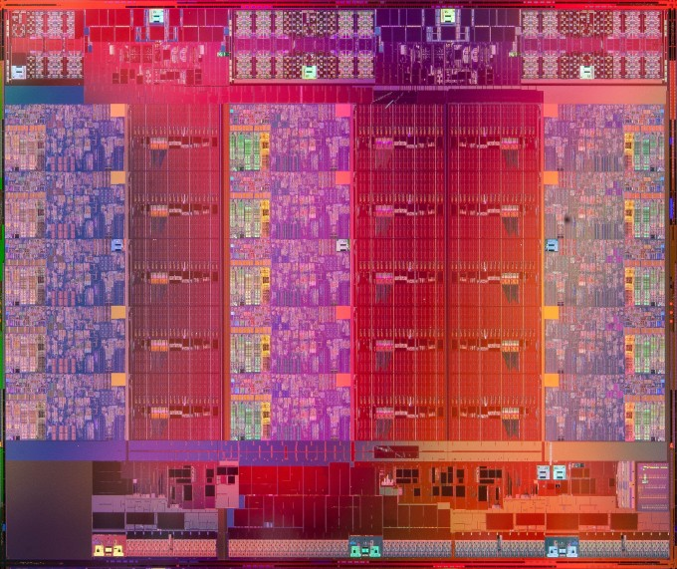
Intel Xeon E7 v2 (Feb 2014)
Not on Exam (Enjoy!)

Slide 19
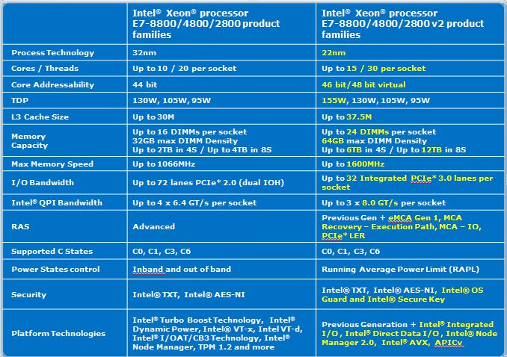
Technical Specifications
Not on Exam (Enjoy!)
For each core:
32KB L1 I-cache,
32KB L1 D-cache,
256KB L2 cache (3.8MB total)
2.5MB L3 Cache (37.5MB total)

Slide 20
Multi-level Caches
Not on Exam (Enjoy!)
Memory Hierarchy example (Intel Xeon 2014)
 | Size | Organization | Latency
L1 Data | 32KB | 8-way assoc, private | ~ 4 cycles
L1 Instruction | 32KB | 8-way assoc, private | 16 bytes, 1 cycle
L2 | 256KB | 8-way assoc, private | ~10 cycles
L3 | 37.5MB | 16-way assoc, shared | ~40 cycles
DRAM | 10-100 GB’s | n.a. | ~200 cycles
Why such a high degree of associativity?

Slide 21
Non-blocking Caches
Not on Exam (Enjoy!)
Loads, Stores
C
Hits
1 Miss outstanding at a time
Data values
Stream of references, when can the cache accept another request?
Hits are pipelined (h, h, h, h,.... in successive cycles)
Cache controller blocks on the first miss.
Hit-under-miss (m, h, h, h,.... in successive cycles)
Why is this possible?
Hits are to other data in the cache. No problem with accessing them (but the cache controller gets more complex)
Cache controller blocks on a the 2nd miss
What order do the data values return in?
How many misses outstanding at one time? (even across multiple levels of the memory hierarchy)

Slide 22
Non-blocking Caches - Aggressive
Not on Exam (Enjoy!)
Loads, Stores
C
Multiple Misses
Issued in-order
Returning out-of-order
Data values
Multiple outstanding misses (m, h, h, m, h, h, h, m, ...)
Misses to different addresses can be processed concurrently
Lots of parallelism
Next cache level can return requests out of order (hit-under-miss or multiple-miss)
Memory system can return request out of order
Banking and variable latency
Cache controller accepts out of order results
Mainstream server processor caches are all aggressive!

Slide 23
Memory Hierarchy Bandwidth (1-core)
3Ghz Nehalem
Processor/L1
Instruction: 16 bytes/clock => 48GB/s
Data: 8 bytes/clock => 24GB/s
Total bandwidth: 72GB/s
Estimate: L1 I-cache hit rate 96%, L1 D-cache 90%
Unified L2 Cache
Instruction 16B/clk * 0.04 * (64/16) = 2.56 GB/s
Data: 8B/clk * 0.10 * (64/8) = 6.4GB/s
Total L2 Bandwidth: 9 GB/s
Estimate L2 shared cache hit rate 75% (??)
1-core demand on shared L3 Cache
Total L3 Bandwidth: 9GB/s * 0.25 = 2.25 GB/s
Estimate L3 shared cache hit rate 50% (??)
1-core demand on Memory
Total Memory Bandwidth: 2.25GB/s * 0.5 = 1.1 GB/s
Not on Exam (Enjoy!)

Slide 24
Memory Hierarchy Bandwidth (8-core)
Not on Exam (Enjoy!)
3Ghz Nehalem, 8-cores
Processor/L1s
Instruction: 16 bytes/clock => 48GB/s
Data: 8 bytes/clock => 24GB/s
Total bandwidth: 72GB/s * 8 = 576GB/s
Estimate: L1 I-cache hit rate 96%, L1 D-cache 90%
Unified L2 Caches
Instruction 16B/clk * 0.04 * (64/16) = 2.56 GB/s
Data: 8B/clk * 0.10 * (64/8) = 6.4GB/s
Total L2 Bandwidth: 9 GB/s * 8 = 72GB/s
Estimate L2 shared cache hit rate 75% (??)
8-core demand on shared L3 Cache
Total L3 Bandwidth: 9GB/s * 0.25 * 8 = 18 GB/s
Estimate L3 shared cache hit rate 50% (??)
8-core demand on Memory
Total Memory Bandwidth: 2.25GB/s * 0.5 * 8 = 9 GB/s
But, misses tend to be bursty, so 25GB/s memory system

Slide 25
Observations
Not on Exam (Enjoy!)
8-core Nehalem requires >500GB/s memory bandwidth
Requires >10 DDR3 Memory Channels (4-10x what mainstream systems use)
Cost would be prohibitive, smallest memory capacity would be extremely large (enough chips to get enough bandwidth)
Caches are essential to reducing the needed bandwidth
Match the processors needs with dual L1 caches
Reduce the bandwidth requirements at lower levels
One cannot build a machine with sufficient memory bandwidth without caches!!!! (and power too!)
Extreme cost, and physical feasibility
Caches allow Moore’s law to be translated into increasing performance
Corollary: if caches don’t work for your application, you cannot get high performance

Slide 26
What do these memory hierarchies remind you of?
Request supplied in order
Response return out of order
Enables tolerating long-latency memory requests (cache misses)
Other memory operations pass them by (hits)
Program continues to run correctly
Out-of-Order Processor <-> Out-of-Order Memory Hierarchy

Slide 27
How to Improve?
In the matrix multiplication example, only spatial locality is utilized
How about temporal locality?
Problem: Cache is too small to take advantage of temporal locality!
Solution: Using blocking to improve temporal locality

Slide 28
Example: Matrix Multiplication
c = (double *) calloc(sizeof(double), n*n);
/* Multiply n x n matrices a and b */
void mmm(double *a, double *b, double *c, int n) {
int i, j, k;
for (i = 0; i < n; i++)
for (j = 0; j < n; j++)
for (k = 0; k < n; k++)
c[i*n + j] += a[i*n + k] * b[k*n + j];
}
j
c
a
b
=
*
i

Slide 29
Cache Miss Analysis
Assume:
Matrix elements are doubles
Cache block = 8 doubles
Cache size C << n (much smaller than n)
No allocate on write
First iteration:
n/8 + n = 9n/8 misses
Afterwards in cache: (schematic)
n
=
*
=
*
8 wide

Slide 30
Cache Miss Analysis
Assume:
Matrix elements are doubles
Cache block = 8 doubles
Cache size C << n (much smaller than n)
Omit accesses to c
Second iteration:
Again: n/8 + n = 9n/8 misses
Total misses:
9n/8 * n² = (9/8) * n³
n
=
*
8 wide

Slide 31
Blocked Matrix Multiplication
c = (double *) calloc(sizeof(double), n*n);
/* Multiply n x n matrices a and b */
void mmm(double *a, double *b, double *c, int n) {
int i, j, k;
for (i = 0; i < n; i+=B)
for (j = 0; j < n; j+=B)
for (k = 0; k < n; k+=B)
/* B x B mini matrix multiplications */
for (i1 = i; i1 < i+B; i++)
for (j1 = j; j1 < j+B; j++)
for (k1 = k; k1 < k+B; k++)
c[i1*n+j1] += a[i1*n + k1]*b[k1*n + j1];
}
matmult/bmm.c
j1
Note: B refers to the size of the matrix blocks (each block has BxB elements), not the block size of the cache
c
a
b
c
=
*
+
i1
Block size B x B

Slide 32
Cache Miss Analysis
Assume:
Cache block = 8 doubles
Cache size C << n (much smaller than n)
Tow blocks fit into cache: 2B² < C
Omit accesses to c
First (block) iteration:
B²/8 misses for each block
Assume B>=8
B is a multiple of 8
2n/B * B²/8 = nB/4 (omitting matrix c)
Afterwards in cache (schematic)
n/B blocks
=
*
Block size B x B
=
*

Slide 33
Cache Miss Analysis
Assume:
Cache block = 8 doubles
Cache size C << n (much smaller than n)
Two blocks fit into cache: 2B² < C
Omit accesses to c
Every (block) iteration:
Same as first iteration
2n/B * B²/8 = nB/4
Total misses:
nB/4 * (n/B)² = n³/(4B)
n/B blocks
=
*
Block size B x B

Slide 34
Blocking Summary
No blocking: (9/8) * n³
Blocking: 1/(4B) * n³
Suggest largest possible block size B s.t. 2B² < C
Reason for dramatic difference:
Matrix multiplication has inherent temporal locality:
Input data: 3n², computation 2n³
Every array elements used O(n) times!
But program has to be written properly
Notes:
Suggest largest possible block size B under the limit 2B² < C

Slide 35
Summary
Cache memories can have significant performance impact
You can write your programs to exploit this!
Focus on the inner loops, where bulk of computations and memory accesses occur.
Try to maximize spatial locality by reading data objects with sequentially with stride 1.
Try to maximize temporal locality by using a data object as often as possible once it’s read from memory.

Slide 36
Miss Rate Analysis for Matrix Multiply
Assume:
Block size = 32B (big enough for four doubles)
Matrix dimension (N) is very large
Approximate 1/N as 0.0
Cache is not even big enough to hold one row/column
Analysis Method:
Look at access pattern of inner loop
j
=
k
x
j
i
i
k
C
A
B

Slide 37
Layout of C Arrays in Memory (review)
C arrays allocated in row-major order
each row in contiguous memory locations
Stepping through one row:
for (i = 0; i < N; i++)
sum += a[0][i];
accesses successive elements
if block size (B) > sizeof(a_{ij}) bytes, exploit spatial locality
miss rate = sizeof(a_{ij}) / B
Stepping through one column:
for (i = 0; i < n; i++)
sum += a[i][0];
accesses distant elements
no spatial locality!
miss rate = 1 (i.e. 100%)

Slide 38
Core i7 Matrix Multiply Performance
jki / kji
ijk / jik
kij / ikj

