Slide 1
The Memory Hierarchy CS154, Autumn 2019, Prof Chien Intro to Computer Systems Book Sections 6.1-6.3

Slide 2
What Have We Covered So Far?
Application
Algorithm
Programming Language
Operating System/Virtual Machines
Instruction Set Architecture (ISA)
Microarchitecture
Register-Transfer Level
Register-Transfer Level
Gates
Circuits
Devices
Physics
Notes:
Interface between SW and HW

Slide 3
ISA / Architecture Topics
Machine representation of numbers
ISA: interface (state + methods) between SW & HW
Architecture state
Basic Assembly
Higher-level language constructs in assembly
Functions
Arrays, structs, and unions

Slide 4
Foundations: Software View of Architecture State
CPU
Memory
Registers
Addresses
PC
Object Code
Program Data
OS Data
Data
Condition
Codes
Instructions
ALU
Stack
Programmer-Visible State
PC: Program counter
Address of next instruction
Called “EIP” (IA32) or “RIP” (x86-64)
Register file
Heavily used program data
Condition codes
Store status information about most recent arithmetic operation
Used for conditional branching
Memory
Byte addressable array
Code, user data, (some) OS data
Includes stack used to support procedures
Notes:
Introduce this new view of “memory”

Slide 5
Foundations: Assembly (“Methods” to Change Architecture State)
Can you recognize a loop?
Can you recognize pointer access?
Can you recognize a loop through an array?
Can you visualize and articulate how the instructions (methods) that make up the loop affect the memory (state) of the system?
Do you understand how the stack tracks function calls?
If the answer is no for any of these questions, seek help:
On Piazza
From Profs, TAs, and each other

Slide 6
Lecture Goals
This week
Microarchitecture
Today
Motivate need to understand memory system
Intro to memory hierarchy
Application
Algorithm
Programming Language
Operating System/Virtual Machines
Instruction Set Architecture
Microarchitecture
Register-Transfer Level
Register-Transfer Level
Gates
Circuits
Devices
Physics

Slide 7
Some numbers
Instruction Type | Frequency
Memory → Register Move | 22%
Conditional Branch | 20%
Compare | 16%
Register → Memory Move | 12%
Add | 8%
And | 6%
Sub | 5%
Register → Register Move | 4%
Function call | 1%
Function return | 1%
Total | 96%
From H&P: Computer Architecture a Quantitative Approach
> 34% of instructions access data memory!
100% of instructions are stored in instruction memory!

Slide 8
Elements of Program Performance
Mem Ops x Mem Time
ALU Ops x ALU Time
+ Cond Ops x Cond Time
Total Time
The time of any operation is the time to access instruction memory + perform the operation (which can be another memory access)
The time of a memory operation is the time to access data memory plus access instruction memory
Notes:
Hardware optimized to execute next instruction in memory

Slide 9
The CPU-Memory Gap
The gap widens between DRAM, disk, and CPU speeds.
Disk
SSD
DRAM
CPU

Slide 10
Synthesize This
> 34% of instructions access data memory
100% of instructions access instruction memory
Memory is many orders of magnitude slower than the processor
For example: Four-issue 2 GHz superscalar accessing 100 ns DRAM could execute 800 instructions during the time for one memory access!
These numbers don’t make sense

Slide 11
There must be a way to speed up memory access!

Slide 12
Why Are Memories Slow in the First Place?
Not all memories are slow
But, bigger means slower ← Fundamental Tradeoff
Technology differences
Hard disk (slow) vs. SSD vs. DRAM vs. SRAM (fast)
Just physics
Signals in longer wires take longer to travel
Notes:
Slower technologies are cheaper, so they can be made bigger while are still affordable

Slide 13
Key Idea: Memory Hierarchy
L0:
Regs
CPU registers hold words retrieved from the L1 cache.
Smaller,
faster,
and
costlier
(per byte)
storage
devices
L1:
L1 cache
(SRAM)
L1 cache holds cache lines retrieved from the L2 cache.
L2:
L2 cache
(SRAM)
L2 cache holds cache lines
retrieved from L3 cache
L3:
L3 cache
(SRAM)
L3 cache holds cache lines
retrieved from main memory.
Larger,
slower,
and
cheaper
(per byte)
storage
devices
L4:
Main memory
(DRAM)
Main memory holds disk blocks retrieved from local disks.
L5:
Local secondary storage
(local disks)
Local disks hold files retrieved from disks
on remote servers
L6:
Remote secondary storage
(e.g., Web servers)

Slide 14
Memory Hierarchy
Processor
Small Fast
Memory
(Cache)
Big Slow
Memory
(DRAM)
Capacity: Register << Cache << DRAM
Speed: Register >> Cache >> DRAM
On a data access:
if data is in fast memory -> low-latency access (to cache or register)
if data is not in fast memory -> long-latency access to DRAM
Notes:
Most of what a program needs would be from the DRAM (let’s focus on this part)

Slide 15
Why Does Memory Hierarchy Work?
Memory hierarchies only work if …
The small, fast memory actually stores data that is used/re-used by the processor at a given time
Do they???

Slide 16
Locality!
The key to bridging this CPU-Memory gap is a fundamental property of computer programs known as locality

Slide 17
Locality
Principle of Locality: Programs tend to use data and instructions with addresses near or equal to those they have used recently
Temporal locality:
Recently referenced items are likely to be referenced again in the near future
Spatial locality:
Items with nearby addresses tend to be referenced close together in time

Slide 18
Locality Example
sum = 0;
for (i = 0; i < n; i++)
sum += a[i];
return sum;
Data references
Reference array elements in succession (stride-1 reference pattern).
Reference variable sum each iteration.
Instruction references
Reference instructions in sequence.
Cycle through loop repeatedly.
Spatial locality
Temporal locality
Spatial locality
Temporal locality

Slide 19
Qualitative Estimates of Locality
Claim: Being able to look at code and get a qualitative sense of its locality is a key skill for a professional programmer.
Question: which of the following functions has good locality with respect to array a?
int sum_array_cols(int a[M][N])
{
int i, j, sum = 0;
for (j = 0; j < N; j++)
for (i = 0; i < M; i++)
sum += a[i][j];
return sum;
}
int sum_array_rows(int a[M][N])
{
int i, j, sum = 0;
for (i = 0; i < M; i++)
for (j = 0; j < N; j++)
sum += a[i][j];
return sum;
}

Slide 20
Locality Example
Question: Can you permute the loops so that the function scans the 3-d array a with a stride-1 reference pattern (and thus has good spatial locality)?
int sum_array_3d(int a[M][N][N])
{
int i, j, k, sum = 0;
for (i = 0; i < M; i++)
for (j = 0; j < N; j++)
for (k = 0; k < N; k++)
sum += a[k][i][j];
return sum;
}

Slide 21
Not all operations are created equal
Instructions between registers are fast
One cycle ~1ns
Accessing memory is several orders of magnitude slower

Slide 22
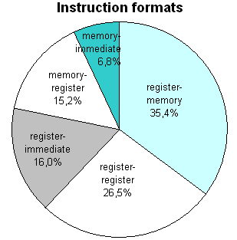
Quantitative Approach to Computer Architecture
Distribution of x86 data access patterns
A lot of memory access
> 35% of instructions read data from memory!
> 20% write data to memory!
The time of any operation is the time to access instruction memory + perform the operation (which can be another memory access)
https://www.strchr.com/x86_machine_code_statistics

Slide 23
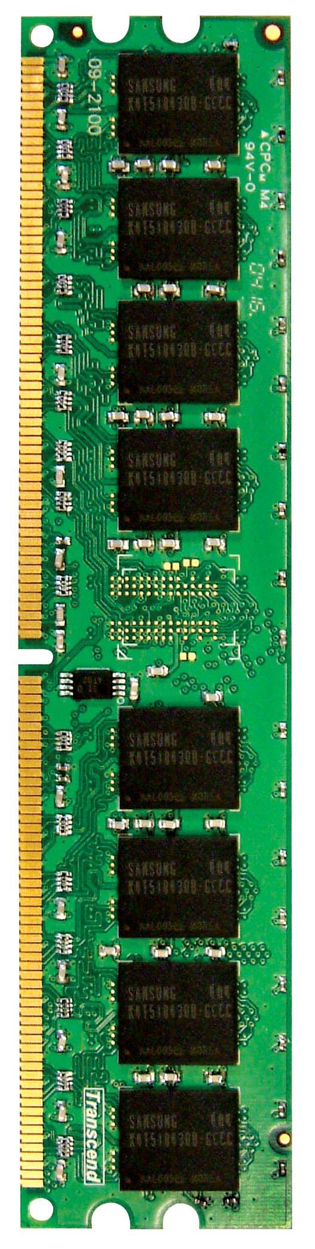
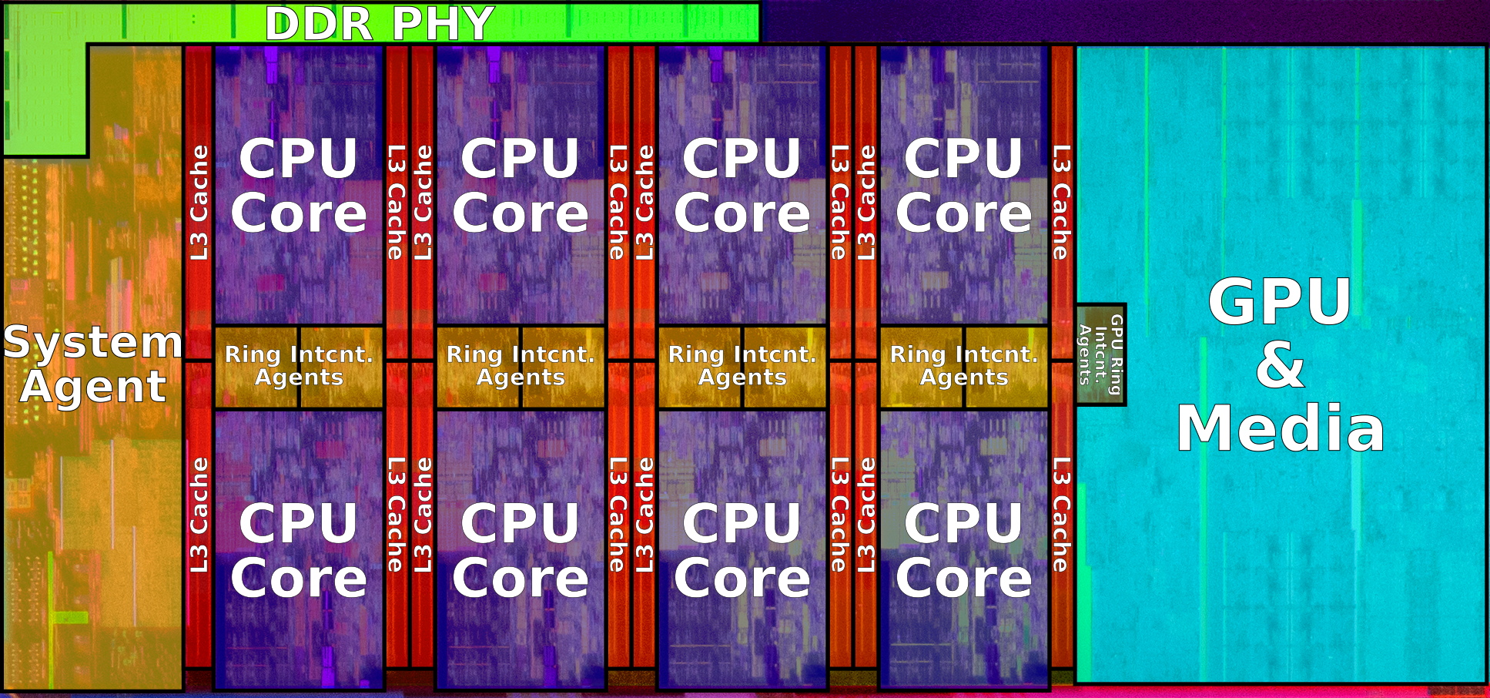
DRAM BANKS
18 Billion Skylake18C Server
CPU Core (incl L1, L2), L3, and DRAM

Slide 24
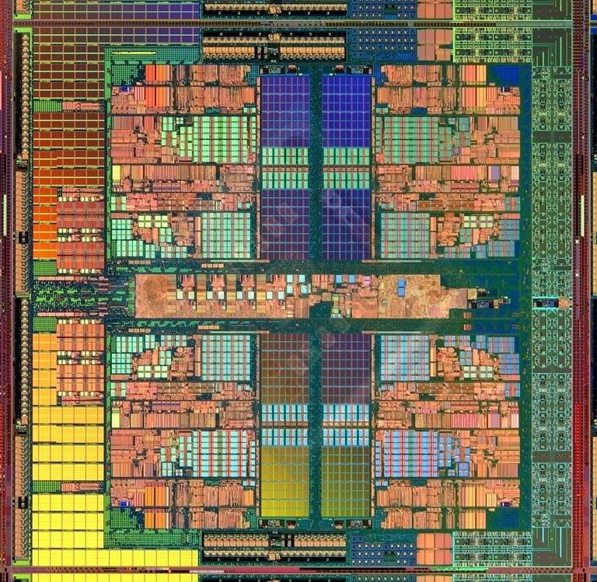
Memory Hierarchy in a Modern System
CORE 0
L2 CACHE 1
CORE 1
L2 CACHE 0
SHARED L3 CACHE
DRAM INTERFACE
DRAM MEMORY CONTROLLER
DRAM BANKS
L2 CACHE 2
CORE 3
CORE 2
L2 CACHE 3

Slide 25
Synthesize (Again)
Fast (more expensive) memories must be small
Large (cheaper) memories must be slow
Therefore, we cannot make all memory fast and we cannot fit all our data in fast memory simultaneously
However…
Programs exhibit locality
Some subset of memory is accessed repeatedly (temporal locality)
Subsequent memory access are likely to be near previous ones (spatial locality)
Therefore…
KEY IDEA: Memory hierarchy

