Slide 1
Machine-Level Programming I: Basics or Introduction to Computer Architecture CS154 Autumn 2019, Prof Chien Lecture 4 Sections 3.1-3.3

Slide 2
Big Picture
Application
Lecture Goals
Define ISA
Motivate the need for an ISA
Understand key instructions and components of an ISA
See examples of different ISAs
Algorithm
Programming Language
Operating System/Virtual Machines
Instruction Set Architecture
Microarchitecture
Register-Transfer Level
Register-Transfer Level
Gates
Circuits
Devices
Physics

Slide 3
Interfaces
insert()
Set_t
A data type is:
state
+
methods
State is data
Methods are operations on data
These methods are the interface for the data object
remove()
contains()

Slide 4
Computer Architecture
imull
Hardware
(Processor + Memory)
The architecture is the
interface
between software and hardware
State - contents of memory
(Note: different architectures may have different kinds of memory)
Methods - change memory
xorl
movl
leal

Slide 5
Example
void swap (int *xp, int *yp)
{
int t0 = *xp;
int t1 = *yp;
*xp = t1;
*yp = t0;
}
Hardware
(Processor + Memory)
swap:
movl (%rdi), %rax
movl (%rsi), %rdx
movl %rdx, (%rdi)
movl %rax, (%rsi)
ret

Slide 6
Compatibility Problem at IBM
In early 1960’s, IBM had 4 incompatible lines of computers!
701 ⇒ 7094
650 ⇒ 7074
702 ⇒ 7080
1401 ⇒ 7010
Each system had its own
Instruction set
I/O system and Secondary Storage:
magnetic tapes, drums and disks
assemblers, compilers, libraries,...
market niche business, scientific, real time, ...

Slide 7
Compatibility Problem at IBM
By early 1960’s, IBM had 4 incompatible lines of computers!
701 ⇒ 7094
650 ⇒ 7074
702 ⇒ 7080
1401 ⇒ 7010
Each system had its own
Instruction set
I/O system and Secondary Storage:
magnetic tapes, drums and disks
assemblers, compilers, libraries,...
market niche business, scientific, real time, ...

Slide 8
Compatibility Problem at IBM
By early 1960’s, IBM had 4 incompatible lines of computers!
701 ⇒ 7094
650 ⇒ 7074
702 ⇒ 7080
1401 ⇒ 7010
Each system had its own
Instruction set
I/O system and Secondary Storage:
magnetic tapes, drums and disks
assemblers, compilers, libraries,...
market niche business, scientific, real time, ...
⇒ IBM 360

Slide 9
IBM 360 : Design Premises Amdahl, Blaauw and Brooks, 1964
The design must lend itself to growth and successor machines
General method for connecting I/O devices
Total performance - answers per month rather than bits per microsecond ◊ programming aids
Simple to assemble systems with redundant I/O devices, memories etc. for fault tolerance
…

Slide 10
IBM 360: A General-Purpose Register (GPR) Machine
Processor State
Memory + registers
16 General-Purpose 32-bit Registers
4 Floating Point 64-bit Registers
A Program Status Word (PSW) -- a special register
PC, Condition codes, Control flags
A 32-bit machine with 24-bit addresses
Data Formats
8-bit bytes, 16-bit half-words, 32-bit words, 64-bit double-words

Slide 11
IBM 360: A General-Purpose Register (GPR) Machine
Processor State
Memory + registers
16 General-Purpose 32-bit Registers
4 Floating Point 64-bit Registers
A Program Status Word (PSW) -- a special register
PC, Condition codes, Control flags
A 32-bit machine with 24-bit addresses
Data Formats
8-bit bytes, 16-bit half-words, 32-bit words, 64-bit double-words
The IBM 360 is why bytes are 8-bits long today!

Slide 12
IBM 360: Initial Implementations
Model 30 . . . Model 70
Storage 8K - 64 KB 256K - 512 KB
Datapath 8-bit 64-bit
Circuit Delay 30 nsec/level 5 nsec/level
Local Store Main Store Transistor Registers
Control Store Read only 1μsec Conventional circuits
IBM 360 instruction set architecture (ISA) completely hid the underlying technological differences between various models.
Milestone: The first true ISA designed as portable hardware-software interface!

Slide 13
IBM 360: Initial Implementations
Model 30 . . . Model 70
Storage 8K - 64 KB 256K - 512 KB
Datapath 8-bit 64-bit
Circuit Delay 30 nsec/level 5 nsec/level
Local Store Main Store Transistor Registers
Control Store Read only 1μsec Conventional circuits
IBM 360 instruction set architecture (ISA) completely hid the underlying technological differences between various models.
Milestone: The first true ISA designed as portable hardware-software interface!
With minor modifications it still survives today!

Slide 14
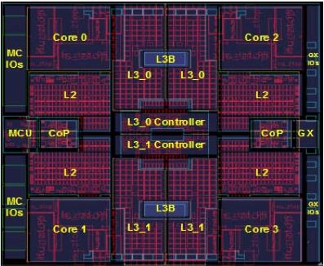
From IBM 360 To The zSeries z11 Microprocessor
5.2 GHz in IBM 45nm PD-SOI CMOS technology
1.4 billion transistors in 512 mm²
64-bit virtual addressing
original S/360 was 24-bit, and S/370 was 31-bit extension
Quad-core design
Three-issue out-of-order superscalar pipeline
Out-of-order memory accesses
Redundant datapaths
every instruction performed in two parallel datapaths and results compared
64KB L1 I-cache, 128KB L1 D-cache on-chip
1.5MB private L2 unified cache per core, on-chip
On-Chip 24MB eDRAM L3 cache
Scales to 96-core multiprocessor with 768MB of shared L4 eDRAM
[ IBM, Kevin Shum, HotChips, 2010]
© International Business Machines Corporation.

Slide 15
Engineering Aside
Architecture design is a tradeoff
On the one hand
Want a compatible line of processors
Don’t want to rewrite all software when new architecture available
On the other hand
Need to maintain interface limits innovation

Slide 16
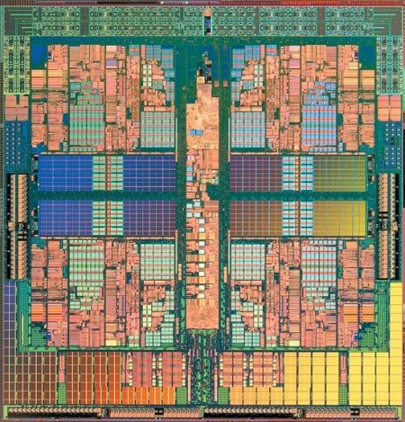
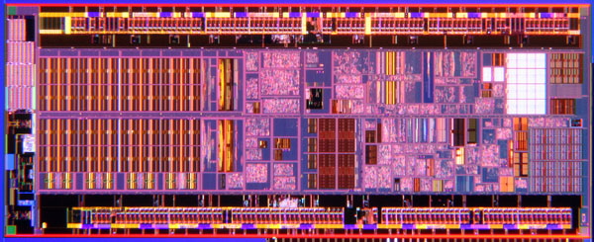
Same Architecture Different Microarchitecture
AMD Phenom X4
Intel Atom
X86 Instruction Set
Quad Core
125W
Decode 3 Instructions/Cycle/Core
64KB L1 I Cache, 64KB L1 D Cache
512KB L2 Cache
Out-of-order
2.6GHz
X86 Instruction Set
Single Core
2W
Decode 2 Instructions/Cycle/Core
32KB L1 I Cache, 24KB L1 D Cache
512KB L2 Cache
In-order
1.6GHz
Image Credit: Intel
Image Credit: AMD

Slide 17
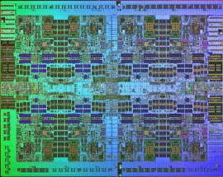
Different Architecture Different Microarchitecture
AMD Phenom X4
IBM POWER7
X86 Instruction Set
Quad Core
125W
Decode 3 Instructions/Cycle/Core
64KB L1 I Cache, 64KB L1 D Cache
512KB L2 Cache
Out-of-order
2.6GHz
Power Instruction Set
Eight Core
200W
Decode 6 Instructions/Cycle/Core
32KB L1 I Cache, 32KB L1 D Cache
256KB L2 Cache
Out-of-order
4.25GHz
Image Credit: IBM
Image Credit: AMD
Courtesy of International Business Machines Corporation, © International Business Machines Corporation.

Slide 18
Let’s Design an Architecture

Slide 19
What Should Our Architecture Do?
Arithmetic and Logical Unit
ALU
What is the smallest number of instructions we have to support?
Does it support all high-level programming languages (e.g., C)?

Slide 20
What Should Our Architecture Do?
sub a, b
Mem[b] = Mem[b] - Mem[a];
Execute next instruction;
ALU
Is this enough?

Slide 21
The Bare Minimum
subleq a, b, c
Mem[b] = Mem[b] - Mem[a];
if (Mem[b] ≤ 0) goto c;
else execute next instruction;
ALU

Slide 22
Example
subleq a, b, c
Mem[b] = Mem[b] - Mem[a];
if (Mem[b] ≤ 0) goto c;
else execute next instruction;
If (a > b)
{
b = a
}
1. subleq x, x, .+1 # set x = 0
2. subleq a, x, .+1 # set x = -a
3. subleq y, y, .+1 # set y = 0
4. subleq x, y, .+1 # set y = a
5. subleq b, y, 10 # set y = a-b, jmp if a-b <= 0
6. subleq z, z, .+1 # set z = 0
7. subleq a, z, .+1 # set z = -a
8. subleq b, b, .+1 # set b = 0
9. subleq z, b, .+1 # set b = -z (a)
10.ret.

Slide 23
Where Do Operands Come from And Where Do Results Go?
ALU
Notes:
By no means all configurations, Memory Memory.
For instance, Hybrid things, and Memory can be destination on some architectures.
This is just the logical abstraction, and by no means is how these things are implemented.

Slide 24
Where Do Operands Come from And Where Do Results Go?
ALU
…
Memory
Notes:
By no means all configurations, Memory Memory.
For instance, Hybrid things, and Memory can be destination on some architectures.
This is just the logical abstraction, and by no means is how these things are implemented.

Slide 25
Where Do Operands Come from And Where Do Results Go?
…
Processor
ALU
…
Memory
Notes:
By no means all configurations, Memory Memory.
For instance, Hybrid things, and Memory can be destination on some architectures.
This is just the logical abstraction, and by no means is how these things are implemented.

Slide 26
Where Do Operands Come from And Where Do Results Go?
Notes:
By no means all configurations, Memory Memory.
For instance, Hybrid things, and Memory can be destination on some architectures.
This is just the logical abstraction, and by no means is how these things are implemented.

Slide 27
Where Do Operands Come from And Where Do Results Go?
Stack
…
TOS
Processor
ALU
…
Memory
Notes:
By no means all configurations, Memory Memory.
For instance, Hybrid things, and Memory can be destination on some architectures.
This is just the logical abstraction, and by no means is how these things are implemented.

Slide 28
Where Do Operands Come from And Where Do Results Go?
Stack
Accumulator
…
TOS
Processor
ALU
Processor
ALU
…
…
Memory
Memory
Notes:
By no means all configurations, Memory Memory.
For instance, Hybrid things, and Memory can be destination on some architectures.
This is just the logical abstraction, and by no means is how these things are implemented.

Slide 29
Where Do Operands Come from And Where Do Results Go?
Register-
Memory
Stack
Accumulator
…
…
TOS
Processor
ALU
Processor
ALU
Processor
ALU
…
…
…
Memory
Memory
Memory
Notes:
By no means all configurations, Memory Memory.
For instance, Hybrid things, and Memory can be destination on some architectures.
This is just the logical abstraction, and by no means is how these things are implemented.

Slide 30
Where Do Operands Come from And Where Do Results Go?
Register-
Memory
Register-
Register
Stack
Accumulator
…
…
…
TOS
Processor
ALU
Processor
ALU
Processor
ALU
Processor
ALU
…
…
…
…
Memory
Memory
Memory
Memory
Notes:
By no means all configurations, Memory Memory.
For instance, Hybrid things, and Memory can be destination on some architectures.
This is just the logical abstraction, and by no means is how these things are implemented.

Slide 31
Where Do Operands Come from And Where Do Results Go?
Register-
Memory
Register-
Register
Stack
Accumulator
…
…
…
TOS
Processor
ALU
Processor
ALU
Processor
ALU
Processor
ALU
…
…
…
…
Memory
Memory
Memory
Memory
Number Explicitly
Named Operands:
0
1
2 or 3
2 or 3
Notes:
By no means all configurations, Memory Memory.
For instance, Hybrid things, and Memory can be destination on some architectures.
This is just the logical abstraction, and by no means is how these things are implemented.

Slide 32
What are states and methods for these architectures?
Register-
Memory
Register-
Register
Stack
Accumulator
…
…
…
TOS
Processor
ALU
Processor
ALU
Processor
ALU
Processor
ALU
…
…
…
…
Memory
Memory
Memory
Memory
Number Explicitly
Named Operands:
0
1
2 or 3
2 or 3
Notes:
By no means all configurations, Memory Memory.
For instance, Hybrid things, and Memory can be destination on some architectures.
This is just the logical abstraction, and by no means is how these things are implemented.

Slide 33
Addressing Modes: How to Get Operands from Memory
Addressing Mode | Instruction | Function
Register | Add R4, R3, R2 | Regs[R4] <- Regs[R3] + Regs[R2] **
Immediate | Add R4, R3, #5 | Regs[R4] <- Regs[R3] + 5 **
Displacement | Add R4, R3, 100(R1) | Regs[R4] <- Regs[R3] + Mem[100 + Regs[R1]]
Register Indirect | Add R4, R3, (R1) | Regs[R4] <- Regs[R3] + Mem[Regs[R1]]
Absolute | Add R4, R3, (0x475) | Regs[R4] <- Regs[R3] + Mem[0x475]
Memory Indirect | Add R4, R3, @(R1) | Regs[R4] <- Regs[R3] + Mem[Mem[R1]]
PC relative | Add R4, R3, 100(PC) | Regs[R4] <- Regs[R3] + Mem[100 + PC]
Scaled | Add R4, R3, 100(R1)[R5] | Regs[R4] <- Regs[R3] + Mem[100 + Regs[R1] + Regs[R5] * 4]
** May not actually access memory!
Notes:
Mention Immediate
Mention 3-register format

Slide 34
ISA Encoding
Fixed Width: Every Instruction has same width
Easy to decode
(RISC Architectures: MIPS, PowerPC, SPARC, ARM…)
Ex: MIPS, every instruction 4-bytes
Variable Length: Instructions can vary in width
Takes less space in memory and caches
(CISC Architectures: IBM 360, x86, Motorola 68k, VAX…)
Ex: x86, instructions 1-byte up to 17-bytes

Slide 35
Real World Instruction Sets
Arch | Type | # Oper | # Mem | Data Size | # Regs | Addr Size | Use
Alpha | Reg-Reg | 3 | 0 | 64-bit | 32 | 64-bit | Workstation
ARM | Reg-Reg | 3 | 0 | 32/64-bit | 16 | 32/64-bit | Cell Phones, Embedded
MIPS | Reg-Reg | 3 | 0 | 32/64-bit | 32 | 32/64-bit | Workstation, Embedded
SPARC | Reg-Reg | 3 | 0 | 32/64-bit | 24-32 | 32/64-bit | Workstation
TI C6000 | Reg-Reg | 3 | 0 | 32-bit | 32 | 32-bit | DSP
IBM 360 | Reg-Mem | 2 | 1 | 32-bit | 16 | 24/31/64 | Mainframe
x86 | Reg-Mem | 2 | 1 | 8/16/32/64-bit | 4/8/24 | 16/32/64 | Personal Computers
VAX | Mem-Mem | 3 | 3 | 32-bit | 16 | 32-bit | Minicomputer
Mot. 68k | Accum. | 1 | 1/2 | 8-bit | 0 | 16-bit | Microcontroller

Slide 36
In summary…
Instruction Must Specify:
What it does (the operation it performs)
Where its operands come from (memory, registers, stack, etc)
Type
Integer or floating point
Sometimes Width
byte, word, double word, etc

Slide 37
Big Picture
Application
Instruction Set Architecture
Interfaces for controlling hardware
Commonly called Architecture
Software cannot directly see anything below this level
Algorithm
Programming Language
Operating System/Virtual Machines
Instruction Set Architecture
Microarchitecture
Register-Transfer Level
Register-Transfer Level
Gates
Circuits
Devices
Physics
Notes:
Bridging Abstractions!

