Slide 1
Course Overview CMSC 15400: Introduction to Computer Systems 1st Lecture
Reading: Chapter 1
Instructors:
Prof. Andrew A. Chien
Prof. Haryadi S. Gunawi

Slide 2
Today, ... Just sit back, relax, and enjoy

Slide 3
What will you learn? Let’s see student evaluation.
“Understanding how computers work. Prior to this it was pretty much magic to me.”
“It was basically all of the things that I wanted to know about how computers work but was too afraid to ask.”
“I feel more comfortable talking about computers and how they work as not just a programmer but also a computer scientist”
“SO MUCH TECHNICAL KNOWLEDGE, AHH - I KNOW MORE ABOUT THE INNER WORKINGS OF COMPUTERS THAN I EVER WANTED ...”

Slide 4
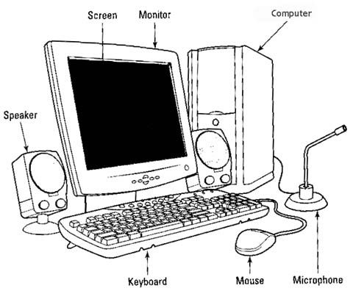
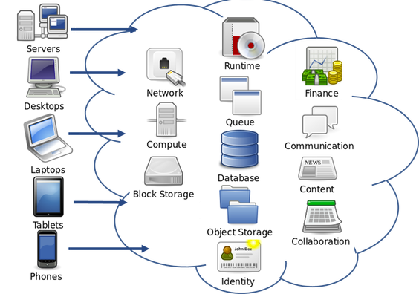
What is a Computer System?
Google image “computer system”
But this is 20 years ago!
Today
Picture from
https://icochat.wordpress.com/2018/01/08/whitepaper-analysis-titanium-blockchain-infrastructure-services/
Notes:
Image appears in Computer Architecture: A Quantitative Approach
http://booksite.mkp.com/9780123838728/figures/PDF/Chapter_01.pdf

Slide 5
What is a Computer System?
Software Application
Notes:
Bridging Abstractions!

Slide 6
What is a Computer System?
Application
Physics
Notes:
Bridging Abstractions!

Slide 7
What is a Computer System?
Application
Gap too large to
bridge in one step
Physics
Notes:
Bridging Abstractions!

Slide 8
What is a Computer System?
Application
In its broadest definition, a computer system is a series of
abstraction/implementation layers
that allow us to execute/process
applications
efficiently using manufacturing
technologies
Gap too large to
bridge in one step
Physics
Notes:
Bridging Abstractions!

Slide 9
Abstractions in Modern Computing Systems
Application
Algorithm
Programming Language
Operating System/Virtual Machines
Instruction Set Architecture
Microarchitecture
Register-Transfer Level
Gates
Circuits
Devices
Physics
Notes:
Bridging Abstractions!

Slide 10
Abstractions in Modern Computing Systems
Application
Algorithm
Programming Language
Operating System/Virtual Machines
Instruction Set Architecture
This class
Microarchitecture
Register-Transfer Level
Gates
Circuits
Devices
Physics
Notes:
Bridging Abstractions!

Slide 11
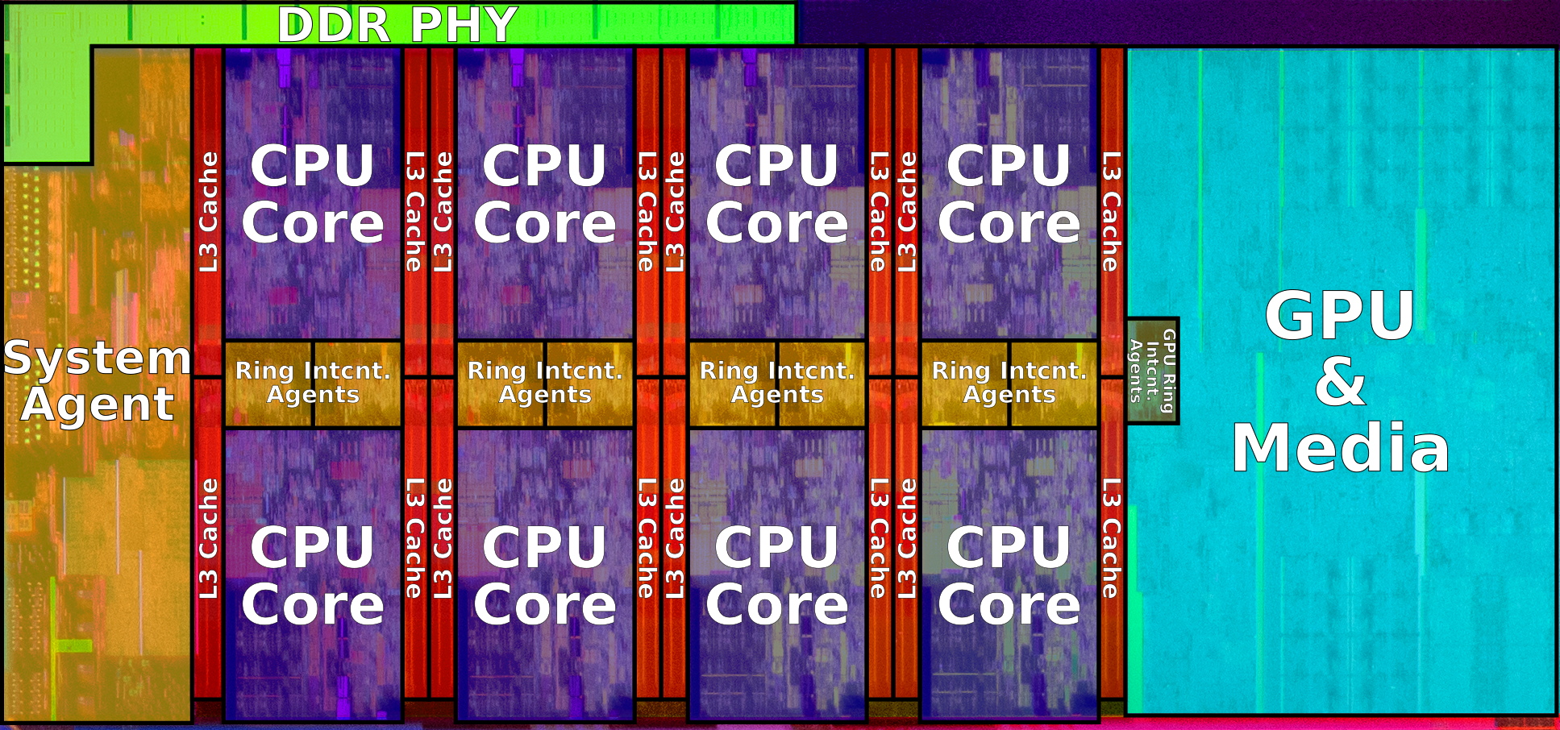
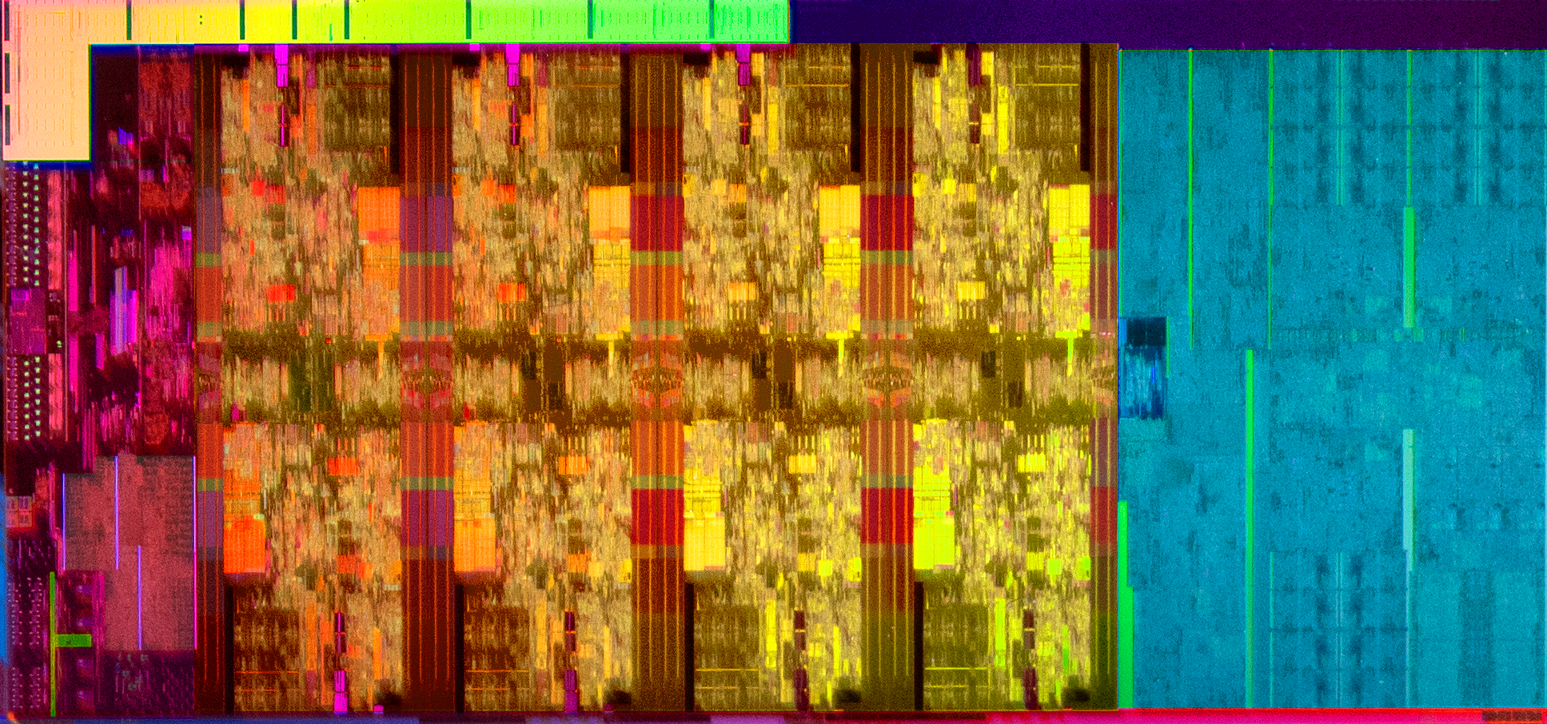
What Are Computer Systems?
3 Billion Transistors
18 Billion Skylake18C Server
Intel Coffee Lake (2019) - 14 nm++ process, 11 metal layers, ~174 mm² die size
8 CPU cores
Notes:
Image appears in Computer Architecture: A Quantitative Approach
http://booksite.mkp.com/9780123838728/figures/PDF/Chapter_01.pdf

Slide 12
Overview
Application
Algorithm
Programming Language
Operating System/Virtual Machines
Instruction Set Architecture
Interfaces for controlling hardware
“Architecture”
Defines what is possible in software
(e.g. int, float, matrix, add, sub, move)
Instruction Set Architecture
Microarchitecture
Register-Transfer Level
Register-Transfer Level
Gates
Circuits
Devices
Physics
Notes:
Bridging Abstractions!

Slide 13
Machine Learning impacts on Computer Architecture
Datatypes
Int32, Int64, FP32, FP64
Operations
Add
Mul
SIMD vmul, vadd
ML inspired datatypes
Bfloat16 (smaller fraction, larger exponent)
Vector
Matrix
ML Operations
8-bit vector, Bfloat16
Vector-vector
Matrix-vector
Cheaper Operations
Easy Parallelism and Locality

Slide 14
Overview
Application
Algorithm
Programming Language
Operating System/Virtual Machines
Instruction Set Architecture
Microarchitecture
Microarchitecture
The ISA implementation. Key to performance, and recently security challenges.
Register-Transfer Level
Register-Transfer Level
Gates
Circuits
Devices
Physics
Notes:
Bridging Abstractions!

Slide 15

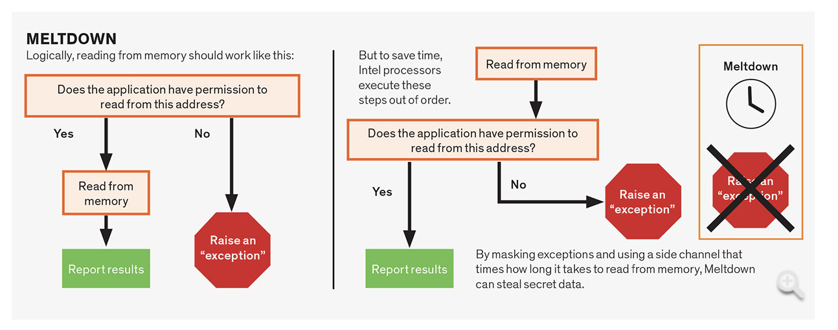
Spectre and Meltdown Attacks
January 2018
Logical (Instruction Set Architecture)
Performance (Microarchitecture)
Problem: Microarchitecture leaks information (performance)
Creates side-channel to access OS protected data
Cost: 8-19% slowdown ($2-3B servers a year?)

Slide 16
Overview
More and more layers and abstractions in each layer
(cs 2xx series)
Application
Algorithm
Programming Language
Operating System/Virtual Machines
Instruction Set Architecture
Microarchitecture
Register-Transfer Level
Register-Transfer Level
Operating System
Interfaces for controlling and coordinating the use of hardware among various applications and users
Gates
Circuits
Devices
Physics
Notes:
Bridging Abstractions!

Slide 17
Goal of the Class
Give you the basis to understand how the OS, Architecture, and Microarchitecture affect the programmer
The book is an excellent technical reference
Not great for big picture
Lectures ...
designed to tie the technical content of book, homeworks, labs, and projects to big picture impact on computer systems

Slide 18
Overview
Course Theme and Roadmap
Logistics
Getting help

Slide 19
154 Site
Website:
Just google “cs154uchicago”, “or 154 chicago”
Just find the google site link
https://sites.google.com/site/cs154uchicago/
READ THE FAQs (A Must!)
https://sites.google.com/site/cs154uchicago/main/course-faqs
Not in class? Change labs? See the FAQs
Four most important links at the top
Calendar/schedule
Homeworks
Projects
Office Hours
(and Piazza, implicitly)

Slide 20
Calendar
Bookmark the link
Check each column
Due dates, reading list,
Lecture Tags
bit
asm
mm
os
mem
sync

Slide 21
Lectures
Vertical division
Prof. Andrew Chien (first half) and Haryadi Gunawi (second half)
Student eval: “The fact that each instructor in the rotation ... is helpful. I think, while their lecture styles differ, all were wonderful teachers”
COME TO LECTURES
“The lectures were for the most part fun and engaging”
“I've loved every lecture (attended them all), and the professors have done an amazing job teaching the material”
“Gunawi went very fast; Haryadi was an OK lecturer; ...”

Slide 22
Projects
5 Projects
Bit manipulation, defusing bombs (asm), cache, your shell, your malloc()
No project partnership (sorry) – not easily partitionable
“a lot of C programming”
“I had several days where I didn't move or eat because I was working on a project”
“I learned a lot about how to better debug code,“ ... “Getting a more precise understanding of the problems in my code that before seemed to be demonic in origin”
“I felt like this course made me more confident than I have ever been in being able to program”

Slide 23
Labs
Optional
“Labs didn't feel super necessary or useful”
“Labs are good to go to. Labs can be super helpful later on.”
Make your choice

Slide 24
Homeworks
9 homeworks
Will remove the worst HW score (top-8 out of 9)
Due every Monday 11:59pm
Homework #X covers Week #X
Please read instructions carefully!! Word by word.
How to hand in, format file name, always run “svn status”, …

Slide 25
Overview
Course Theme and Roadmap
Logistics
Getting help

Slide 26
Help
I need help (HWs, projects, etc.), where should I go?
Piazza
We guarantee a fast response (30 min average response time)
If not, re-post – we actively monitor this
TAG your post properly (e.g., “hw1”, “p1”)
Office hours
10 hours/week for homeworks
40+ hours/week for projects
Do NOT send emails to individual faculty/TAs
(unless necessary)
Vertical division of TA duties
TA | Duties
1. Nan | Proj 1
2. Dan | Proj 2
3. Meng | Proj 3
4. Xin | Proj 4
5. Will | Proj 5
6. Mingzhe | Homeworks

Slide 27
Why vertical TA management?
A TA’s life: 15 hours/week
Old way:
Do P1
Off. Hours P1
Do P2
Off. Hours P2
Do P3
Off. Hours P3
Do P4
Off. Hours P4
Too much overhead that does NOT benefit students
Do Px
Off. Hours Px
Newway:
We can serve you better!

Slide 28
Help, Help, Help!!! ... START EARLY
“Deadline is less than 24 hr, but I’m not getting enough help.”
We’ll try our best, but … please start early!
We cannot help 100+ students who start late
How to ask for help?
Use Details -- “it doesn’t work” vs “I tried X, but got Y, then tried Z …”
Help us help you -- svn commit code so far, so we can check it out
Keep trying -- we will try to put you on the right path
[Note: no feedback after projects submitted]
The best way to get feedback is in office hours

Slide 29
Academic misconduct
Well … don’t cheat!
We run a very smart code comparator tool
We’ve discovered code duplications before [almost every year!]
Involve department and university level, and potentially a Fail
Don’t ruin your good reputation
Start early, go to office hours

Slide 30
No exception!
“I need to pass this course (for my graduation, major requirement, making my parents happy, etc.), but I get a C ...
... can I do extra work to get to B?”
We’re really sorry, but no ...
You have 10 weeks … 2 exams, 5 projects, 9 homeworks
Many opportunities to improve your grade

Slide 31
Where to go? (recap)
if (projects)
Piazza or office hours, Proj #X → TA #X
else if (homeworks)
Piazza or Ash’s office hours (tag “hX”)
else if (lectures / exams)
Piazza
Or meet (email / open door)
else
// life, inspiration, issues with class
Email/meet the instructors

Slide 32
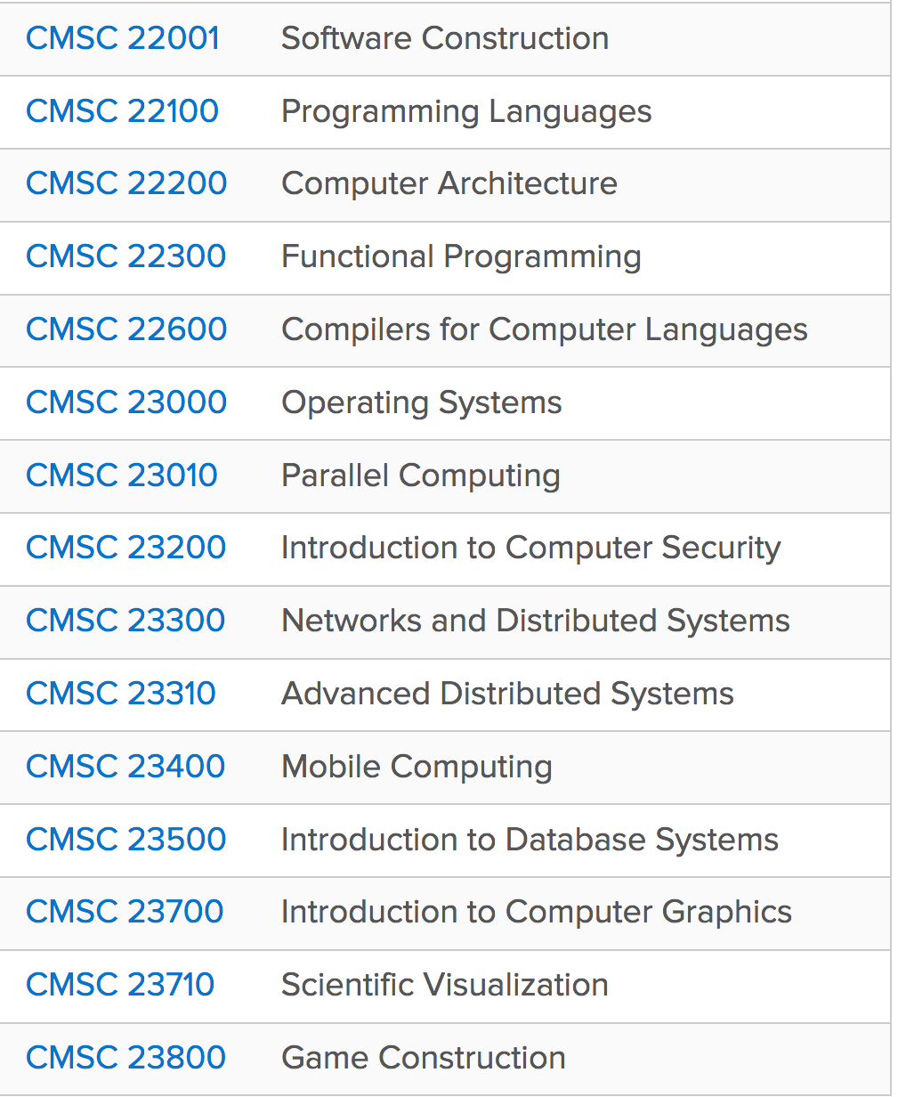
“SO MUCH TECHNICAL KNOWLEDGE, AHH - ...
... BUT IT ONLY GETS DEEPER FROM HERE.”
154 is the last gateway to all other systems classes
http://collegecatalog.uchicago.edu/thecollege/computerscience/

Slide 33
Conclusion (again from student evaluation)
“151 is somewhat challenging, 152 is easy, and then 154 is brutal ...
... but don't worry - don't be afraid to ask for help and start projects early!”
“this class will push you and try to set you up for defeat, ...
so one has to be disciplined, go into every project, hw, or [and] exam with a gameplan and a thorough understanding of the material.”
But don’t worry to much, just show your efforts and enjoy learning
Why? We’re quite generous (I think)
“I'm surprised I am in the B range, I thought I'm failing and was ready to drop the course”
Only less than 5% get Cs

Slide 34
Today ... Just sit back and relax Tomorrow ... get ready! Questions?
“Difficult but rewarding would sum up this course”

Slide 35
EXTRAs [old stuffs, might not be accurate]

Slide 36
END END END END
(All slides after this are old slides, not updated)

Slide 37
Add/Drop and joining late
Last day to Add/Drop is 2 weeks from this Friday
Will have had 2 homeworks and 1 project due by then, so you’ll have a sense if this class makes sense
Projects will have grading scripts you can run
If you are not registered for the class now, or if you join the class late, it is your responsibility to complete the work due to date

Slide 38
Pink slipping OR switching lab (“activity”) section
Margaret Jaffey in Ry 156 (margaret@cs.uchicago.edu) will handle pink slipping into the class, and changes in lab (“activity”) registration with the registrar
Tell her all the detailed information about you including your majors, minors, standing (senior/junior/sophomore), and all possible lab sections that work with your schedule
Do this preferably before 5pm on Monday 3/30, the earlier the better
Wait for Margaret’s email in the next couple of days.
There is no guarantee that you will get a lab. If Margaret cannot find a lab for you, then unfortunately you can’t take the class.

Slide 39
How to hand work in: svn
http://www.classes.cs.uchicago.edu/archive/2015/spring/15400/svn
We use svn to give files to you, and to get files from you
The only paper is for the two exams
You have an svn repo created for you for this class
CNETID-cs154-2015
Do you know your CNetID? (It is not a 6-digit number)
You need to read email you get at CNetID@uchicago.edu
Its your responsibility to make sure your work is handed in, uncorrupted, and legible
For homeworks (and exams): you work alone
For projects: you can choose to work solo or in a pair
Can create pairs at https://work-groups.cs.uchicago.edu

Slide 40
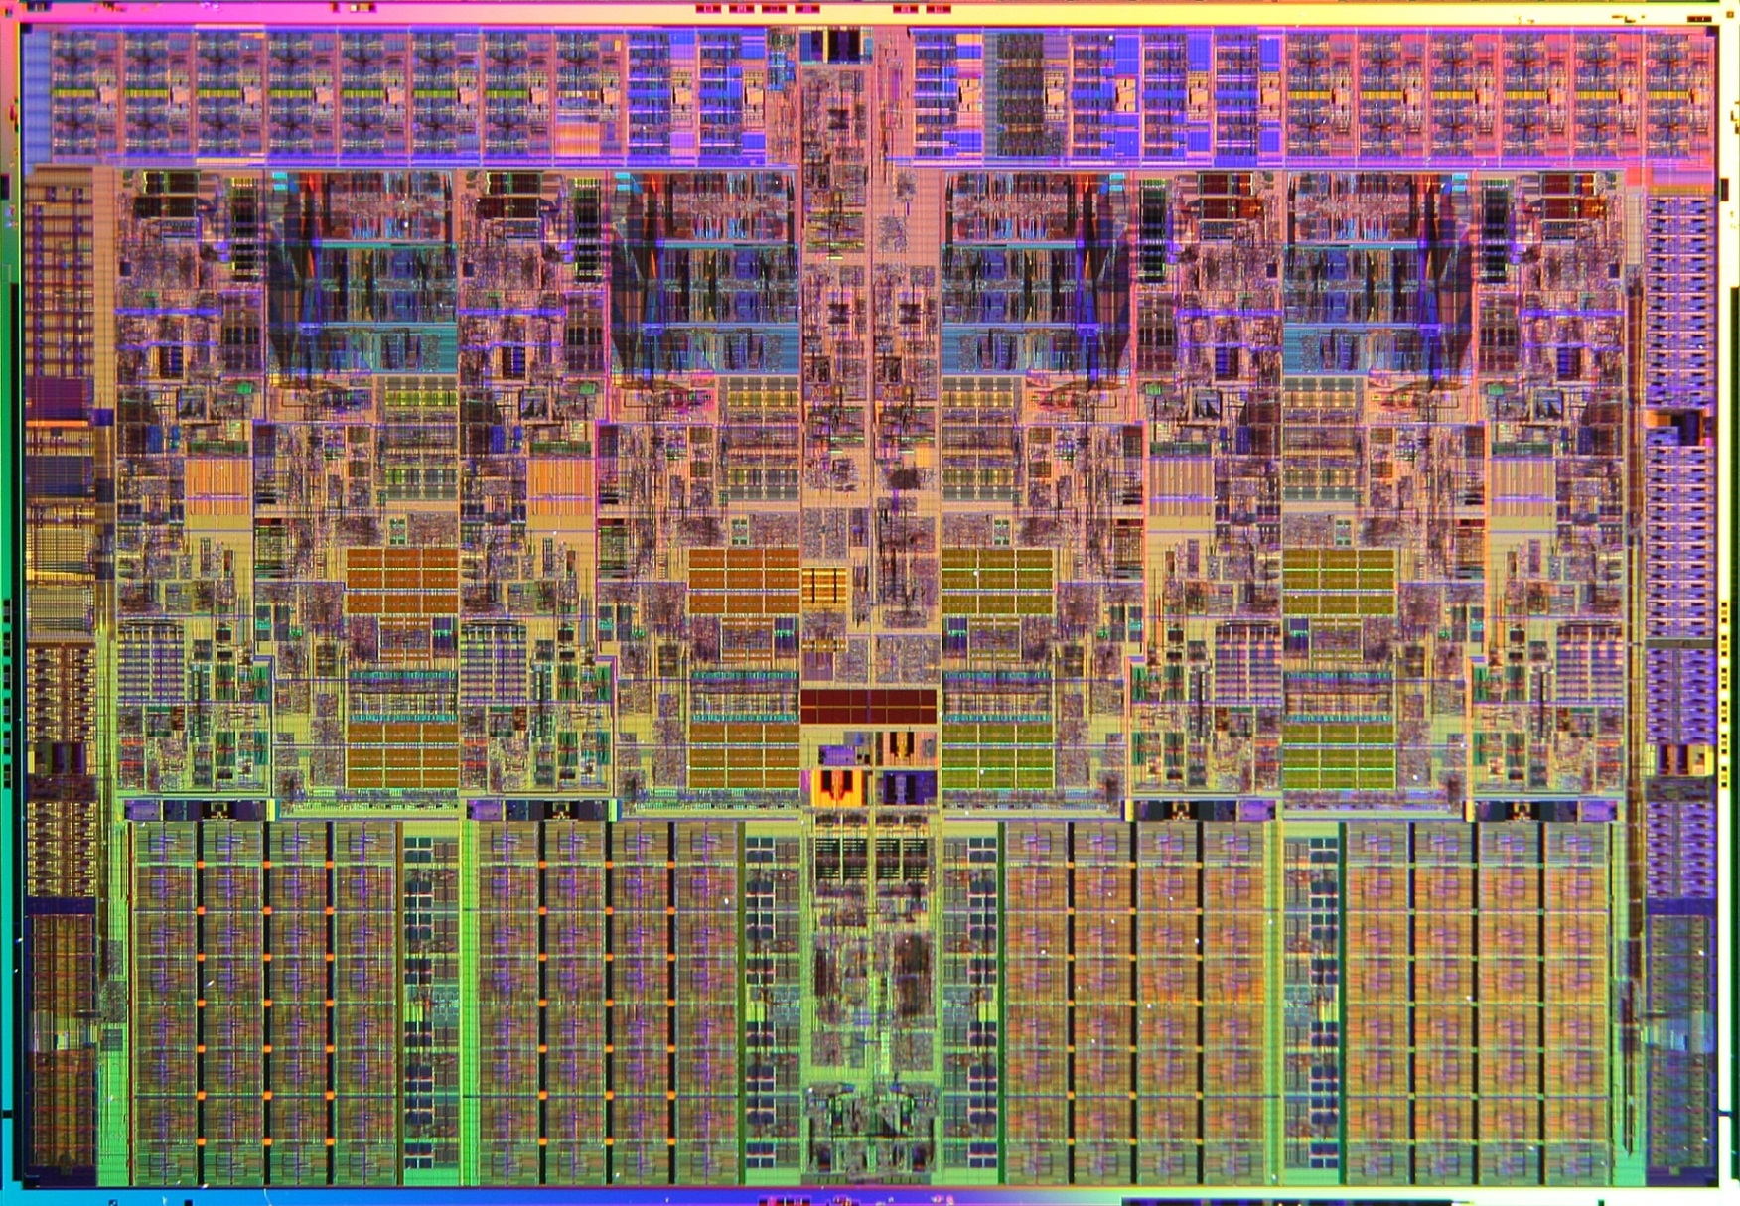
What Are Computer Systems?
~700,000,000 Transistors
Intel Nehalem Processor, Original Core i7, Image Credit Intel:
http://download.intel.com/pressroom/kits/corei7/images/Nehalem_Die_Shot_3.jpg
Notes:
Image appears in Computer Architecture: A Quantitative Approach
http://booksite.mkp.com/9780123838728/figures/PDF/Chapter_01.pdf

Slide 41
Computer Systems are Constantly Changing
Application
Application Requirements:
Suggest how to improve architecture
Provide revenue to fund development
Algorithm
Programming Language
Operating System/Virtual Machines
Instruction Set Architecture
Systems researchers and developers provide feedback that guides application and technology research directions
Microarchitecture
Register-Transfer Level
Register-Transfer Level
Gates
Circuits
Technology Constraints:
Restrict what can be done efficiently
New technologies make new systems possible
Devices
Physics
Notes:
Bridging Abstractions!

