Slide 1
Object Adapter Pattern
Wilm Kranz
January 2019

Slide 2
What is an object adapter?
An adapter allows you to convert the interface of an existing class [adaptee] into the desired interface [target]

Slide 3
The Kindergarten Description
Adaptee
Target
At a high level describe the three important parts of an object adapter
Adaptee class – existing code with incompatible interface, don’t want to change it
Target interface – desired interface of the
Adapter class – new class that will allow the adaptee to connect to target interface
Best to show with high level example that everyone will recognize
These two clearly don’t fit!!!
Existing interface is square
Desired interface is
circular

Slide 4
The Kindergarten Description
Adaptee
Adapter
Target
At a high level describe the three important parts of an object adapter
Adaptee class – existing code with incompatible interface, don’t want to change it
Target interface – desired interface of the
Adapter class – new class that will allow the adaptee to connect to target interface
Best to show with high level example that everyone will recognize
Voila!

Slide 5
When do you want to use an object adapter?
Use an object adapter when you want to:
Use an existing class with an interface that does not match your target interface
Create a reusable class that can interface with many classes that don’t have compatible interfaces
Adapt the interface of several existing subclasses
[only object adapter – NOT class adapter]

Slide 6
Object vs. Class Adapter – What’s the difference?
Object adapter
Class adapter
The object adapter implements the target interface by delegating to an adaptee object at run-time
The class adapter implements the target interface by inheriting from an adaptee class at compile-time
Uses composition
Can wrap classes or interfaces since it wraps the class the class or interface object instance
Uses inheritance
Can only wrap classes since it must be derived from some base class

Slide 7
So which one should I use? It depends...
Object-Oriented Programing (OOP) has too well known candidates for the reuse of functionality: Inheritance (whitebox reuse) and Composition (blackbox reuse). If you try to reuse code by inheriing from a class you will make the subclass dependent on the parent class. This makes a system in many cases unnecessarily complex, less testable and makes the exchange of functionality at run time unnecessarily hard. As a [Clean Code Developer] you should follow the Liskov Substitution Principle (LSP) when you need to decide if inheritance is appropriate.
Composition means that one class uses another. You will further promote decoupling by defining the interfaces clearly. That will also give you the advantage that implementations can be easily replaced. So before you start applying the Liskov Substitution pronciple, think about the Favour Composition over Inheritance concept and ask yourselve why you shouldn't prefer composition right away.
"Because inheritance exposes a subclass to details of its parent's implementation, it's often said that 'inheritance breaks encapsulation'". (Gang of Four 1995:19)
Object adapter
Class adapter
Adapter an work with many Adaptees (Adaptee + its subclasses)
Adapter can add functionality to all Adaptees at once
Adapter cannot easily override Adaptee behavior
Adapter can override some Adaptee behavior
Simplicity – introduces only one object
Adapter commits to specific Adaptee class
+
+
+
+
-
-

Slide 8
Implementation example setup
The example is simple…
We have an Adaptee class which does the following:
Gets the current date using datetime module
Outputs date in American format – Month/Day/Year
However, our Target interface requires the current date in European format
Since we can’t (don’t want to) change the Adaptee, we create an Adapter to automatically convert the date format from American to European

Slide 9
Details of Object Adapter including UML diagram
Client
Target (interface)
Adaptee
OperationX()
OperationY()
adaptee
Adapter
OperationX()
Adaptee.OperationY()

Slide 10
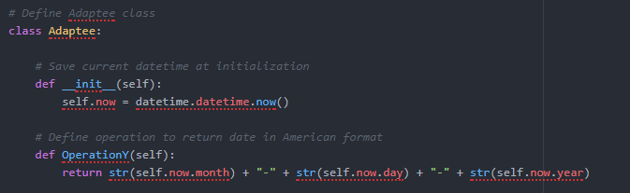

The Adaptee Class

Slide 11
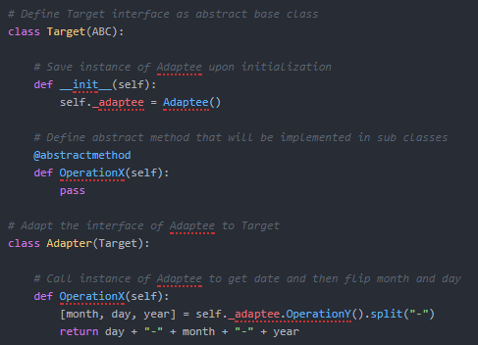
The Target and Adapter classes

Slide 12
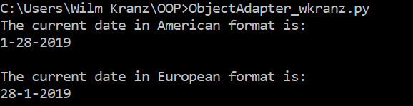
The end result – simple and effective!
In conclusion, object adapters:
Allow you to convert an incompatible interface [of an adaptee] to a desired target interface
Use composition i.e. delegate to adaptee object at run-time
Are generally better when working with many adaptees (& adding functionality)

Slide 13
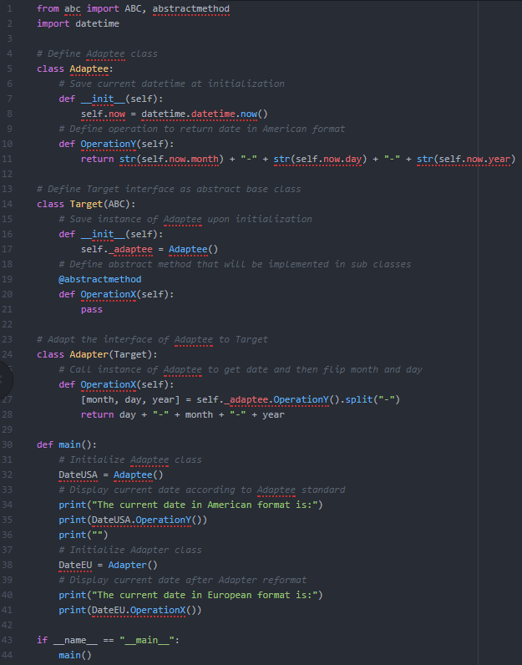
Full python code for reference

Slide 14
Sources
Gamma, Erich. Design Patterns (Addison-Wesley Professional Computing Series) . Pearson Education. Kindle Edition.
https://stackoverflow.com/questions/9978477/difference-between-object-adapter-pattern-and-class-adapter-pattern
https://en.wikipedia.org/wiki/Adapter_pattern
https://sourcemaking.com/design_patterns/adapter
https://www.geeksforgeeks.org/adapter-pattern/

