Slide 1
Users: Affordances and Interfaces

Slide 2
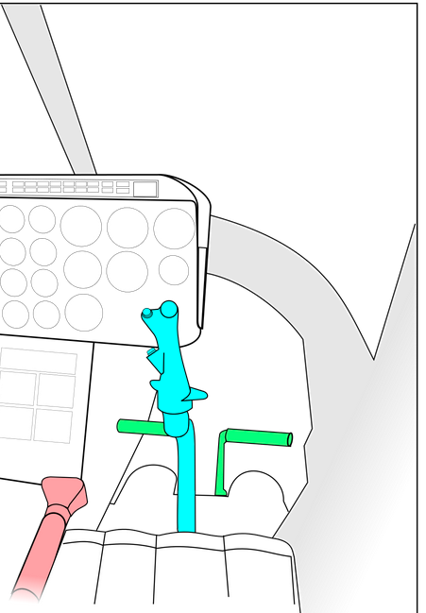
Helicopter Controls

Slide 3
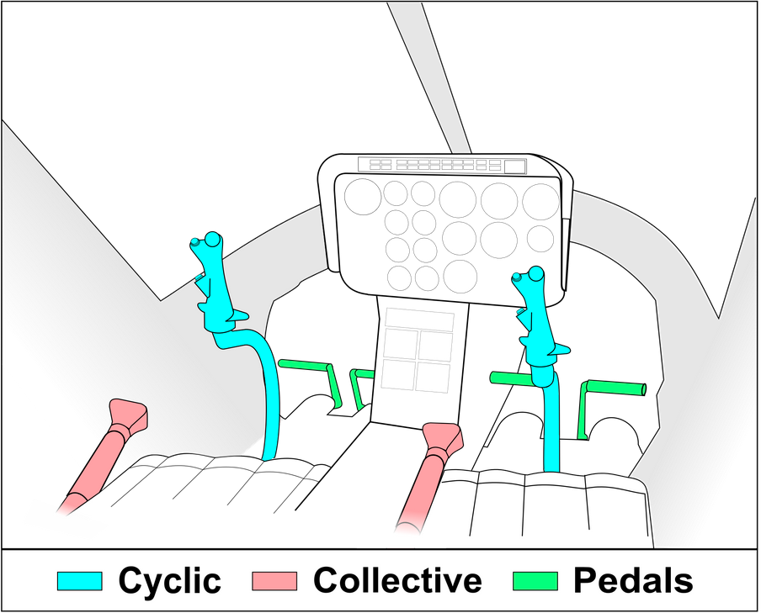
Helicopter Controls

Slide 4
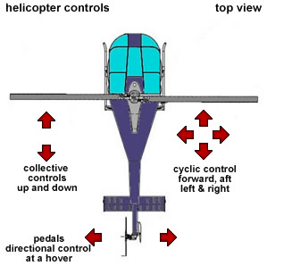
Helicopter Controls

Slide 5
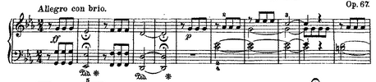
Blind Spots: Novices vs Experts
https://www.youtube.com/watch?v=_4IRMYuE1hI
Notes:
Look at this piece of music for a moment. Some of you in this audiense can read music. Think quietly and see if you can figure out what song this is.
Alright, for the rest of you, let me play this for you, and you can see what it is.
Now let’s take a look at this musical notation. For those who could correctly guess what song it is, it’s probably very difficult for you to judge what aspects of musical notation are easy vs hard. I don’t even remember a time I didn’t know how to read music. Look at the elements – the key signature on the left, the different types of notes, the weird rest symbols, the words at the top, the letters in the music, Led, asterisks, numbers below or on top of some notes, some notes tied together. There is a lot of information there. Maybe there is a simpler way to depict music (Guitar Hero found one!).

Slide 6
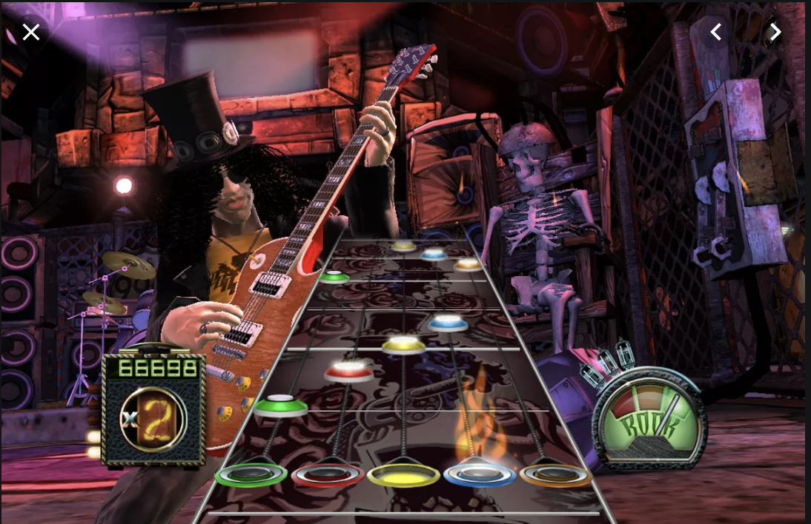
Guitar Hero Musical Notation

Slide 7
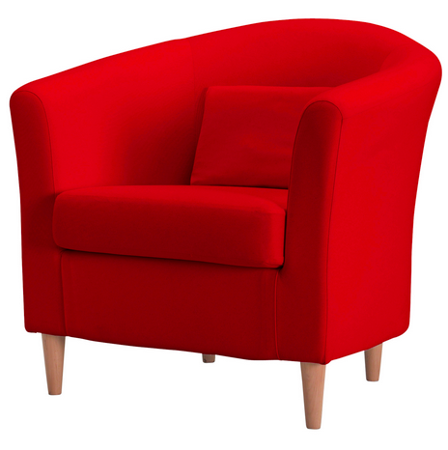
Affordances
Ecological Perspective: Interaction between the user and the object.
Types of Affordances:
Perceived
False
Hidden
Notes:
Gaver:
Perceived affordance – to the person who sits down in it to enjoy a relaxing cup of tea
False affordance – to me, who sits down and realizes my feet don’t touch the floor, my back doesn’t reach the back. My neck and knees are crying out, why did you think this was a seat for you?!?
Hidden affodance – my daughter comes over, scoots it over to the counter, climbs up, and steals a cookie from the cookie jar. What is a perceived affordance to her (stepstool) is a hidden affordance to me.

Slide 8
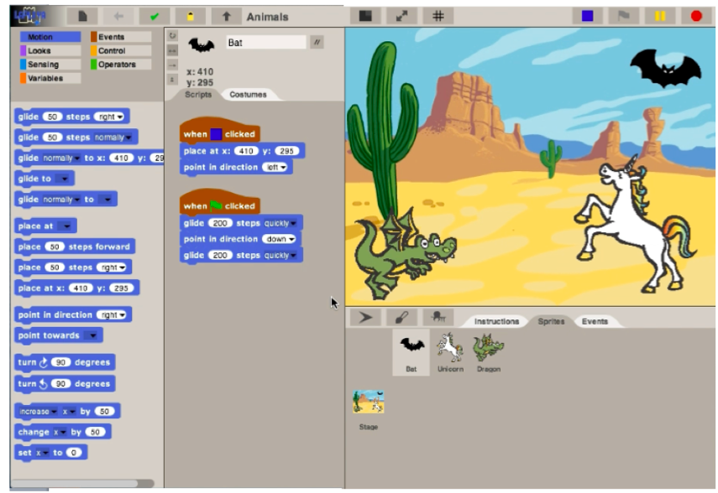
Visual Block-based Environment
Designed for young children
Notes:
I think it is reasonable to conclude that you all know what visual block-based programs are. In this talk, we will focus on the user interface of those environments. VBBL’s have been revolutionary in simplifying some aspects of programming for kids – most notably changing the commands, type of data, and the drag and drop interface. We seek to understand whether it has gone far enough – are there more simplifications for different age groups? How do students use the interface?

Slide 9
How could we evaluate Scratch?

Slide 10
How could we evaluate Scratch?
Analyze all requirements for language and interface
Do user studies with target age students
Do user studies with students of different backgrounds

Slide 11
Visual Block-based Environment
What was simplified?
What was not simplified?
Language & Interface
Notes:
I think it is reasonable to conclude that you all know what visual block-based programs are. In this talk, we will focus on the user interface of those environments. VBBL’s have been revolutionary in simplifying some aspects of programming for kids – most notably changing the commands, type of data, and the drag and drop interface. We seek to understand whether it has gone far enough – are there more simplifications for different age groups? How do students use the interface?

Slide 12
Look at Scratch
Fill out handout

Slide 13
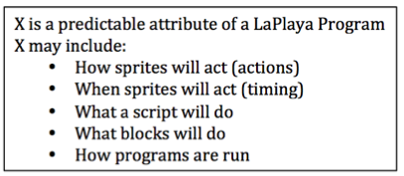
Analysis: 1st rounds
Analyze full transcripts (3 activities), perform Spradley analysis

Slide 14
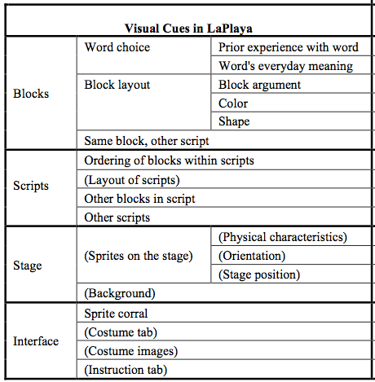
Analysis: 2nd round
Spradley Analysis: Z is a tool for predicting X
theoretical analysis + transcripts / videos
Notes:
We used a combination of transcripts, theoretical analysis of UI itself, and

Slide 15
Analysis: 3rd round
Introductory project only, focus on affordances
Ecological Perspective: Interaction between the user and the object.
Notes:
Gaver:
Perceived affordance – to the person who sits down in it to enjoy a relaxing cup of tea
False affordance – to me, who sits down and realizes my feet don’t touch the floor, my back doesn’t reach the back. My neck and knees are crying out, why did you think this was a seat for you?!?
Hidden affodance – my daughter comes over, scoots it over to the counter, climbs up, and steals a cookie from the cookie jar. What is a perceived affordance to her (stepstool) is a hidden affordance to me.

Slide 16
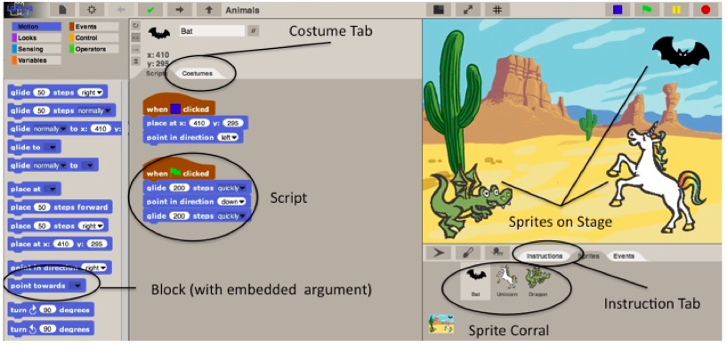
Notes:
Gaver further broke down affordances into three categories.
The color of a block gives information
Perceptible affordance: child noticed and understood
Hidden affordance: child did not notice or did not realize the meaning
False affordance: child thought the position of the script on the canvas determined the order

Slide 17
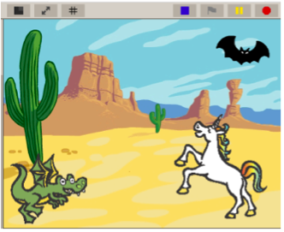
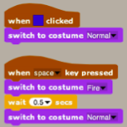
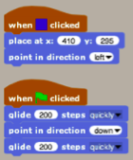
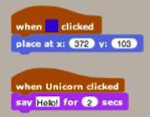

Slide 18
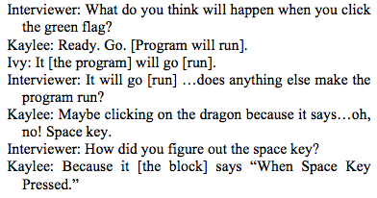
Perceptible Affordance
The words contained in the block (command + argument(s))
The sprite icons to go to other sprites’ scripts

Slide 19
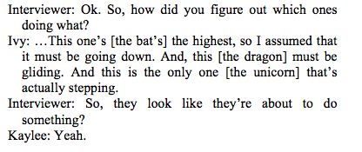
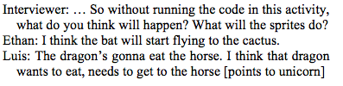
False Affordance
Sprites on the stage

Slide 20
Bonus: Hidden Affordance
For ELL students, they read but sometimes do not comprehend blocks in script
By the time they read all of the words in a block, they forget the first ones
By the time they get through multiple blocks, they do not remember the earlier blocks
Interferes with both block and script understanding

Slide 21
Bonus: False Affordance
One pair might have thought the position on the canvas influenced the order in which scripts ran

Slide 22
Conclusions
Methodical way of analyzing the interfaces, and how students use them
Initial data that shows some interesting perceptible, hidden, and false affordances
Talk-alouds are challenging at this age
Hidden affordances particularly difficult to find
Supported by NSF 1240985

Slide 23
Project partners
Fill out mythical user for your project

