Slide 1
Computers for Learning CMSC 209
Prof. Diana Franklin

Slide 2
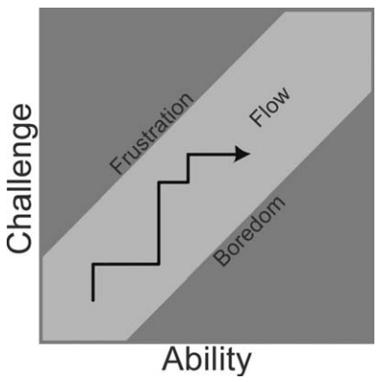
Challenge & Engagement

Slide 3
Important elements to flow

Slide 4
Important elements to flow
Challenge, requires skill
Clear goals & feedback
Concentration
Loss of self-consciousness
Journey, not destination
Time flies
Paradox of control

Slide 5
Types of players
Competitor – wants to beat others
Explorer – curious, adventurous
Collector – acquire/organize items, knowledge,
Achiever – get higher levels
Joker – play for fun / social reasons
Artist – creativity, creation, design
Director – loves to be in charge, direct play
Storyteller – create or live in fantasy worlds
Performer – put on a show for others
Craftsman – build, craft, puzzle things out

Slide 6
What type of player are you?
Competitor – wants to beat others
Explorer – curious, adventurous
Collector – acquire/organize items, knowledge,
Achiever – get higher levels
Joker – play for fun / social reasons
Artist – creativity, creation, design
Director – loves to be in charge, direct play
Storyteller – create or live in fantasy worlds
Performer – put on a show for others
Craftsman – build, craft, puzzle things out

Slide 7
Group Design Exercises
Digital Logic game
Premise / Backstory
Motivation
Elements to “make it real”

Slide 8
Group Design Exercises
Quantum Computing Operations
Premise / Backstory
Motivation
Elements to “make it real”

Slide 9
Learning within Games
Monopoly
Monopoly Jr
Choose whether or not to buy property when land on it
Everything costs M60-M400
Properties, chance, railroads, utilities
10 spots corner-to-corner
2 dice
Monopoly: Double rent, buy houses / hotels
Income tax: 2% of holdings
mortgaging, selling properties
Buy property when land on it
Everything costs M1 - M5
Only properties, chance, jail
6 spots corner-to-corner
1 die
Monopoly: double rent
No income tax
No mortgaging, selling properties

Slide 10
Skill differences
Monopoly Jr
Monopoly Jr
Losing choice of property to land on
Lower costs
No railroads, utilities
fewer spots corner-to-corner
1 die
Monopoly: Double rent
No mortgaging, selling properties
No income tax

Slide 11
Skill differences
Monopoly Jr
Monopoly Jr
Losing choice of property to land on
No mortgaging, selling properties
Lower costs
No railroads, utilities
fewer spots corner-to-corner
1 di3
Monopoly: Double rent
No income tax
Fewer choices
always buy if can
no mortgaging, selling
Math
fewer spots, 1 die – no addition
double rent – practicing doubling, early skill
tax – no percentages, multiplication
utilities – less complexity

Slide 12

Inauthentic Integration: Prodigy

Slide 13
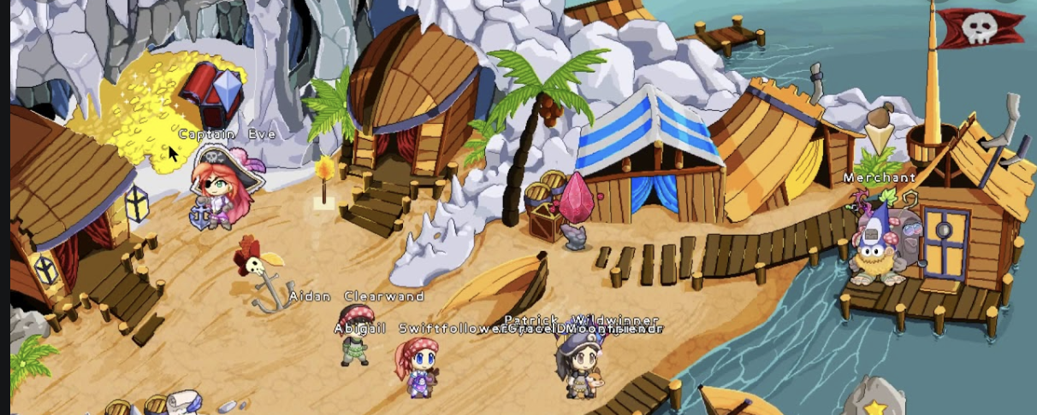
Inauthentic Integration: Prodigy

Slide 14
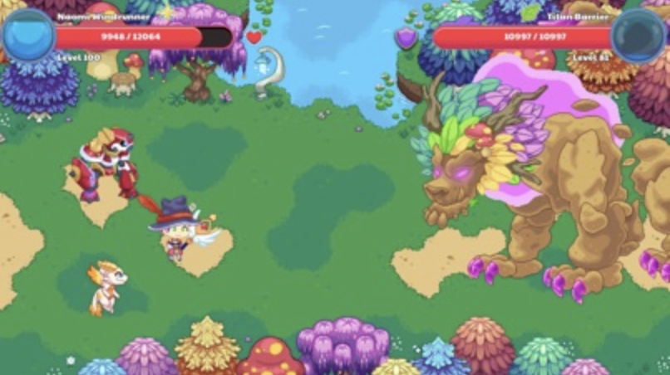
Inauthentic Integration: Prodigy

Slide 15
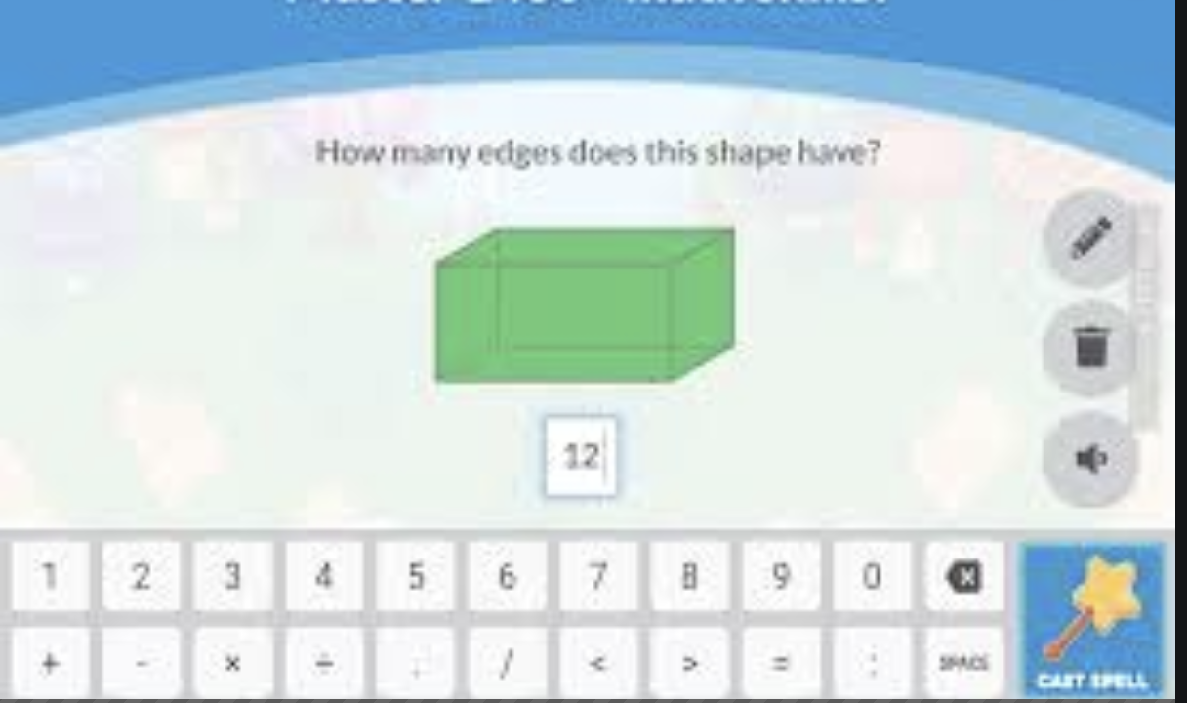
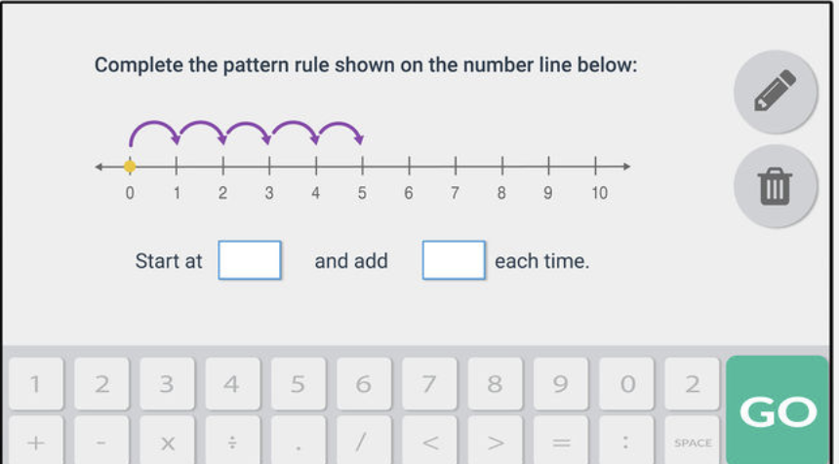
Inauthentic Integration: Prodigy

Slide 16
Analysis
Positives
Negatives

Slide 17
Analysis
Positives
Negatives
Good story
Rich graphics
Modifies questions based on student accuracy
Reason for math questions not motivated well

Slide 18
Design in teams
Phase 1: Free-flow brainstorm
Free flow of ideas
No criticism
Phase 2: Refinement
Identify what you like about each phase 1 idea
Extend brainstorm by taking those identified elements and morphing them
Phase 3: Filter
Take groups of 4 ideas and remove the one you like the least. Continue until you are down to a few ideas.
Continue refining as you work if you wish.

Slide 19
Get in project pairs
Brainstorm
Decide on the general subject, age group for Learning Content assignment
Ideas on the premise and general game type
just want a starting point
Report out on what you have decided

Slide 20
What will you start with?
User?
Storyline?
Type of game?

