Slide 1
Constructionism &
Learning Trajectories
Prof. Diana Franklin

Slide 2
Constructionism: Critical Elements beyond Constructivism

Slide 3
Constructionism: Critical Elements beyond Constructivism
Creating an artifact
Self directed
Public sharing

Slide 4
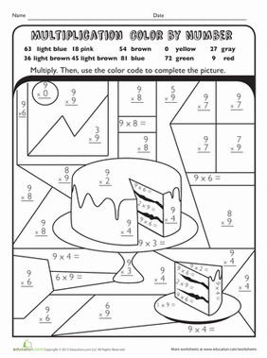
Counteracting this view:

Slide 5

Constructionism:

Slide 6
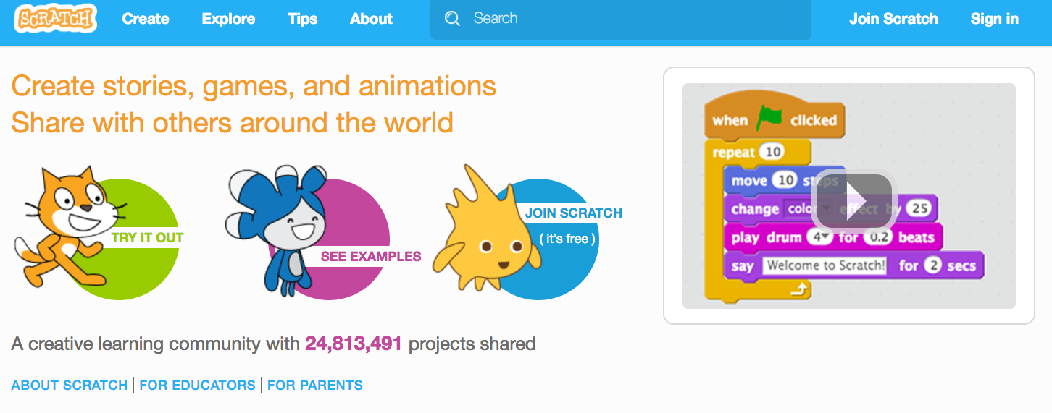
scratch.mit.edu

Slide 7
Motivation for Learning
How many have “gears-like” experiences?
  Something that drove you to learn beyond requirements of school
How many learn in structured environments?
  What structures motivate you?

Slide 8
Guided Reciprocal Peer Questioning
No groups larger than 3
Share your “gear” story with your group or, if none, what motivates you with structured learning: 6 min
Each person generates two or three thought-provoking questions about the material: 5 min
Share out: 5 min

Slide 9
Rewards
Praise
Grades
Long-term goals
Confidence and how people perceive you
“looking smart”
knowing everything/more about that subject
Being able to build something with the knowledge
Higher salary
Role model
Fun/Entertainment if you’re bored
Competition

Slide 10
Negative motivators
Fear of poverty
Fear of failure and disappointment

Slide 11
Making a gears experience
Can you “force” or “ensure” that every child has a gears experience
  If people succeed without it, does everyone need it?
  How do you force something that is, at its heart, internally motivated
Removing barriers
  Providing lots of subjects they can get obsessed about and the tools to explore them

Slide 12
Generic Questions
What students respond to ….
What barriers are there to learning with ….
How can teachers / apps encourage learning with …

Slide 13
Constructionism Discussion
What were the most effective constructionist techniques you learned about?
What made those techniques successful?

Slide 14
Constructionism vs
Constructivism vs Active Learning
Constructionism is more narrow, specific
  Assumes constructivism is true
  Layers on motivational factors
Leads to very specific types of activities that are in the realm of active learning

Slide 15
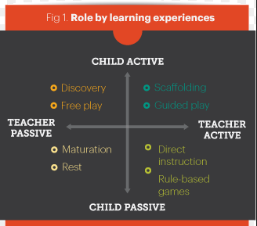

Slide 16

What is a Learning Trajectory?
A learning trajectory is a path from students’
existing knowledge to some particular learning goal.
One useful way to conceptualize an LT is to think of it as having three components¹:
  An overarching learning goal;
  A partially ordered list of waypoints that suggest a pathway to the learning goal; and
  A set of learning activities that help students move along the path.

Slide 17
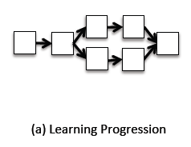
How does theory influence Learning Trajectory shape?

Slide 18
Pieces of Knowledge
What factors influence order in which knowledge is learned?
How is Pieces of Knowledge different from prior views of Learning Progressions?

Slide 19
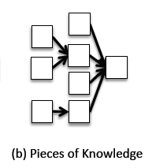
How does theory influence Learning Trajectory shape?

Slide 20
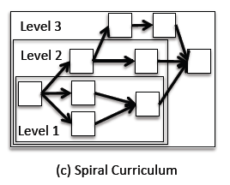
How does theory influence Learning Trajectory shape?

Slide 21
Spiral Curriculum – 3 key aspects

Slide 22
Spiral Curriculum – 3 key aspects
Same concepts revisited
Revisited in more depth
Connections made to previous visit

Slide 23
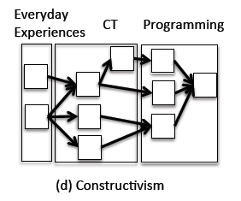
How does theory influence Learning Trajectory shape?

Slide 24
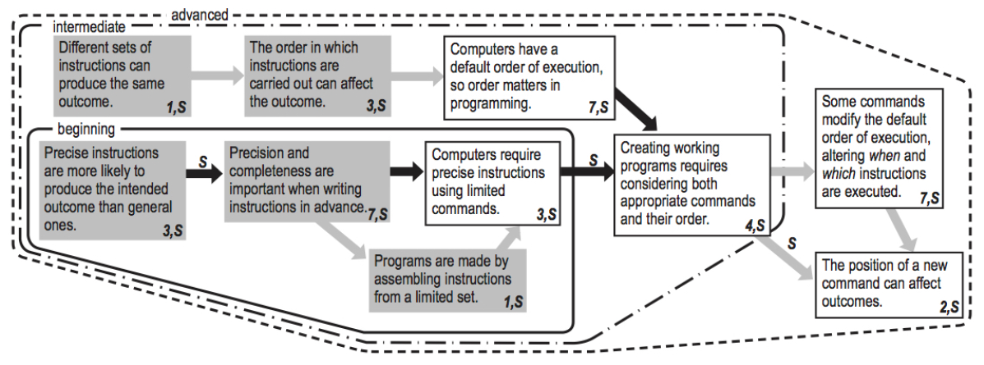
Results: Sequence Trajectory
Big ideas include precision, order, and the coordination of the two.
Notes:
Things to mention:
Number and letter codes in the boxes
Gray before white (CT before programming)
Black vs gray arrows (dependence versus choice)
Beginning, intermediate, advanced as indication of spiral

Slide 25
Ordering Example 1:
Student Evidence
Dwyer et al. (2014)¹⁰ found that kids were able to recognize the benefits of specific instructions, but unable to produce them:
  “Finding 1a: Fourth graders recognized the need for specific instructions.”
  “Finding 1d: Fourth graders struggled to employ precision and cover all attributes consistently.”
Precise instructions are more likely to produce the intended outcome than general ones.
Precision and completeness are important when writing instructions in advance.

Slide 26
Ordering Example 2:
Learning Context
We happen to be interested in integration of CT with mathematics.
In early mathematics, order of steps often has no effect on outcome.
  E.g. You can add three numbers in any order and get the same sum.
Multiple strategies are often explored.
Different sets of instructions can produce the same outcome.
The order in which instructions are carried out can affect the outcome.

Slide 27
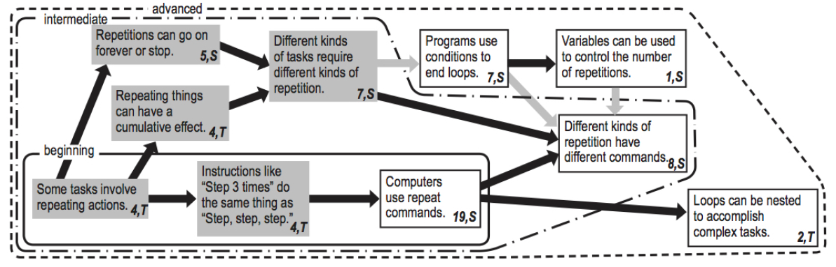
Results: Repetition Trajectory
Big ideas include recognizing repetition, stopping repetitions, and cumulative effects of repeating things.
Notes:
Starts with the basic idea of repetition being needed for lots of things– nice example of starting with what kids know
Progresses to sorting out different categories of repetition– what makes them stop?

Slide 28
Ordering Example 3:
Theoretical Framework
In accordance with the LT literature, we attempted to organize our trajectories to progress from everyday ideas toward specific disciplinary ideas.
Everyday → CT → Programming
Some tasks require repeating things.
Instructions like “Step 3 times” do the same thing as “step, step, step.”
Computers use repeat commands.

Slide 29
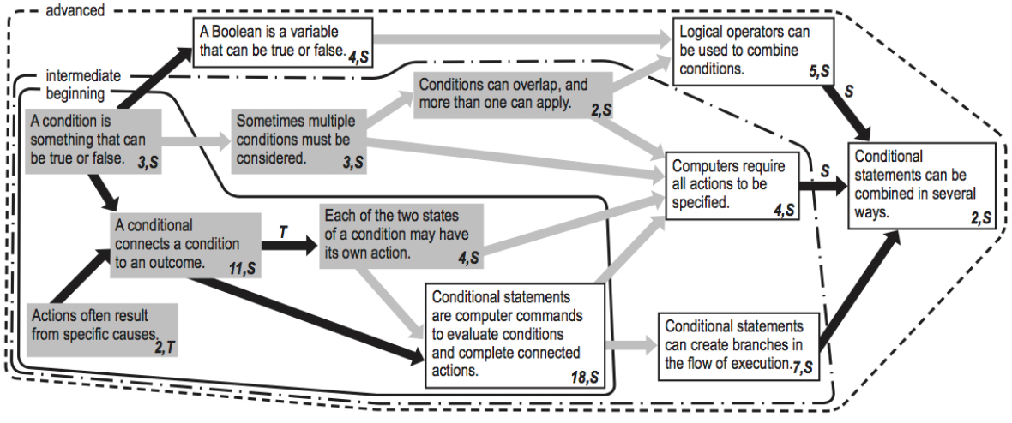
Results: Conditionals Trajectory
Big ideas include binary nature of conditions, connecting conditions to actions, and thoroughness.
Notes:
Starts with the basic idea of cause and effect in the world.
Goes through different ways to consider both multiple conditionals and multiple conditionals.

Slide 30
Learning Trajectories

Slide 31
Learning Trajectories
Content, not teaching method
Provide possible orderings for presenting material that builds upon itself
Identifies points of understanding to focus on before going to next level

Slide 32
Project
Pairs
Choose a subject to teach
Choose what level to teach (3rd grade +)
  What limitations does this introduce?
Main target must be different from yourself in some meaningful way (age, interests, opportunities, etc.)

Slide 33
Project
Design
  Complete design
  No resource constraints (time, $)
Implementation
  Agreed-upon subset of full design
  Reasonable to complete by end of quarter
  Illustrates the design of the game and principles of course

