Slide 1
State Pattern
Ben Verducci

Slide 2
What is the State Pattern?
And Why Should I Care?
Problem – An object’s behavior depends on its current internal state, want to perform the correct operations for correct state
One solution: write many conditional statements for each operation that the object can perform (this can get messy)
(sometimes) Better Solution – State Pattern
Allows for a class to behave differently under different circumstances (states) at runtime

Slide 3
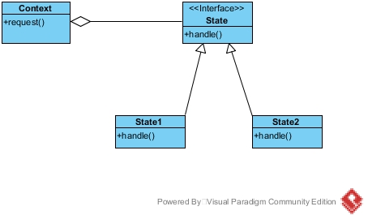
Generalized UML Diagram
Invokes State.handle()

Slide 4
Parts of the State Pattern
Context
Contains state object
Indicates the current state
State
Interface for the concrete states
Concrete States
Defines each state that the object can be in (and functionality)
Can be any number of states

Slide 5
When Should I Use The State Pattern?
When an objects behavior depends on its state, and that behavior must change at runtime depending on the current state
When you have complicated conditional structures in several different operations that depend on an objects state

Slide 6
Advantages and Disadvantages
Advantages:
Can save you from having to write many conditionals multiple times (DRY)
Makes it easier to make changes later
Additions, deletions, and edits
Simplifies and localizes conditions
Conditional logic isn’t spread out (if statements everywhere)
More explicitly indicates state
Disadvantages:
Adds more classes
Can add unnecessary design complexity depending on use

Slide 7
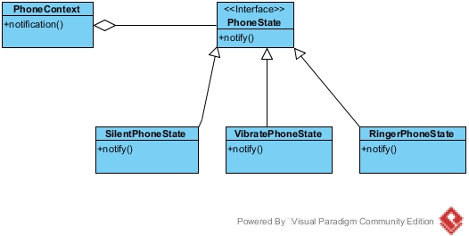
Example
Phone notifications
Three states: Ringer on, vibrate, and silent mode
State pattern would actually add complexity in such a small example, but what if we needed to add several more functionalities that relied on the ringer state?

Slide 8
How is This Different From Strategy?
Similar design patterns, solve different problems
State pattern deals with what state an object is in, rather than how a certain task should be accomplished
State pattern involves changes to the internal state at runtime
State often changes when an operation is performed

