Slide 1
Iterator Pattern
By: Jonathan Ly
MPCS 51410

Slide 2
Intent of the Iterator
Put the responsibility for access and transversal from the aggregate object and into the Iterator object.
Creates a standard traversal protocol using the Iterator object.

Slide 3
Iterator Significance
Iterator pattern falls under behavioral pattern category.
Ability to access an aggregated element without exposing its internal structure.
Ability to transverse a list in different ways, without bloating the list interface with operations for different transversal.
Provides a uniform interface for transversal for many types of aggregated objects.

Slide 4
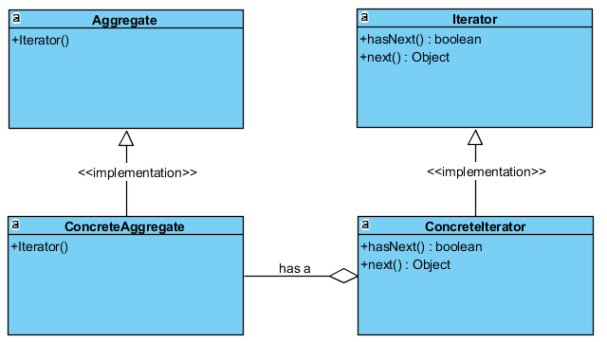
UML Implementation

Slide 5
Applicability and Advantages
Provides a way of to access the elements of a collection object in a sequential manner.
Iterators can work without knowing the underlying representation of the collection object.
Ultimately, it separates the notion of algorithm and data structures, which helps promote component-based development, boost productivity, and reduce configuration management

Slide 6
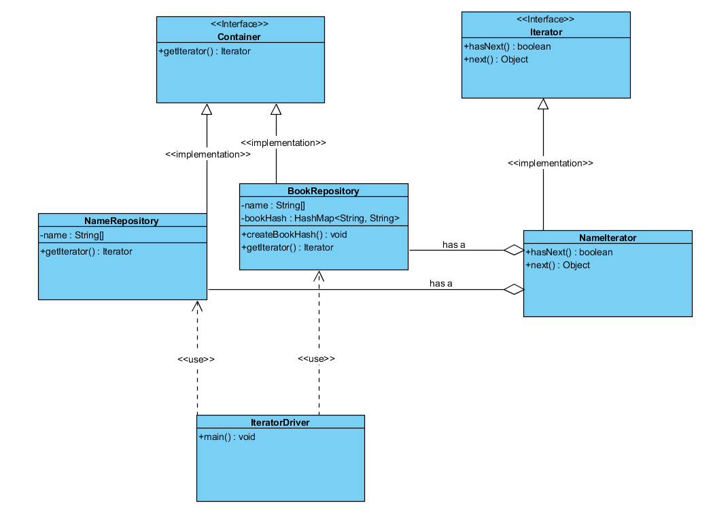
Iterator Example: Person’s Favorite Book

Slide 7
Implementation of Example

Slide 8
References
https://en.wikipedia.org/wiki/Iterator_pattern
https://www.tutorialspoint.com/design_pattern/iterator_pattern.htm
https://sourcemaking.com/design_patterns/iterato

