Slide 1
The Open Group Architecture Framework (TOGAF)
David Selvaraj
CSPP 51075
June 1, 2011

Slide 2
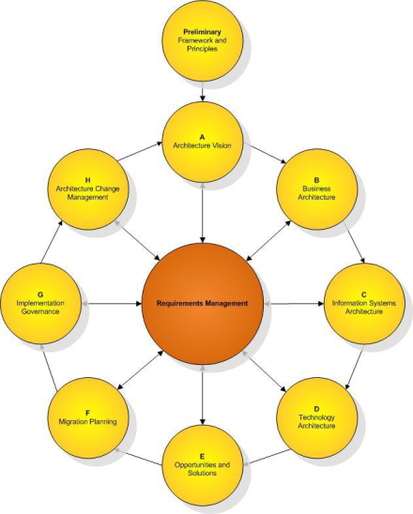

What is TOGAF?
TOGAF is an Architecture Framework which has been developed by the Open Group “to provide the methods and tools for assisting in the acceptance, production, use and maintenance of an Enterprise Architecture”.
It is based on an iterative process model supported by best practices and a re-usable set of existing architecture assets.

Slide 3


Who is The Open Group?
The Open Group is a vendor- and technology-neutral consortium, whose vision of Boundaryless Information Flow™ will enable access to integrated information within and between enterprises based on open standards and global interoperability

Slide 4
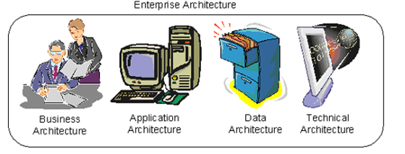
TOGAF EA
Business architecture—Describes the processes the business uses to meet its goals
Application architecture—Describes how specific applications are designed and how they interact with each other
Data architecture—Describes how the enterprise datastores are organized and accessed
Technical architecture—Describes the hardware and software infrastructure that supports applications and their interactions

Slide 5
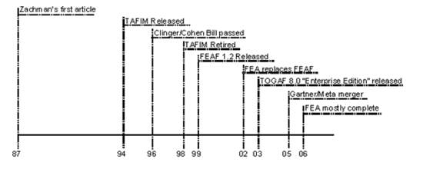
Evolution of TOGAF
TOGAF Version 1 in 1994
  Based on the Technical Architecture Framework for Information Management (TAFIM), developed by the US Department of Defense (DoD).
The Open Group Architecture Forum have developed successive versions of TOGAF
Current Version TOGAF 9 in 2009

Slide 6
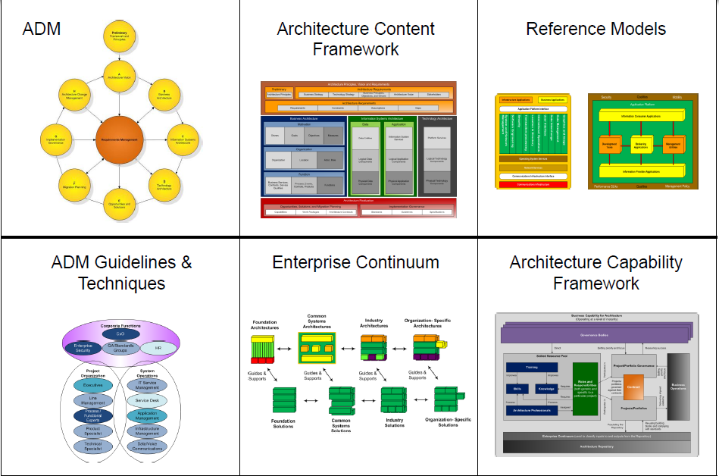
TOGAF Structure

Slide 7
Architecture Development Method (ADM)
Provides a tested and repeatable process for developing architectures
ADM includes
  Establishing an architecture framework
  Developing architecture content
  Transitioning
  Governing the realization of architectures
Carried out within an iterative cycle
  Continuous architecture definition and realization that allows organizations to transform their enterprises in a controlled manner in response to business goals and opportunities.

Slide 8
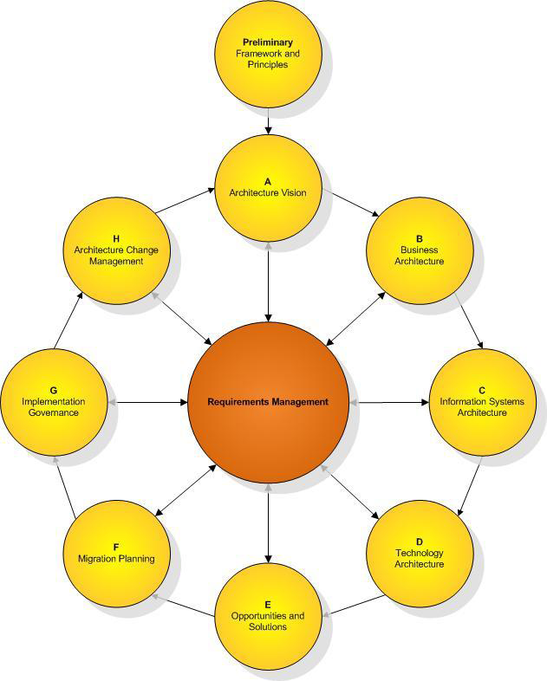
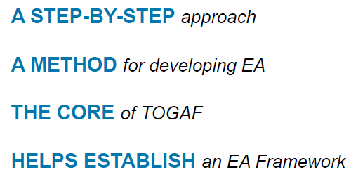
The ADM: Phase-by-Phase

Slide 9
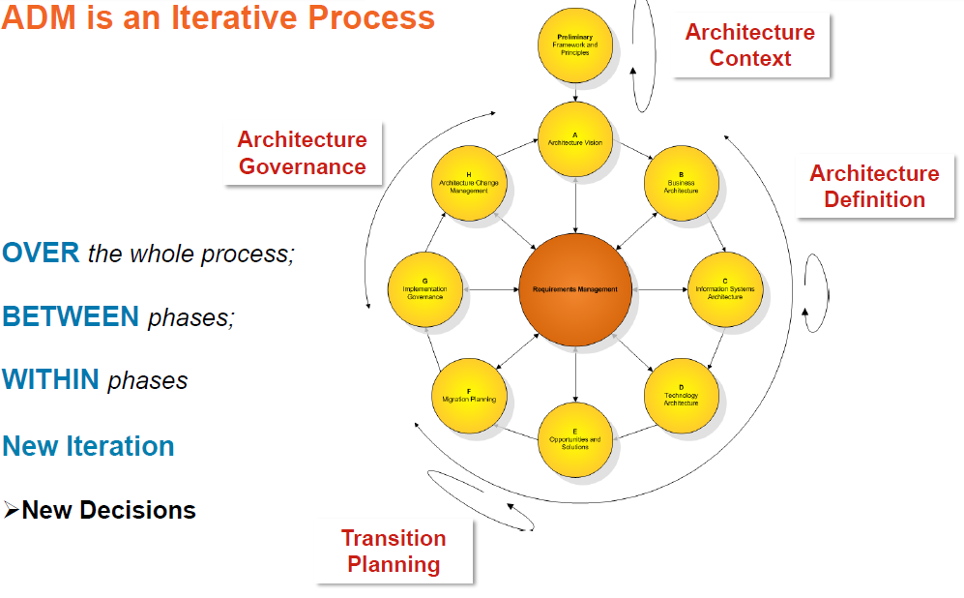
ADM Iteration

Slide 10
ADM Phases
The Preliminary Phase describes the preparation and initiation activities required to prepare to meet the business directive for a new enterprise architecture, including the definition of an Organization-Specific Architecture framework and the definition of principles.
Phase A: Architecture Vision describes the initial phase of an architecture development cycle. It includes information about defining the scope, identifying the stakeholders, creating the Architecture Vision, and obtaining approvals.
Phase B: Business Architecture describes the development of a Business Architecture to support an agreed Architecture Vision.
Phase C: Information Systems Architectures describes the development of Information Systems Architectures for an architecture project, including the development of Data and Application Architectures.
Phase D: Technology Architecture describes the development of the Technology Architecture for an architecture project.
Phase E: Opportunities & Solutions conducts initial implementation planning and the identification of delivery vehicles for the architecture defined in the previous phases.
Phase F: Migration Planning addresses the formulation of a set of detailed sequence of transition architectures with a supporting Implementation and Migration Plan.
Phase G: Implementation Governance provides an architectural oversight of the implementation.
Phase H: Architecture Change Management establishes procedures for managing change to the new architecture.
Requirements Management examines the process of managing architecture requirements throughout the ADM.

Slide 11
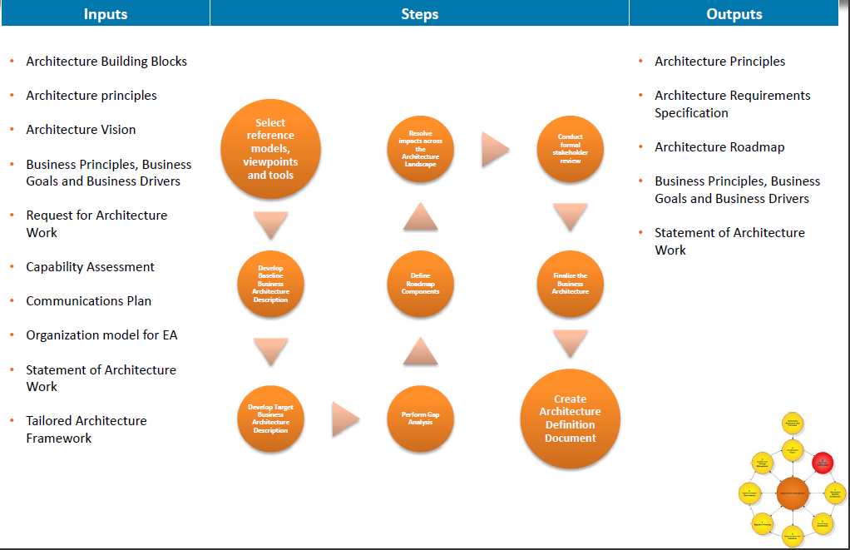
Phase B: Business Architecture

Slide 12
Data Architecture - Inputs
Organizational Model for Enterprise Architecture (see Part IV, 36.2.16 Organizational Model for Enterprise Architecture), including:
  Scope of organizations impacted
  Maturity assessment, gaps, and resolution approach
  Roles and responsibilities for architecture team(s)
  Constraints on architecture work
  Budget requirements
  Governance and support strategy
Tailored Architecture Framework (see Part IV, 36.2.21 Tailored Architecture Framework), including:
  Tailored architecture method
  Tailored architecture content (deliverables and artifacts)
  Configured and deployed tools
Data principles (see Part III, 23.6.2 Data Principles), if existing
Statement of Architecture Work (see Part IV, 36.2.20 Statement of Architecture Work)
Architecture Vision (see Part IV, 36.2.8 Architecture Vision)
Architecture Repository (see Part IV, 36.2.5 Architecture Repository), including:
  Re-usable building blocks (in particular, definitions of current data)
  Publicly available reference models
  Organization-specific reference models
  Organization standards
Draft Architecture Definition Document (see Part IV, 36.2.3 Architecture Definition Document), including:
  Baseline Business Architecture, Version 1.0 (detailed), if appropriate
  Target Business Architecture, Version 1.0 (detailed)
  Baseline Data Architecture, Version 0.1, if available
  Target Data Architecture, Version 0.1, if available
  Baseline Application Architecture, Version 1.0 (detailed) or Version 0.1 (Vision)
  Target Application Architecture, Version 1.0 (detailed) or Version 0.1 (Vision)
  Baseline Technology Architecture, Version 0.1 (Vision)
  Target Technology Architecture, Version 0.1 (Vision)
Draft Architecture Requirements Specification (see Part IV, 36.2.6 Architecture Requirements Specification), including:
  Gap analysis results (from Business Architecture)
  Relevant technical requirements that will apply to this phase
Business Architecture components of an Architecture Roadmap (see Part IV, 36.2.7 Architecture Roadmap)

Slide 13
Data Architecture - Steps
Select Reference Models, Viewpoints, and Tools
Develop Baseline Data Architecture Description
Develop Target Data Architecture Description
Perform Gap Analysis
Define Roadmap Components
Resolve Impacts Across the Architecture Landscape
Conduct Formal Stakeholder Review
Finalize the Data Architecture
Create Architecture Definition Document

Slide 14
Data Architecture - Output
Refined and updated versions of the Architecture Vision phase deliverables, where applicable:
  Statement of Architecture Work (see Part IV, 36.2.20 Statement of Architecture Work), updated if necessary
  Validated data principles (see Part III, 23.6.2 Data Principles), or new data principles (if generated here)
Draft Architecture Definition Document (see Part IV, 36.2.3 Architecture Definition Document), including:
  Baseline Data Architecture, Version 1.0, if appropriate
  Target Data Architecture, Version 1.0
    Business data model
    Logical data model
    Data management process models
    Data Entity/Business Function matrix
  Views corresponding to the selected viewpoints addressing key stakeholder concerns
Draft Architecture Requirements Specification (see Part IV, 36.2.6 Architecture Requirements Specification), including such Data Architecture requirements as:
  Gap analysis results
  Data interoperability requirements
  Relevant technical requirements that will apply to this evolution of the architecture development cycle
  Constraints on the Technology Architecture about to be designed
  Updated business requirements, if appropriate
  Updated application requirements, if appropriate
Data Architecture components of an Architecture Roadmap (see Part IV, 36.2.7 Architecture Roadmap)

Slide 15
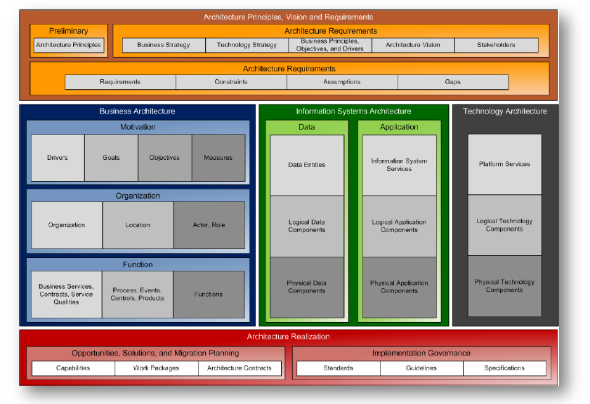
Building Blocks

Slide 16
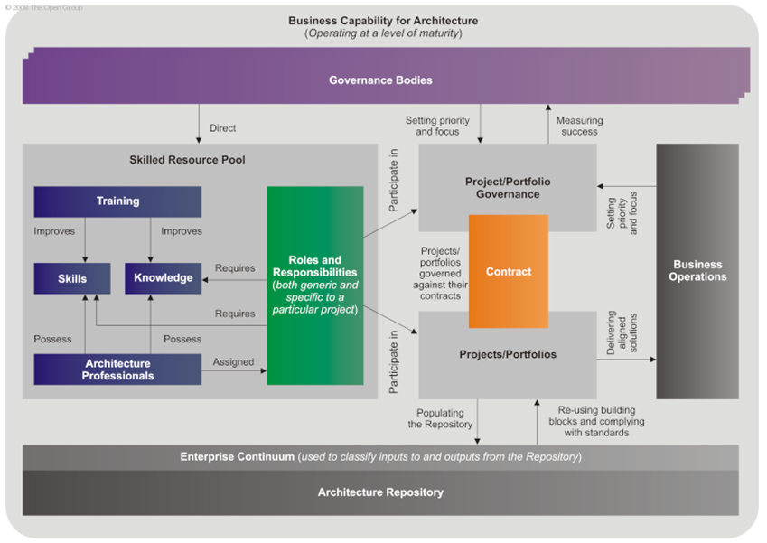
Architecture Capability Framework

Slide 17
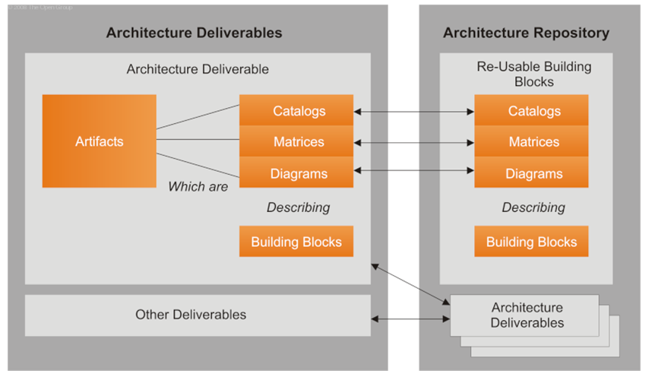
Architecture Content Framework

Slide 18
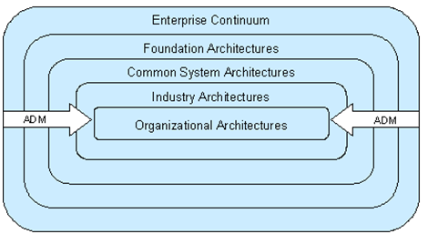
Enterprise Continuum
TOGAF views the world of enterprise architecture as a continuum of architectures, ranging from highly generic to highly specific.

Slide 19
Enterprise Continuum
A view of the Architecture Repository that provides methods for classifying architecture and solution artifacts as they evolve from generic Foundation Architectures to Organization-Specific Architectures
Explains how generic solutions can be leveraged and specialized in order to support the requirements of an individual organization

Slide 20
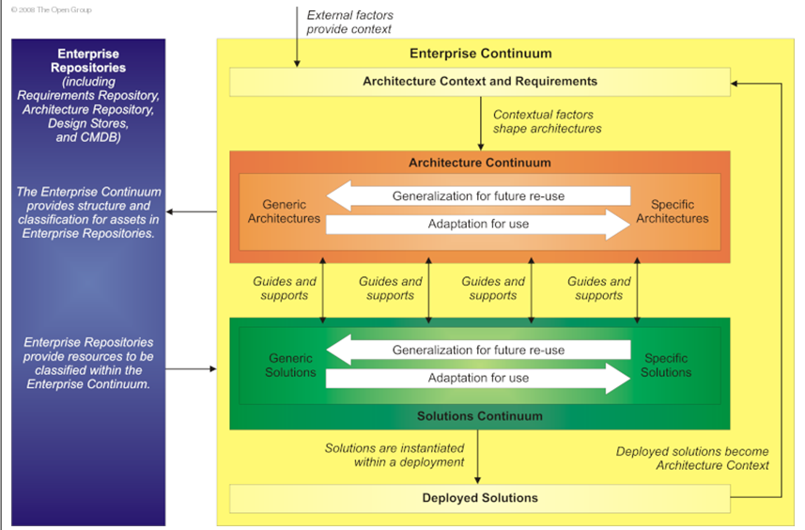
Enterprise Continuum

Slide 21
Stakeholders, Views, Viewpoints
Viewpoint is a perspective (where you are looking from) and generally specific to a stakeholder group
view is what you see and is created to ensure that particular stakeholders can see an architecture from a point of view which matches their concerns

Slide 22
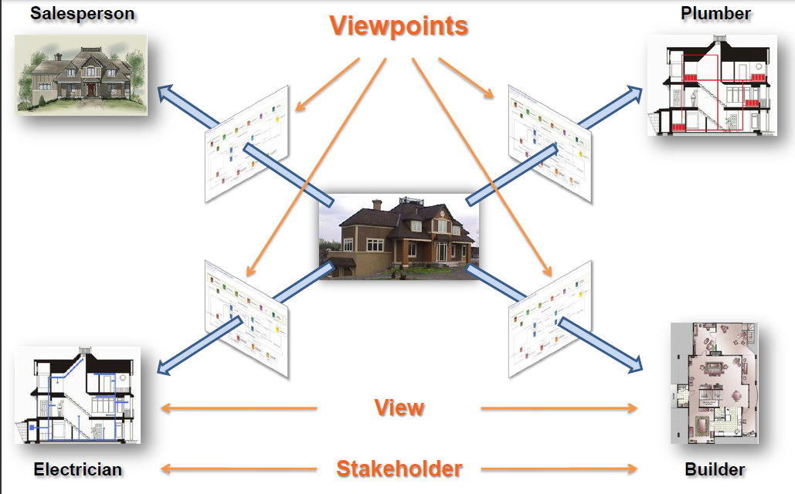
Views and Viewpoints

Slide 23
Limitations
The TOGAF specification is also flexible with respect to the phases.
  TOGAF allows phases to be done incompletely, skipped, combined, reordered, or reshaped to fit the needs of the situation
Lacks templates for some artifacts.

Slide 24
Framework Comparison
The Zachman Framework for Enterprise Architectures—Although self-described as a framework, is actually more accurately defined as a taxonomy
The Open Group Architectural Framework (TOGAF)—Although called a framework, is actually more accurately defined as a process
The Federal Enterprise Architecture—Can be viewed as either an implemented enterprise architecture or a proscriptive methodology for creating an enterprise architecture
- Based on Roger Sessions, ObjectWatch Inc.

Slide 25
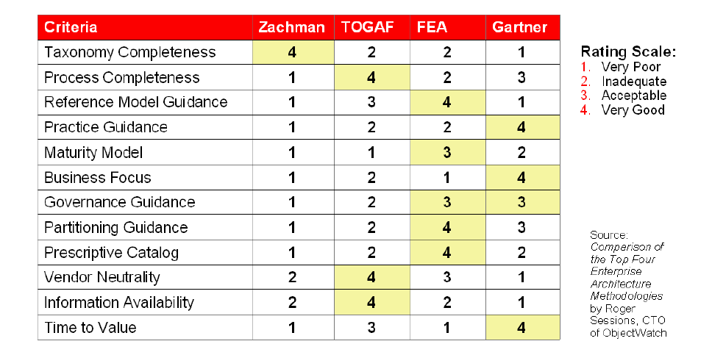
Framework Comparison

Slide 26
References
http://pubs.opengroup.org/architecture/togaf9-doc/arch
www.orbussoftware.com/enterprise.../togaf/togaf-9-in-pictures
The Oracle Enterprise Architecture Framework – White paper 2009
A Comparison of the Top Four Enterprise-Architecture Methodologies - http://msdn.microsoft.com/en-us/library/bb466232.aspx

