Slide 1
TMF Information Framework
Chip Srull

Slide 2
Integrated Models and Frameworks
Frameworks provide containment and structure
  Different models, each developed for a domain/perspective
  Integrated within framework for alignment and containment
Models for each viewpoint, perspective, domain, etc.
  Enterprise architecture & business process models
  Conceptual, logical and physical data models
  Application architecture and UML models
Integrate domains and transform between perspectives
  Data and process and applications align
  Context, concept, logic and implementation views sync’d

Slide 3
Integrated Models with Frameworx
Frameworx defines a comprehensive enterprise IT and process architecture that also embraces major IT industry standards such as ITIL and TOGAF.
  Business Process Framework (eTOM) is the industry's common process architecture for both business and functional processes
    Business and functional processes for telecommunication
    Full scope and interactions defined
  Information Framework (SID) provides a common reference model to describe management information:
    Common model: standardization and reduce complexity
    Consistent data use: service providers and business partners
    Conceptual Data Models
    UML class (domain) diagrams
  Application Framework (TAM) provides a common language to describe systems and their functions:
    Represents applications aligned to business functions
    Provides mapping between eTOM and SID
  Integration Framework provides a service oriented integration approach with standardized interfaces and support tools

Slide 4
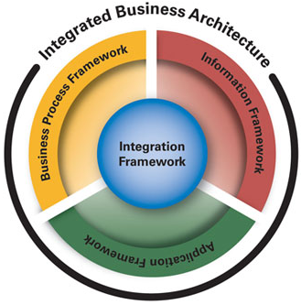
TMF Frameworx
Frameworx
  Is the industry’s most comprehensive business architecture
  Provides the flexibility of a vendor and technology-independent blueprint
  Allows Service Providers to realize ITIL-compliant implementations
  Is fully supported by a range of commercial products
  SOA compatible
TM Forum’s Frameworx Integrated Business Architecture provides an industry agreed, service oriented approach for rationalizing operational IT, processes, and systems that enables Service Providers to significantly reduce their operational costs and improve business agility.
Frameworx uses standard, reusable, generic blocks—Platforms and Business Services—that can be assembled in unique ways to gain the advantages of standardization while still allowing customization where necessary.

Slide 5
Information Framework (SID)
Focuses on business entities and associated attribute definitions.
  Business Entity -- “a thing of interest to the business, such as customer, product, service, or network. Its attributes are facts that describe the entity.” (sound familiar?)
Is fundamentally an Information Model.
  Information Model-- “a representation of business concepts, their characteristics and relationships, described in an implementation independent manner.” (sound familiar?)
Entities and models are packaged in a series of documents and modeled in UML.
Provides:
  an information/data reference model and a common information/data vocabulary, from a business entity perspective.
  the definition of the “things” that are to be affected by the business processes defined in the eTOM.
  the model that represents business concepts and their characteristics and relationships, described in an implementation-independent manner.
Designed as a layered framework that partitions the shared information and data into eight high level domains.

Slide 6
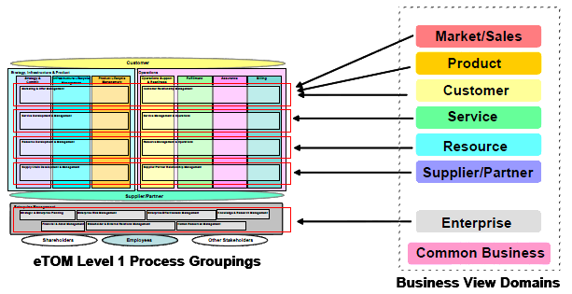
Information Framework (SID)
Uses the concepts of domains and ABEs (i.e. sub-domains) to categorize business entities
Developed by the application of data affinity concepts to a telecom enterprise’s processes and data.
High degree of cohesion between entities
Loose coupling between different domains
Top domains are broadly aligned with the eTOM

Slide 7
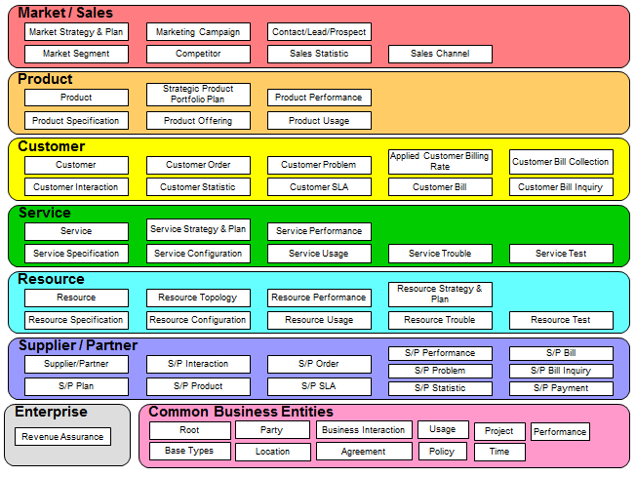
SAM – SID Mapping
Accounting
Activities and Events
Contact Point
Contracts
Document Management
Geography
People and Organizations
Physical Assets
Roles

Slide 8
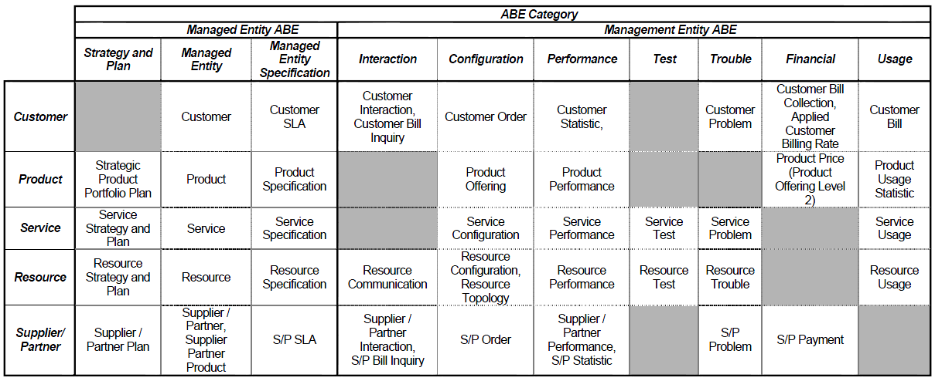
SID Common Categories
To ensure consistency, each ABE is aligned with a categorization pattern
  Management Entity ABE
    Interaction
    Configuration
    Performance
    Test
    Trouble Price
    Usage
  Managed Entity ABE
    Strategy and Plan
    Managed Entity
    Managed Entity Specification

Slide 9
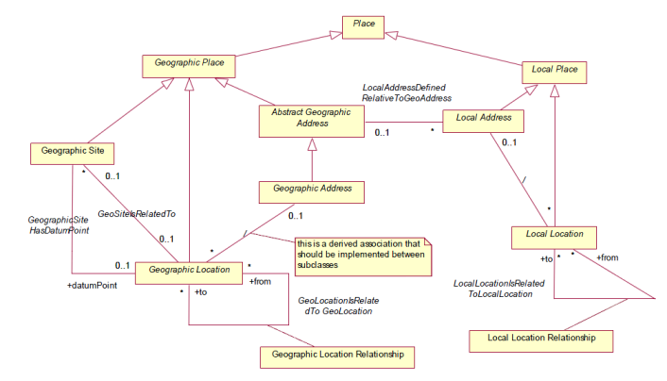
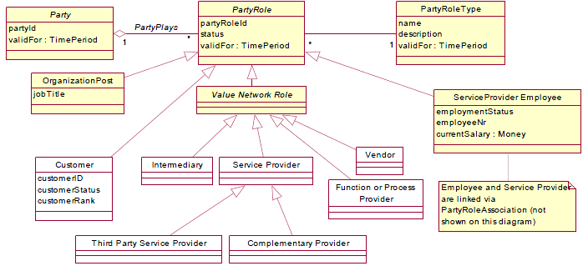
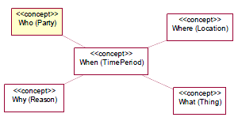
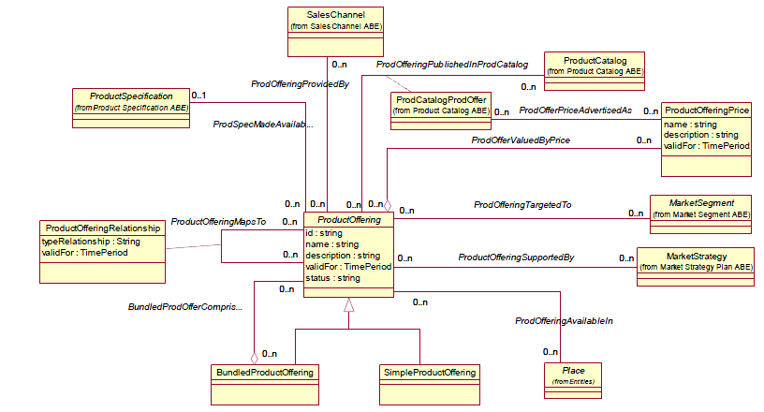
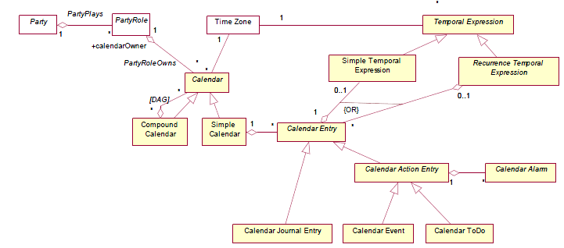
What, Where, Why, When, Who
GB922 Addendum 1P, V9.6, p. 6
GB922 Addendum 1L, V3.4, p. 22
GB922 Addendum 1T, V1.4, p. 15
GB922 Addendum 3, V9.5, p. 21

Slide 10
Conceptual Model - Entities
Identity / Party (who)
  Individuals & Organizations
  Customer (actual or potential)
  Supplier
  User
Time & Time Period (when)
  Calendar
Places / Locations (where)
  Locations & Sites
  Addresses
Motivation (why)
  Business Planning
Work (how)
  Plan & Project
  Process
Policy (how)
The Business (what)
  Agreement & Contract
  Product
  Service
  Resource
Event (when)
Financials (what)

Slide 11
Information Framework Domain Addenda
Number | Deliverable | Description
GB922-1 Usage | Usage Business Entities | Uses the Usage abstract business entity to describe any resource-, service- or product-based usage that the external system can read, update and process.
GB922-1A | SID Agreement | Provides the informational characteristics that are unique to an Agreement
GB922-1BI | SID Business Interaction | Describes the relationship that business entities have with business interactions and how the business entities party role, resource role, and customer account, are involved in business interactions
GB922-1BT | SID Business Entity Base Types | Covers base types that have been found to be useful during the documentation of the SID business models
GB922-1J | SID Project | Provides a generic model, based on current industry best practice that can be used to link parts of the SID model together
GB922-1L | SID Location | Provides a high level framework for the location (which is a complexe model with a number of subtleties), explains broad concepts and gives illustrative examples.
GB922-1P | SID Party | Defines the information about companies and people.
GB922-1Perform | Performance Business Entities | Describes the SID Service and Resource Performance Aggregate Business Entities (ABEs)
GB922-1POL | SID Policy | Covers the business definition of the Policy model
GB922-1R | SID Root Business Entities | Defines a set of common business entities that collectively serve as the foundation of the SID business view.
GB922-1T | SID Time Related Entities | Covers the non base type entities that are time related
GB922-2 | SID Customer | Provides the definitions of the customer business entities
GB922-3 | SID Product | Provides detailed specification of products (ProductSpecifications), the way they are offered into the market (ProductOfferings) and in which they are maintained and perform while in use (Products)
GB922-4SO | SID Service Overview | Provides the definition of services, differentiate between “customer facing” and “resource services
GB922-4S-QoS | SID Quality of Service | Covers the business definition of QoS entities
GB922-5LR | SID Logical Resource | Presents the LogicalResource Framework with an extensible set of classes and relationships that enable new lower-level LogicalResource concepts to be plugged into it
GB922-5PR | Information Framework Physical Resources | Presents the management of network entities to better illustrate a complete worked example and to explain some of the more subtle parts of the model
GB922-6 | Information Framework Market / Sales | Describes the Aggregate Business Entities (ABEs) that comprise the Market/Sales domain of the SID model
GB922-7 | SID Security | Initial development of Enterprise domain Security ABEs including, Security Entity and associated Security Vulnerability, Security Event, Security Threat, Security Incident.
GB922-7RA | Information Framework: Enterprise Domain Revenue Assurance Business Entities | Describes the Revenue Assurance area of the SID with controls, violations, key performance indicators, objectives, and rules. And includes revenue assurance actions/responses
GB922-8 | SID Supplier/Partner | Initial development of Supplier/Partner domain, focused on Supplier/Partner and Supplier/Partner Agreement.
GB922-X | Information Framework XSD Schema Overview | Provides an overview of the SID XML schema, including design considerations, an introduction to the schema, and an example of their use within an application integration framework

Slide 12
Information Framework (SID)
The top layer (Layer 1) contains domains which are aligned with eTOM level 0 concepts
Domain – collection of ABEs associated with a specific mgmt area.
ABE – well-defined set of info and ops that characterize a highly cohesive, loosely coupled set of business entities.

Slide 13
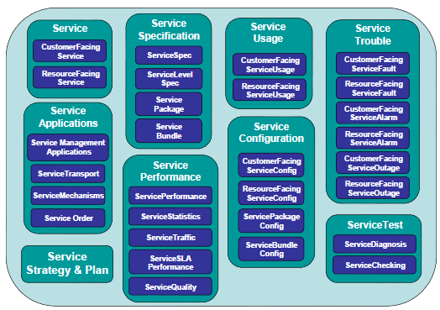
SID – Level 2
Within each domain are multiple “Aggregate Business Entities” (ABEs)
Service Domain

Slide 14
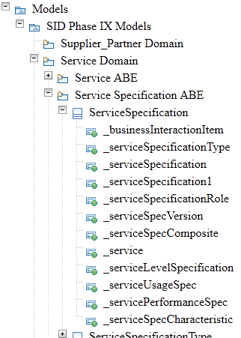
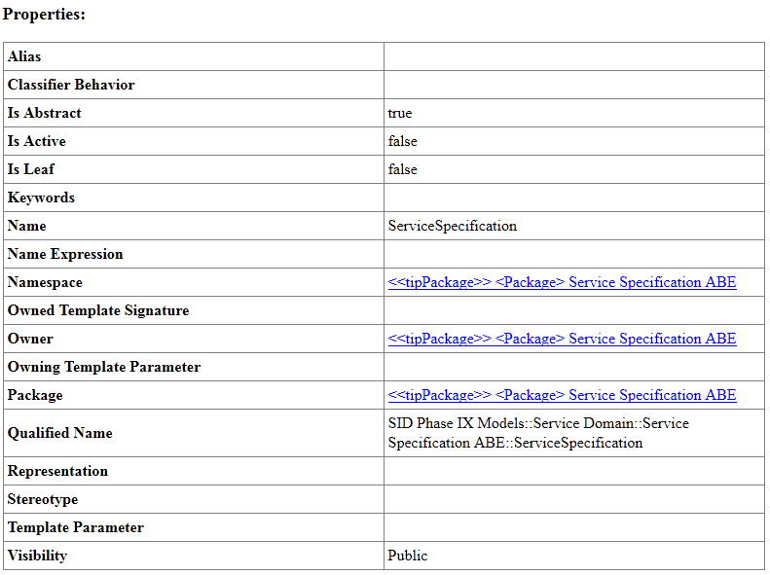
Example - ServiceSpecification

Slide 15
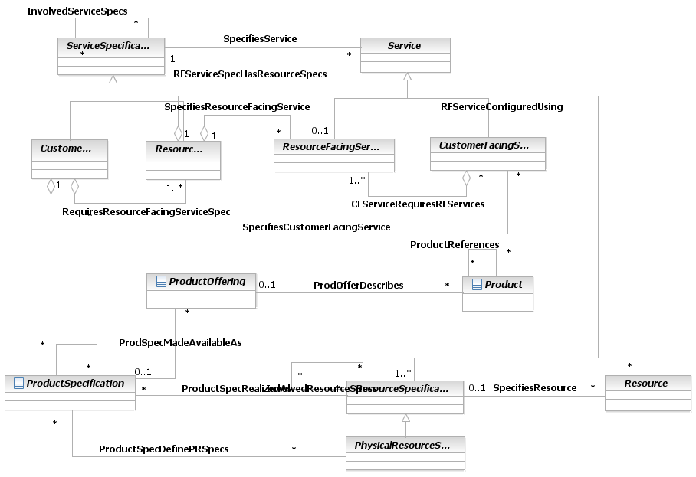
Example - ServiceSpecification

Slide 16
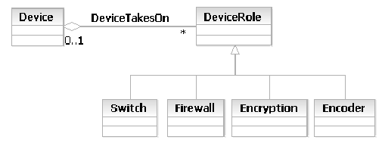
Architectural Patterns
As with the Party entity, roles can be used to simplify the modeling of different types of Resources and to make the model inherently more extensible. [GB922 Addendum 5LR, v.9.5, p.38]
  Party and Party Role
  Resource and ResourceRole
  Service and ServiceRole
  Device and DeviceRole
Other architectural patterns
  Specification
  Abstract Superclass (e.g. Party)
  Composite (assemble objects into trees; e.g. Party)
  Role Entity
  Temporal State Entity
  Self Relationship

Slide 17
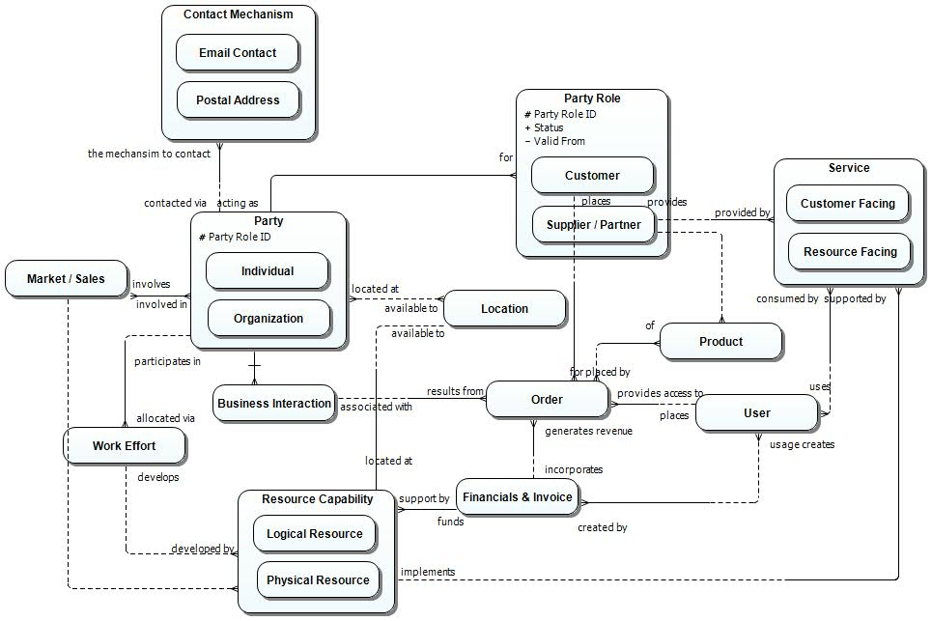
High Level Conceptual Model

